Slide 1
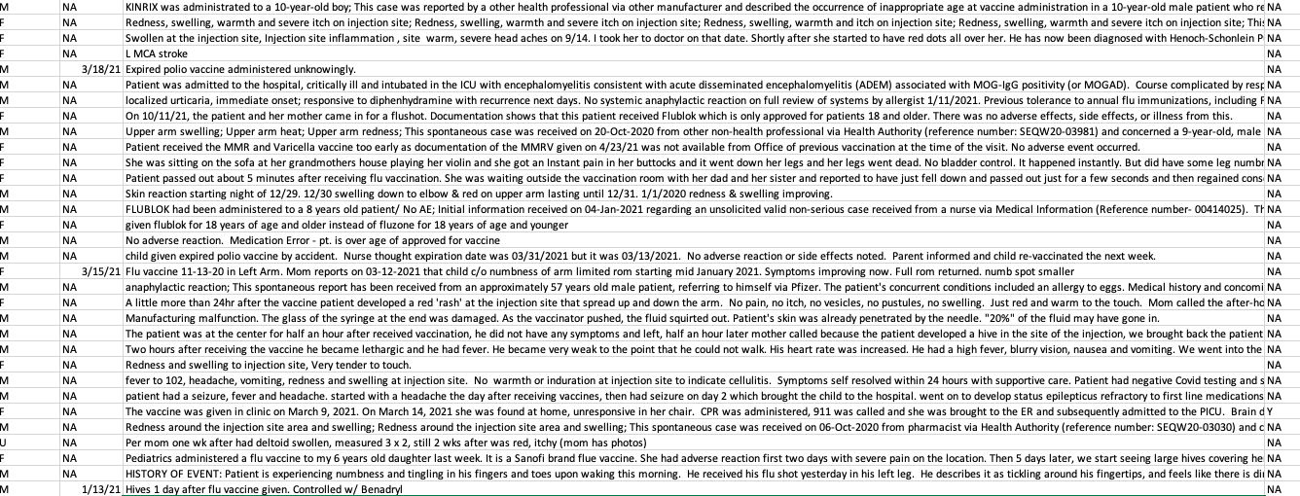
VAERS
Safety + Efficacy, General, Specific
What now?
Dr. Jessica Rose
January 2022

Slide 2
Background
What is VAERS?
What is an adverse event (AE)?
What is a severe adverse event (SAE)?
Pharmacovigilance in VAERS – detection of AEs not recognized in pre-market testing
Under-reporting and under-recording a problem
HUNDREDS OF THOUSANDS of AEs have been reported to VAERS in the context of the COVID-19 injectable products

Slide 3
VAERS was implemented as a consequence of the 1986 National Childhood Vaccine Injury Act. While vaccine companies were given blanket immunity against liability for adverse reactions under this law, VAERS was created to collect injury reports in a centralized database so that the post-marketing safety of childhood vaccines could be monitored.

Slide 4

Talking points
SAFETY AND EFFICACY
GENERAL VAERS
SPECIFIC VAERS
WHAT CAN WE DO?

Slide 5
Talking points
SAFETY AND EFFICACY
GENERAL VAERS
SPECIFIC VAERS
WHAT CAN WE DO?

Slide 6
Safety and Efficacy in biologicals development and administration*
Risk: A measure of the probability of an adverse event or untoward outcome occurring and the severity of the resultant harm to health of individuals in a defined population associated with use of a medical technology applied for a given medical problem under specified conditions of use.
Safety: A judgement of the acceptability of risk in a specified situation.
Efficacy: The probability of benefit to individuals in a defined population from a medical technology applied for a given medical problem under ideal conditions of use.
*Book: Assessing the Efficacy and Safety of Medical Technologies: The Concepts of Efficacy and Safety

Slide 7
A typical vaccine development timeline takes 5 to 10 years, and sometimes longer, to assess whether the vaccine is safe and efficacious in clinical trials, complete the regulatory approval processes, and manufacture sufficient quantity of vaccine doses for widespread distribution.*
*https://coronavirus.jhu.edu/vaccines/timeline
Notes:
Risk: A measure of the probability of an adverse event or untoward outcome occurring and the severity of the resultant harm to health of individuals in a defined population associated with use of a medical technology applied for a given medical problem under specified conditions of use.
Safety: A judgement of the acceptability of risk in a specified situation.
Efficacy: The probability of benefit to individuals in a defined population from a medical technology applied for a given medical problem under ideal conditions of use.
Preclinical testing of vaccine candidates typically starts in animal models, first in small mammals such as mice or rats and then non-human primates such as monkeys. Preclinical studies are important for eliminating potential vaccines that are either toxic or do not induce protective immune responses. But many vaccines that appear to be safe and induce protective immune responses in animals fail in human studies. Only vaccine candidates that are very promising in preclinical testing move forward into phase I clinical trials.
Phase I clinical trials are the first step in assessing vaccines in people. Typically involving one to several dozen healthy volunteers, phase I trials assess short-term safety (e.g., soreness at the site of injection, fever, muscle aches) and immune responses, often with different vaccine dosages. Only if a vaccine candidate is shown to be safe in phase I trials will it move to larger phase II trials.
Phase II clinical trials continue to assess safety and immune responses but in a larger number and more diverse group of volunteers, typically one to several hundred people. Phase II trials may include target populations of a specific age or sex, or those with underlying medical conditions. Vaccines for children start with adult volunteers and move to progressively younger groups of children. Different types of immune responses are often measured, including antibodies and cell-mediated immunity, but phase II trials do not assess how well a vaccine actually works. Only in phase III trials is vaccine efficacy assessed.
Phase III clinical trials are critical to understanding whether vaccines are safe and effective. Phase III trials often include tens of thousands of volunteers. Participants are chosen at random to receive the vaccine or a placebo. In Phase III, participants and most of the study investigators do not know who has received the vaccine and who received the placebo. Participants are then followed to see how many in each group get the disease. Assessing short- and long-term safety is also a major goal of phase 3 trials.

Slide 8
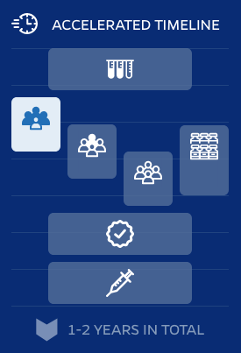
Phase I -> Phase II -> Phase III
Safety, Dosing, and Immune Responses -> Assessment of Safety and Immune Responses -> Assessment of Safety and Efficacy
TYPICAL TIMELINE
ACCELERATED TIMELINE
Typical
COVID
Animal testing – years
Phase I – 3 months
Phase II – 2 years
Phase III – several years
Manufacturing
FDA approval
Safety monitoring - years
The total amount of time taken for Pfizer/BioNTech Phase III trial was 6 months
Animal testing
Animal testing
Manufacturing
Manufacturing
Phase III
Phase III
Phase I
Phase I
Phase II
Phase II
FDA approval
FDA approval
Safety monitoring
Safety monitoring
5-10 YEARS IN TOTAL
1-2 YEARS IN TOTAL
*https://coronavirus.jhu.edu/vaccines/timeline
Notes:
Risk: A measure of the probability of an adverse event or untoward outcome occurring and the severity of the resultant harm to health of individuals in a defined population associated with use of a medical technology applied for a given medical problem under specified conditions of use.
Safety: A judgement of the acceptability of risk in a specified situation.
Efficacy: The probability of benefit to individuals in a defined population from a medical technology applied for a given medical problem under ideal conditions of use.
Preclinical testing of vaccine candidates typically starts in animal models, first in small mammals such as mice or rats and then non-human primates such as monkeys. Preclinical studies are important for eliminating potential vaccines that are either toxic or do not induce protective immune responses. But many vaccines that appear to be safe and induce protective immune responses in animals fail in human studies. Only vaccine candidates that are very promising in preclinical testing move forward into phase I clinical trials.
Phase I clinical trials are the first step in assessing vaccines in people. Typically involving one to several dozen healthy volunteers, phase I trials assess short-term safety (e.g., soreness at the site of injection, fever, muscle aches) and immune responses, often with different vaccine dosages. Only if a vaccine candidate is shown to be safe in phase I trials will it move to larger phase II trials.
Phase II clinical trials continue to assess safety and immune responses but in a larger number and more diverse group of volunteers, typically one to several hundred people. Phase II trials may include target populations of a specific age or sex, or those with underlying medical conditions. Vaccines for children start with adult volunteers and move to progressively younger groups of children. Different types of immune responses are often measured, including antibodies and cell-mediated immunity, but phase II trials do not assess how well a vaccine actually works. Only in phase III trials is vaccine efficacy assessed.
Phase III clinical trials are critical to understanding whether vaccines are safe and effective. Phase III trials often include tens of thousands of volunteers. Participants are chosen at random to receive the vaccine or a placebo. In Phase III, participants and most of the study investigators do not know who has received the vaccine and who received the placebo. Participants are then followed to see how many in each group get the disease. Assessing short- and long-term safety is also a major goal of phase 3 trials.

Slide 9


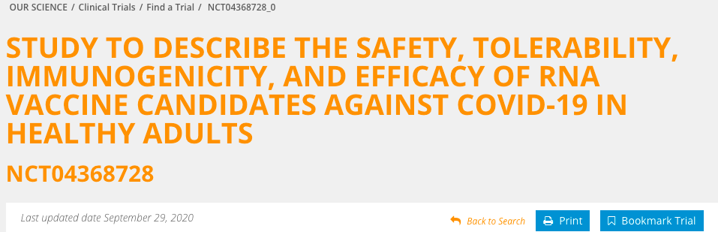
Exclusion criteria list of Phase III Pfizer trial NCT04368728
Take home message: long list and…
*https://coronavirus.jhu.edu/vaccines/timeline
Notes:
Risk: A measure of the probability of an adverse event or untoward outcome occurring and the severity of the resultant harm to health of individuals in a defined population associated with use of a medical technology applied for a given medical problem under specified conditions of use.
Safety: A judgement of the acceptability of risk in a specified situation.
Efficacy: The probability of benefit to individuals in a defined population from a medical technology applied for a given medical problem under ideal conditions of use.
Preclinical testing of vaccine candidates typically starts in animal models, first in small mammals such as mice or rats and then non-human primates such as monkeys. Preclinical studies are important for eliminating potential vaccines that are either toxic or do not induce protective immune responses. But many vaccines that appear to be safe and induce protective immune responses in animals fail in human studies. Only vaccine candidates that are very promising in preclinical testing move forward into phase I clinical trials.
Phase I clinical trials are the first step in assessing vaccines in people. Typically involving one to several dozen healthy volunteers, phase I trials assess short-term safety (e.g., soreness at the site of injection, fever, muscle aches) and immune responses, often with different vaccine dosages. Only if a vaccine candidate is shown to be safe in phase I trials will it move to larger phase II trials.
Phase II clinical trials continue to assess safety and immune responses but in a larger number and more diverse group of volunteers, typically one to several hundred people. Phase II trials may include target populations of a specific age or sex, or those with underlying medical conditions. Vaccines for children start with adult volunteers and move to progressively younger groups of children. Different types of immune responses are often measured, including antibodies and cell-mediated immunity, but phase II trials do not assess how well a vaccine actually works. Only in phase III trials is vaccine efficacy assessed.
Phase III clinical trials are critical to understanding whether vaccines are safe and effective. Phase III trials often include tens of thousands of volunteers. Participants are chosen at random to receive the vaccine or a placebo. In Phase III, participants and most of the study investigators do not know who has received the vaccine and who received the placebo. Participants are then followed to see how many in each group get the disease. Assessing short- and long-term safety is also a major goal of phase 3 trials.

Slide 10
Exclusion criteria list of Phase III Pfizer trial NCT04368728
Pregnant women, lactating women and women of childbearing age were on the exclusion criteria list.
The ‘safety’ studies lasted 6 months… How is it possible that pregnant woman are being injected now? There is NO SAFETY DATA pertaining to pregnant women or women of child-bearing age.
Notes:
Risk: A measure of the probability of an adverse event or untoward outcome occurring and the severity of the resultant harm to health of individuals in a defined population associated with use of a medical technology applied for a given medical problem under specified conditions of use.
Safety: A judgement of the acceptability of risk in a specified situation.
Efficacy: The probability of benefit to individuals in a defined population from a medical technology applied for a given medical problem under ideal conditions of use.
Preclinical testing of vaccine candidates typically starts in animal models, first in small mammals such as mice or rats and then non-human primates such as monkeys. Preclinical studies are important for eliminating potential vaccines that are either toxic or do not induce protective immune responses. But many vaccines that appear to be safe and induce protective immune responses in animals fail in human studies. Only vaccine candidates that are very promising in preclinical testing move forward into phase I clinical trials.
Phase I clinical trials are the first step in assessing vaccines in people. Typically involving one to several dozen healthy volunteers, phase I trials assess short-term safety (e.g., soreness at the site of injection, fever, muscle aches) and immune responses, often with different vaccine dosages. Only if a vaccine candidate is shown to be safe in phase I trials will it move to larger phase II trials.
Phase II clinical trials continue to assess safety and immune responses but in a larger number and more diverse group of volunteers, typically one to several hundred people. Phase II trials may include target populations of a specific age or sex, or those with underlying medical conditions. Vaccines for children start with adult volunteers and move to progressively younger groups of children. Different types of immune responses are often measured, including antibodies and cell-mediated immunity, but phase II trials do not assess how well a vaccine actually works. Only in phase III trials is vaccine efficacy assessed.
Phase III clinical trials are critical to understanding whether vaccines are safe and effective. Phase III trials often include tens of thousands of volunteers. Participants are chosen at random to receive the vaccine or a placebo. In Phase III, participants and most of the study investigators do not know who has received the vaccine and who received the placebo. Participants are then followed to see how many in each group get the disease. Assessing short- and long-term safety is also a major goal of phase 3 trials.

Slide 11
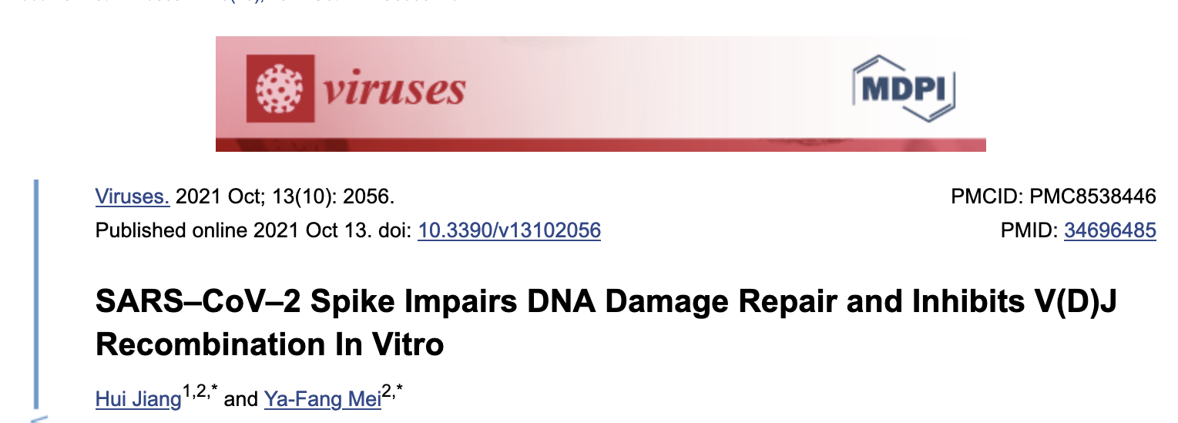

Evidence of the spike protein hijacking the DNA damage repair machinery and adaptive immune machinery in vitro
Evidence that the spike protein sticks around for a long time.

Slide 12
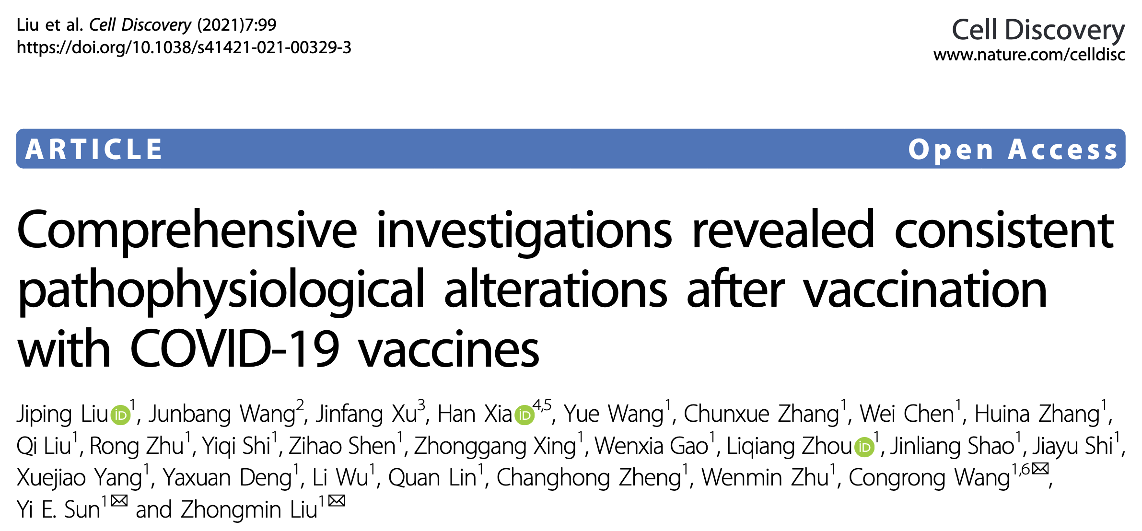
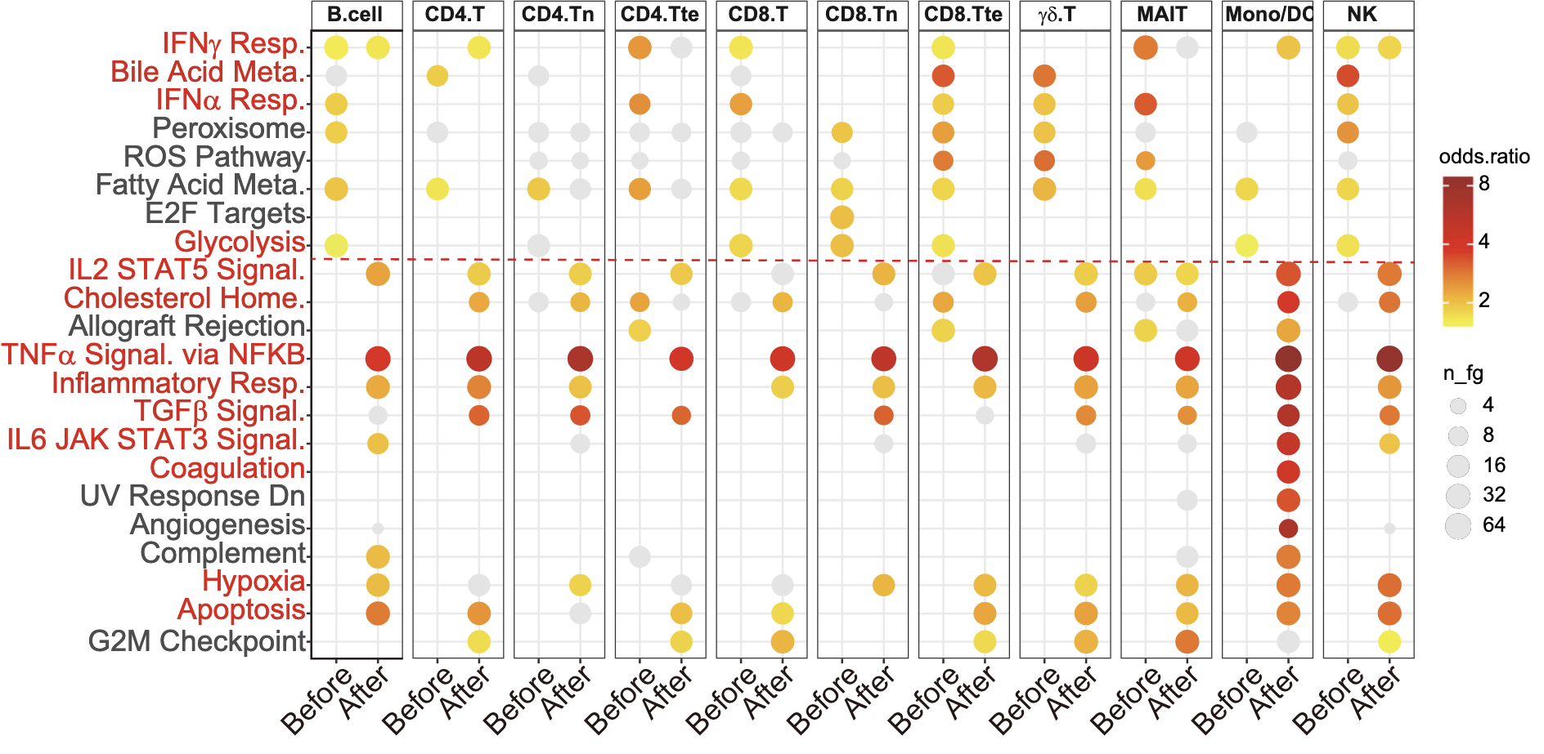
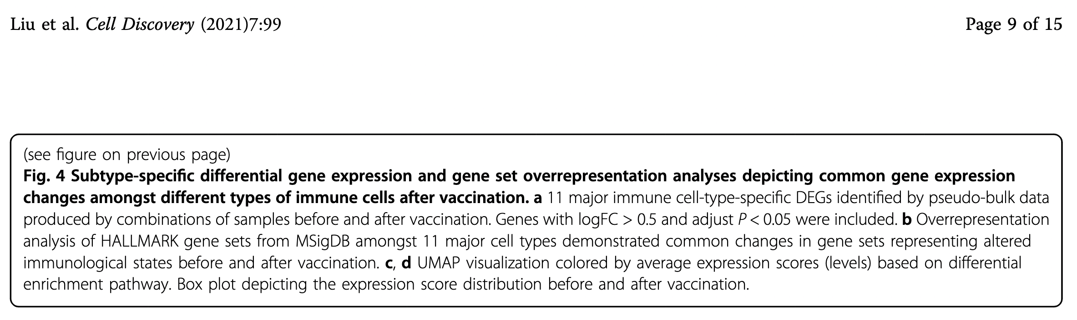
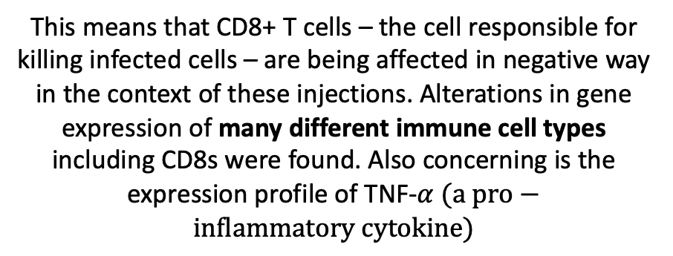
This means that CD8+ T cells – the cell responsible for killing infected cells – are being affected in negative way in the context of these injections. Alterations in gene expression of many different immune cell types including CD8s were found. Also concerning is the expression profile of TNF-$α (a pro−inflammatory cytokine)$
They identified differentially expressed genes among all major cell types and conducted gene functional analysis (above).
Recent findings indicate that the injections are inducing immune deficiencies/immunomodulation and hyperinflammation
Notes:
Gene expression is the process by which the information encoded in a gene is used to direct the assembly of a protein molecule. The cell reads the sequence of the gene in groups of three bases. Each group of three bases (codon) corresponds to one of 20 different amino acids used to build the protein.

Slide 13
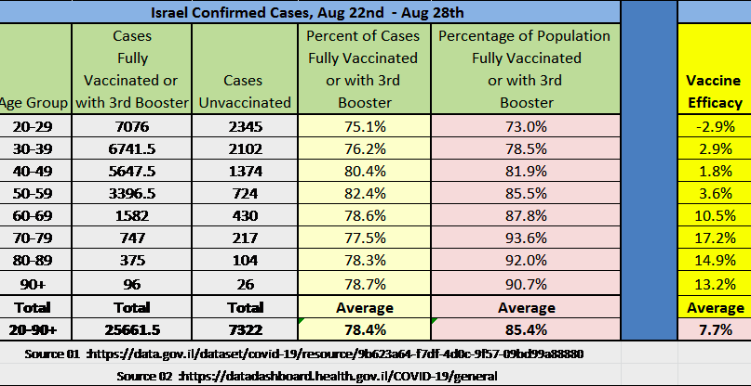
Transient ‘Efficacy’ becoming obvious

Slide 14
Talking points
SAFETY AND EFFICACY
GENERAL VAERS
SPECIFIC VAERS
WHAT CAN WE DO?

Slide 15
Absolute VAERS total counts for the past decade
This is a ~1,700% increase. Since the excess in AEs are NOT due to excess in doses administered*, what explains this?
ALL VACCINES COMBINED
mean for the past decade = 39,218

Slide 16
Absolute VAERS death counts for the past decade
This is a ~7,500% increase. Since the excess in AEs are NOT due to excess in doses administered*, what explains this?
ALL VACCINES COMBINED
mean for the past decade = 155

Slide 17
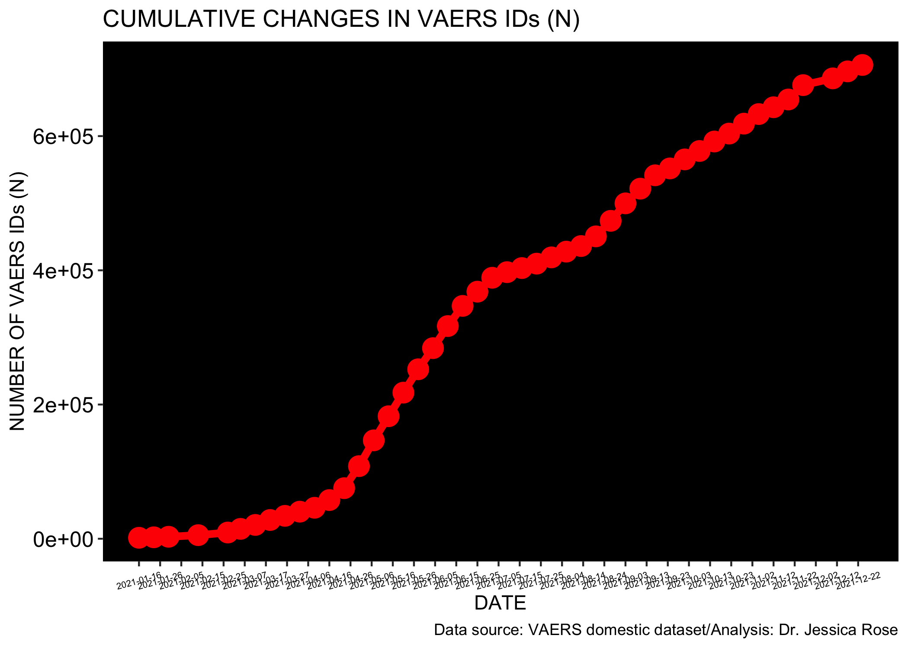
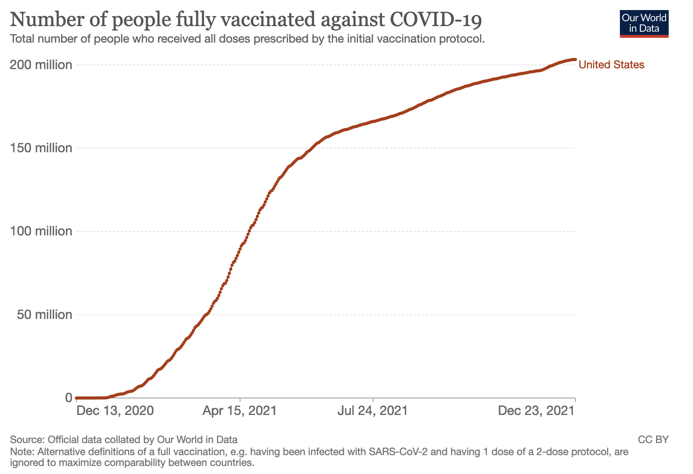
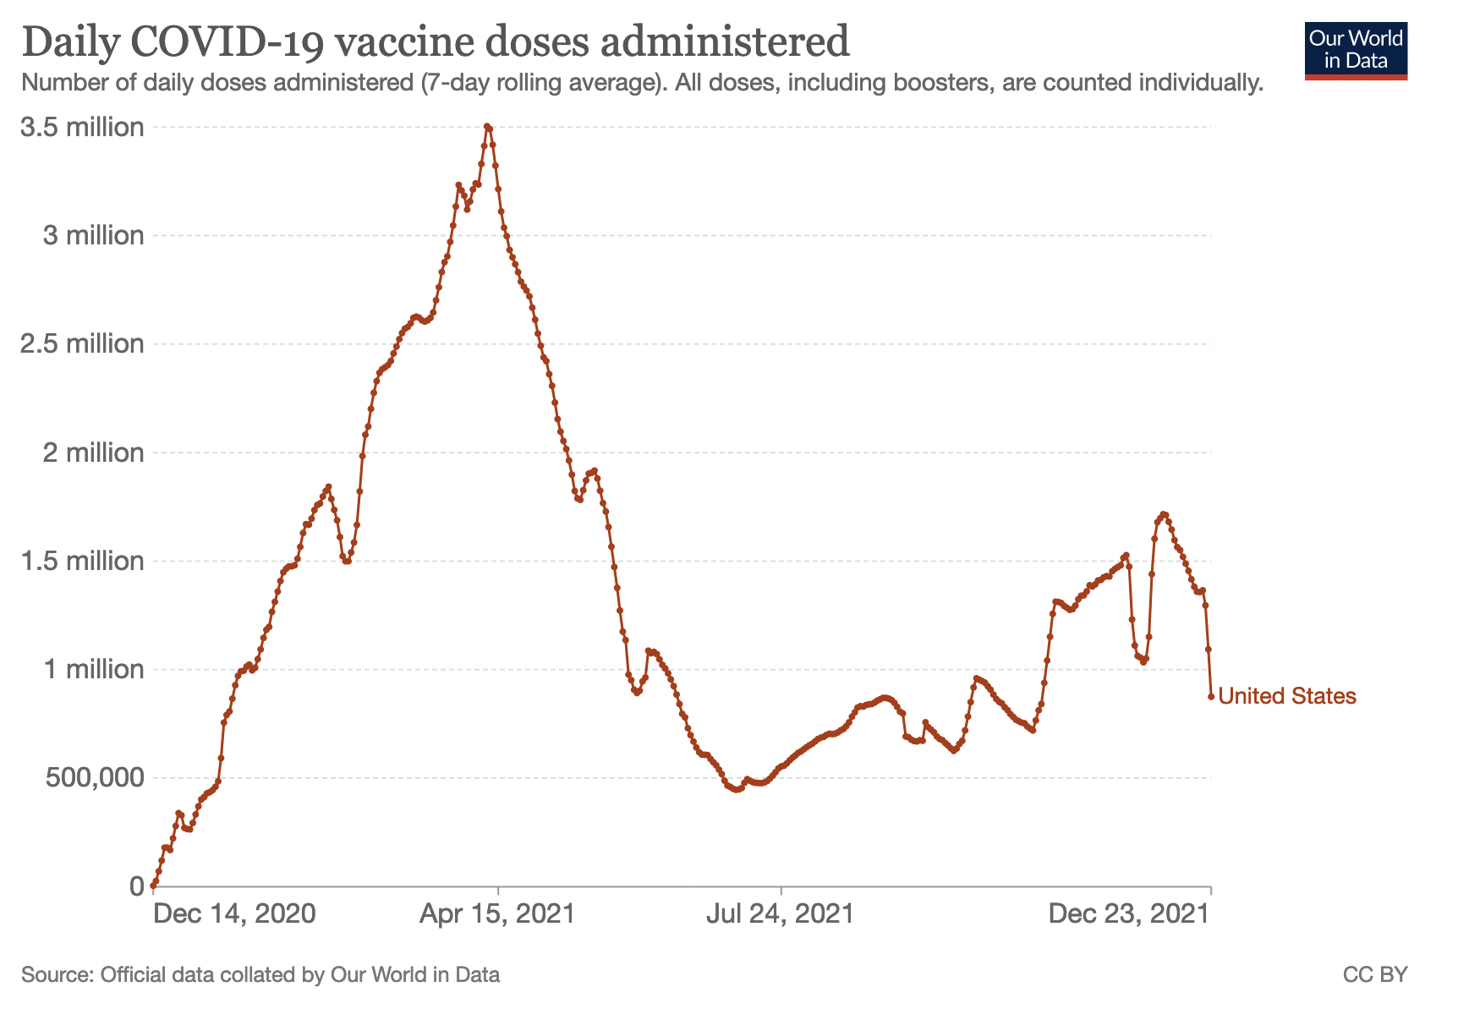
Comparison of cumulative AE counts from VAERS database

Slide 18
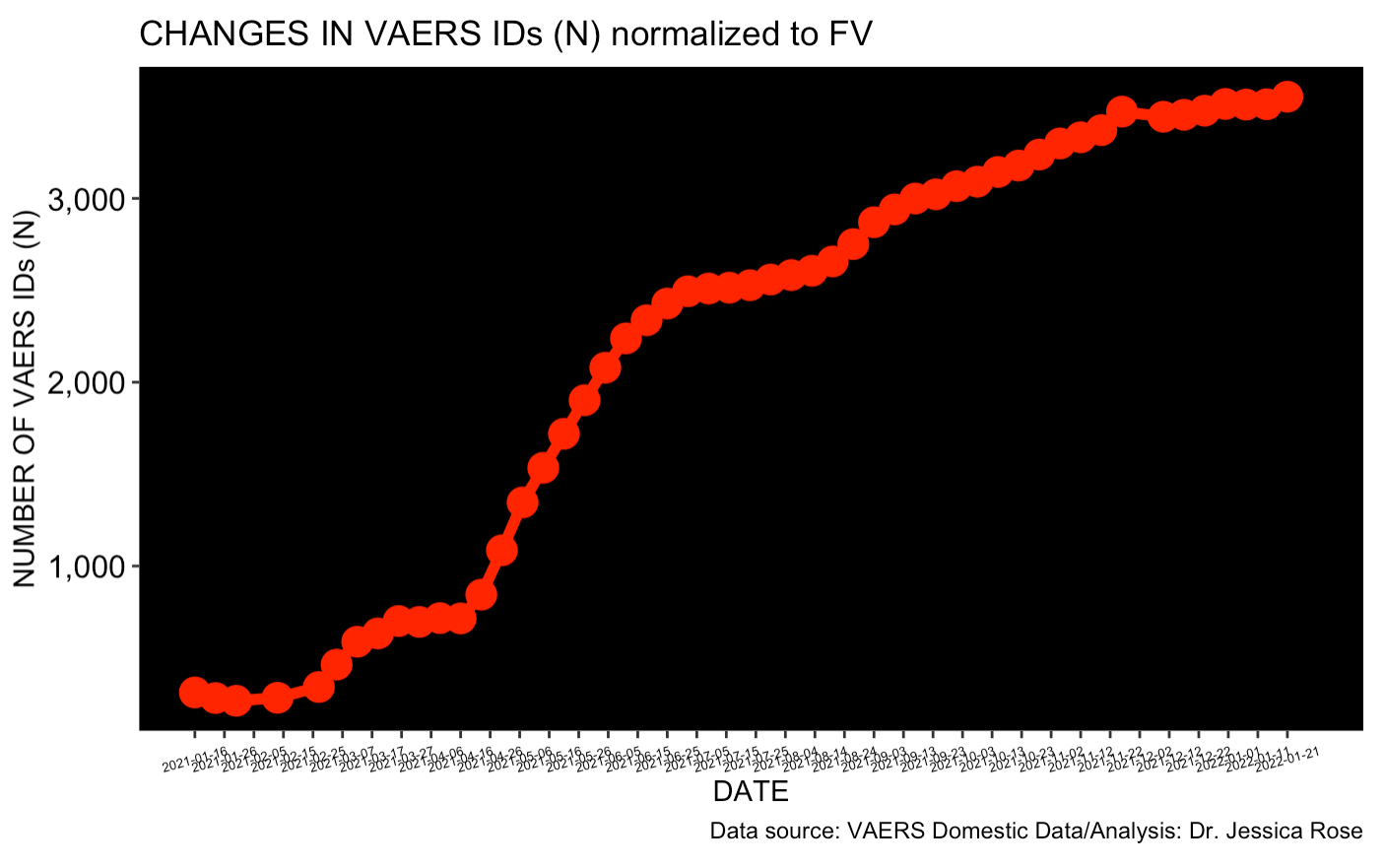
Comparison of cumulative AE counts from VAERS database normalized to FV population (2 doses)
~1/274 individuals have reported an AE to the domestic data set in context of COVID-19 products.

Slide 19
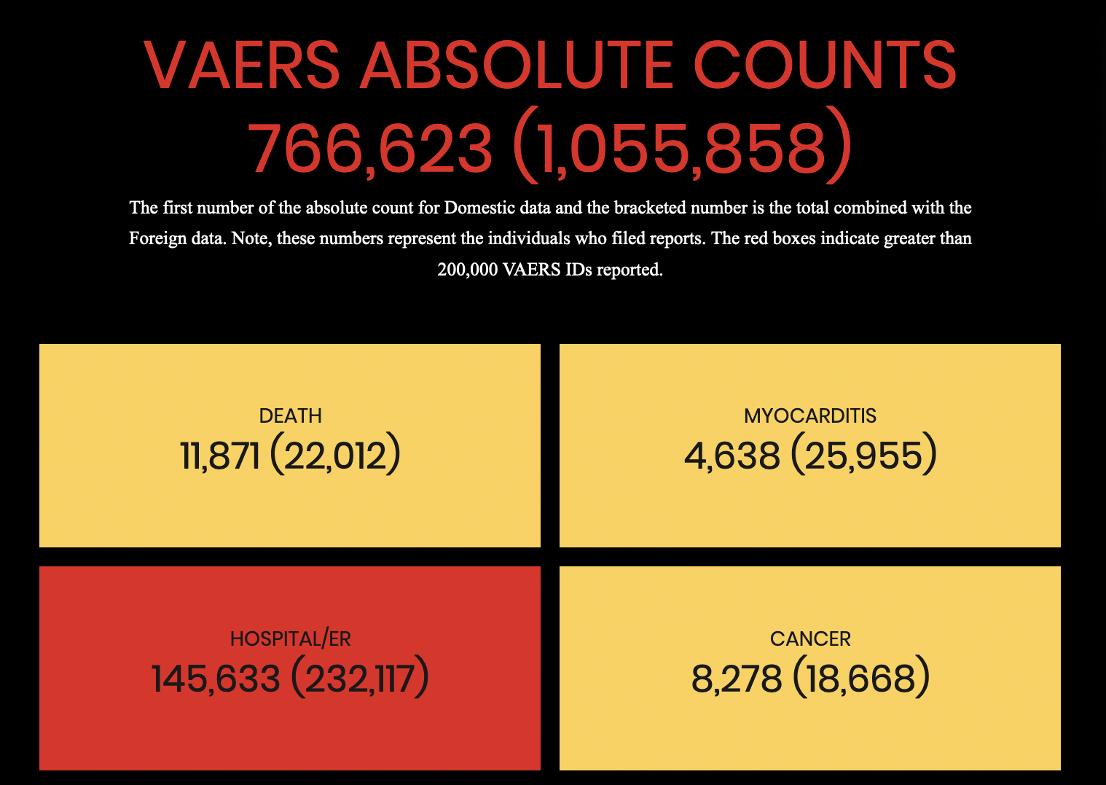
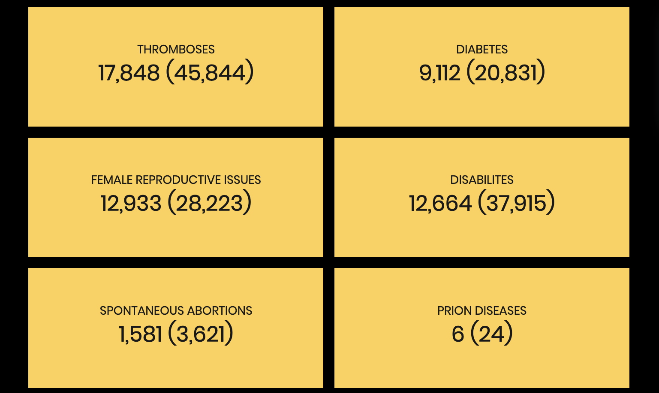
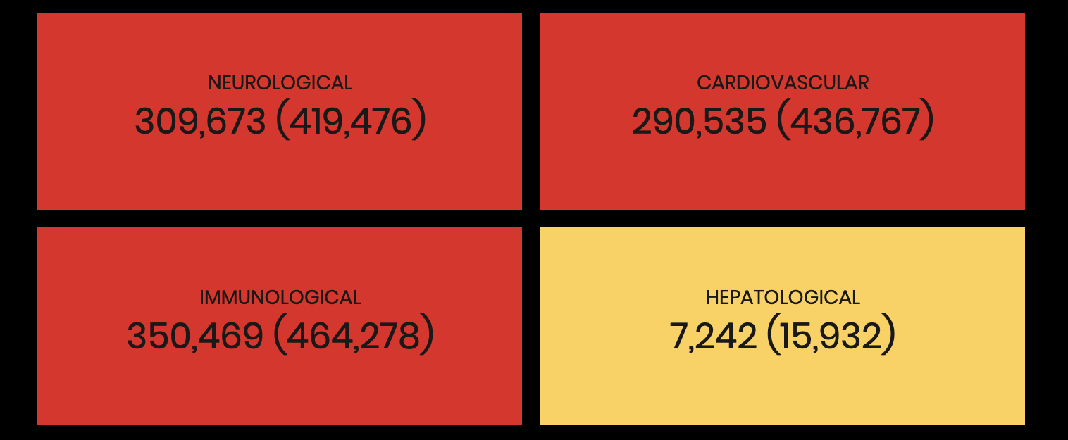
https://www.jessicasuniverse.com/

Slide 20
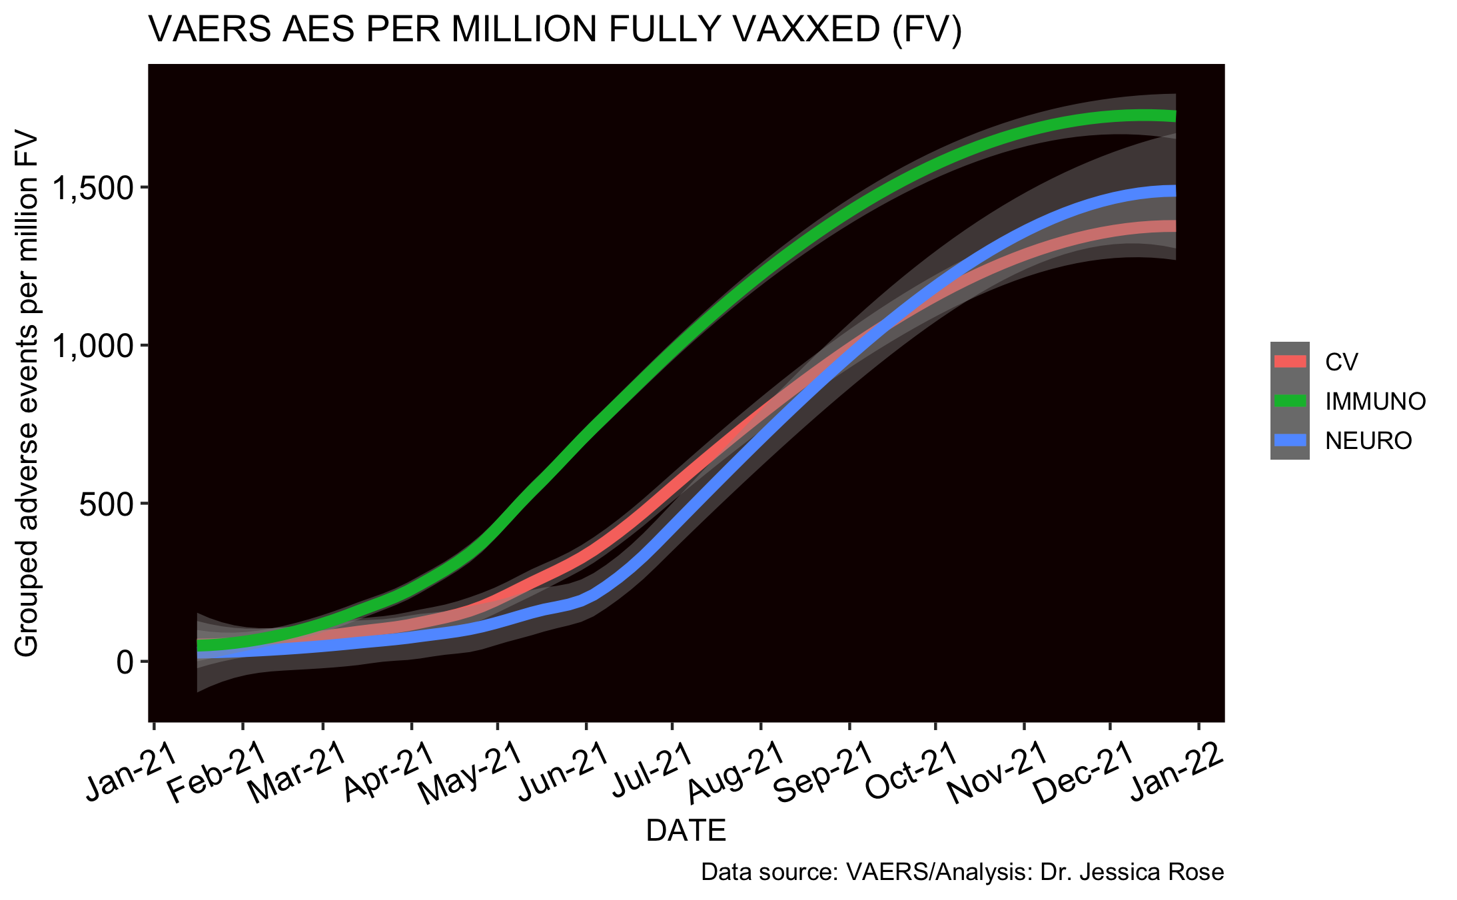
Normalized to Fully Injected
1/450 individuals report an immunological AE in context of COVID-19 products
1/500 individuals report an neurological AE in context of COVID-19 products
1/480 individuals report an cardiovascular AE in context of COVID-19 products

Slide 21
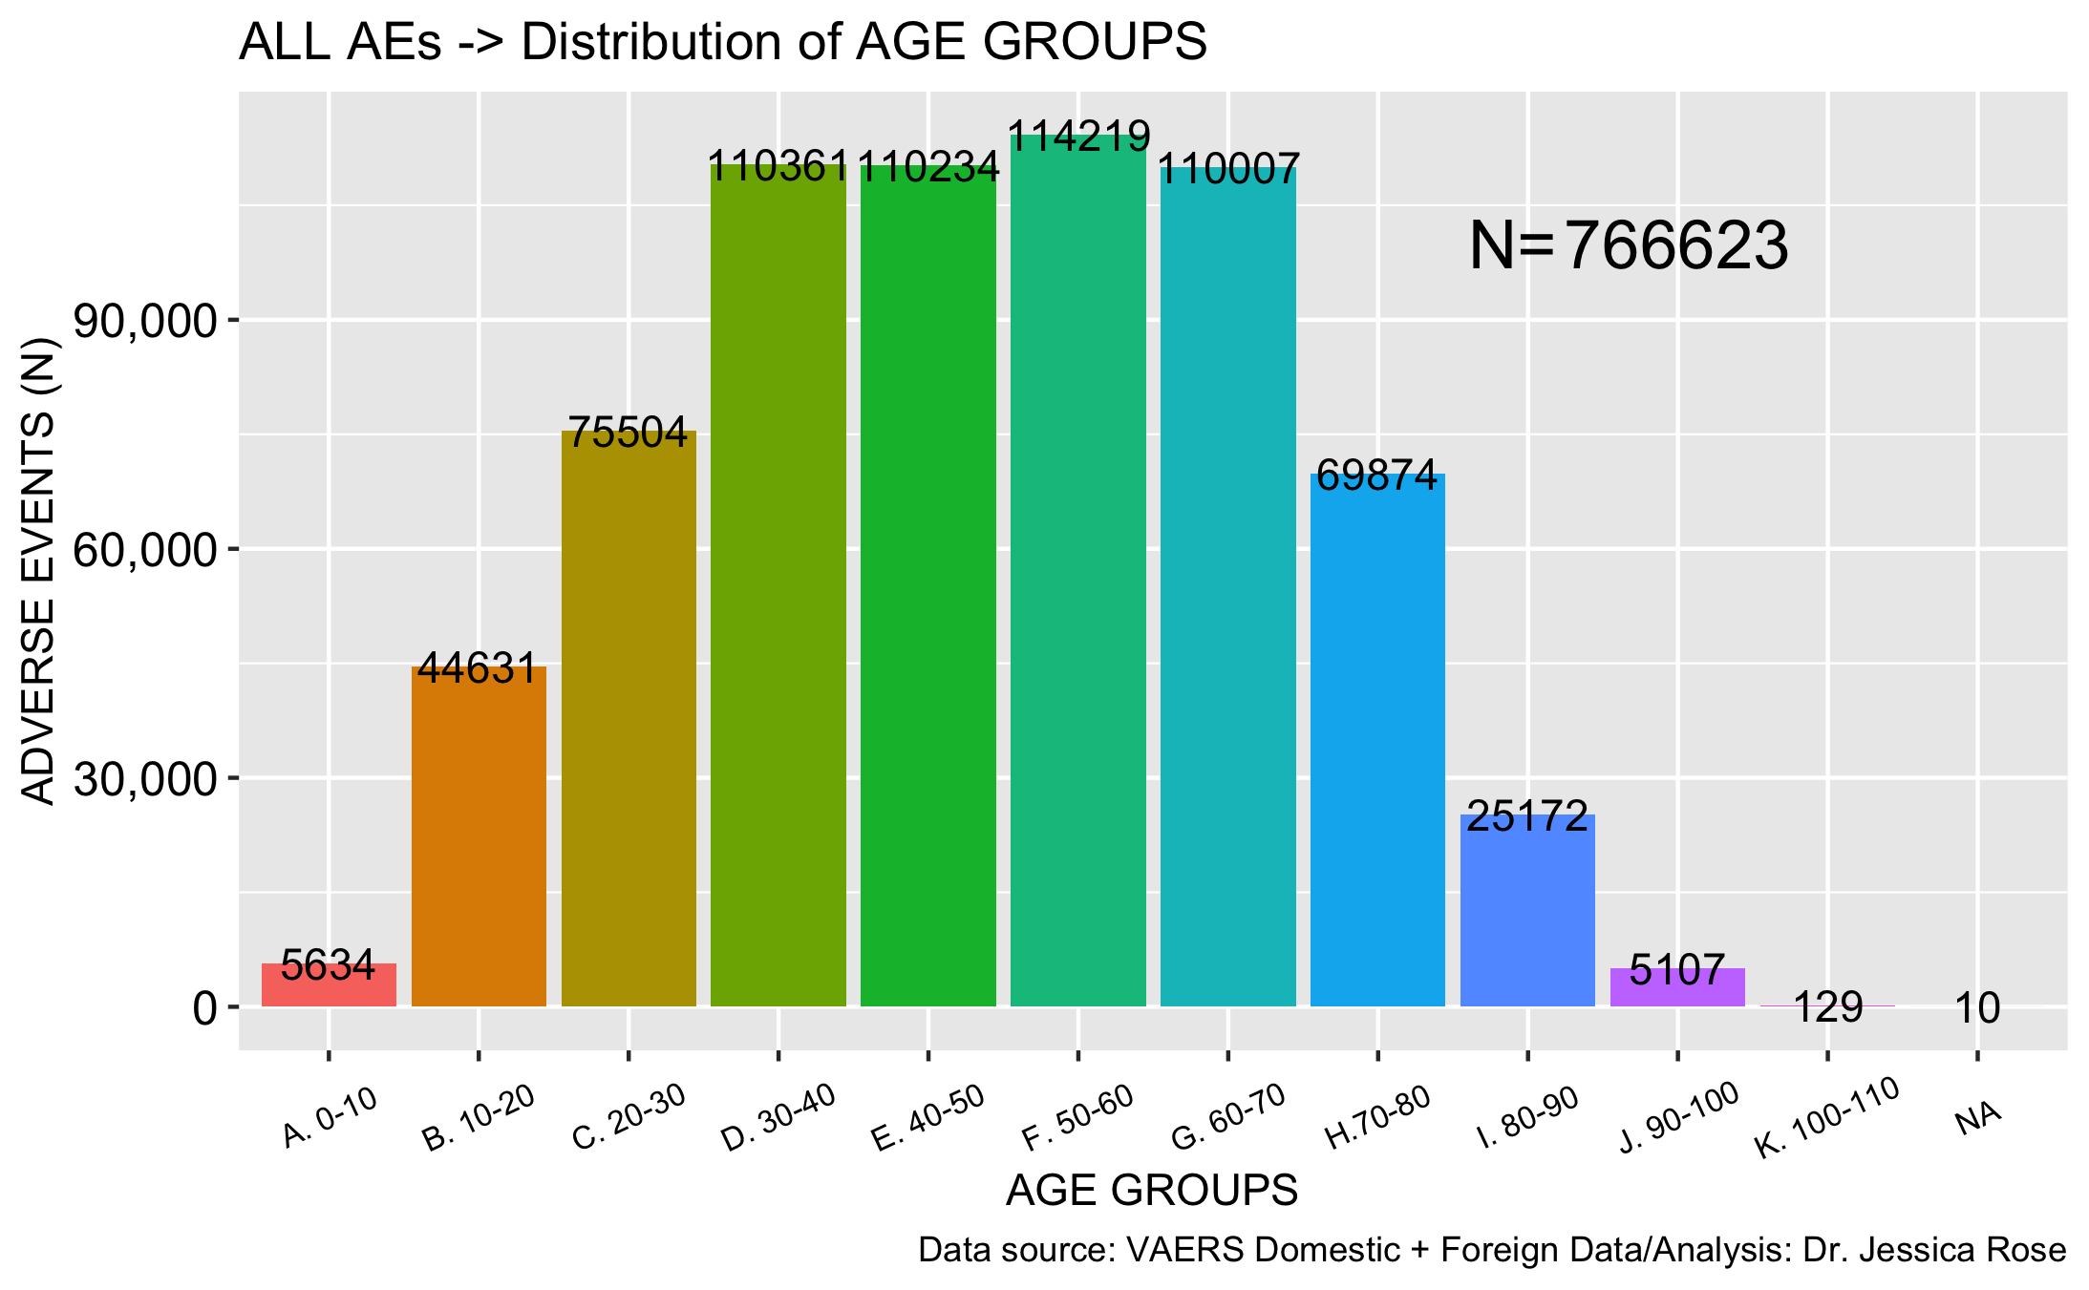
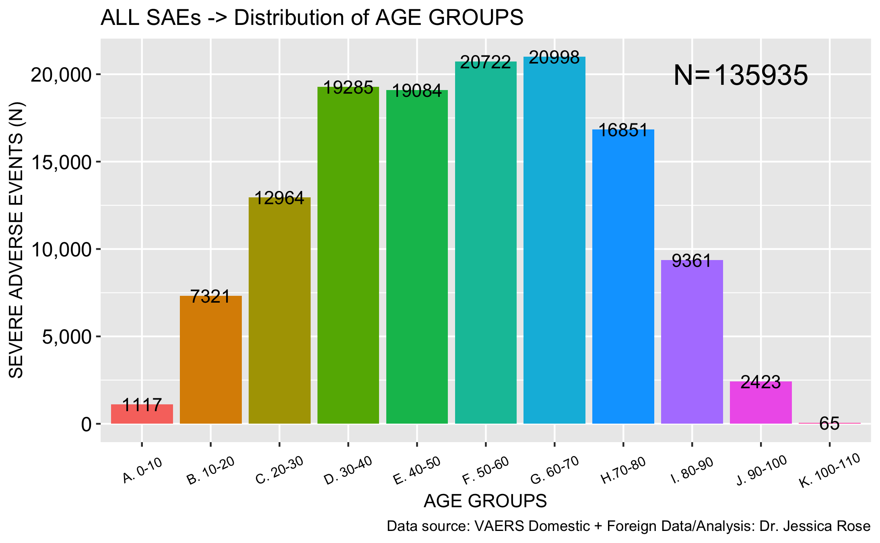
All age groups reporting AEs/SAEs (18%)

Slide 22
Talking points
SAFETY AND EFFICACY
GENERAL VAERS
SPECIFIC VAERS
WHAT CAN WE DO?

Slide 23
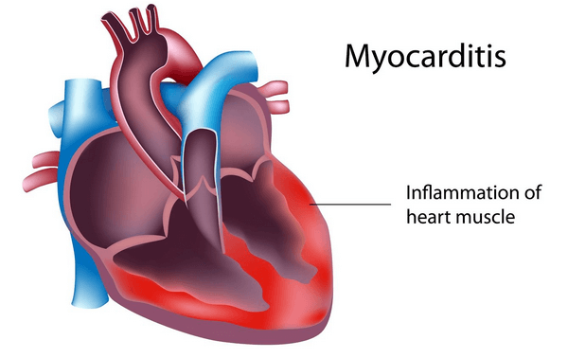
Myocarditis

Slide 24
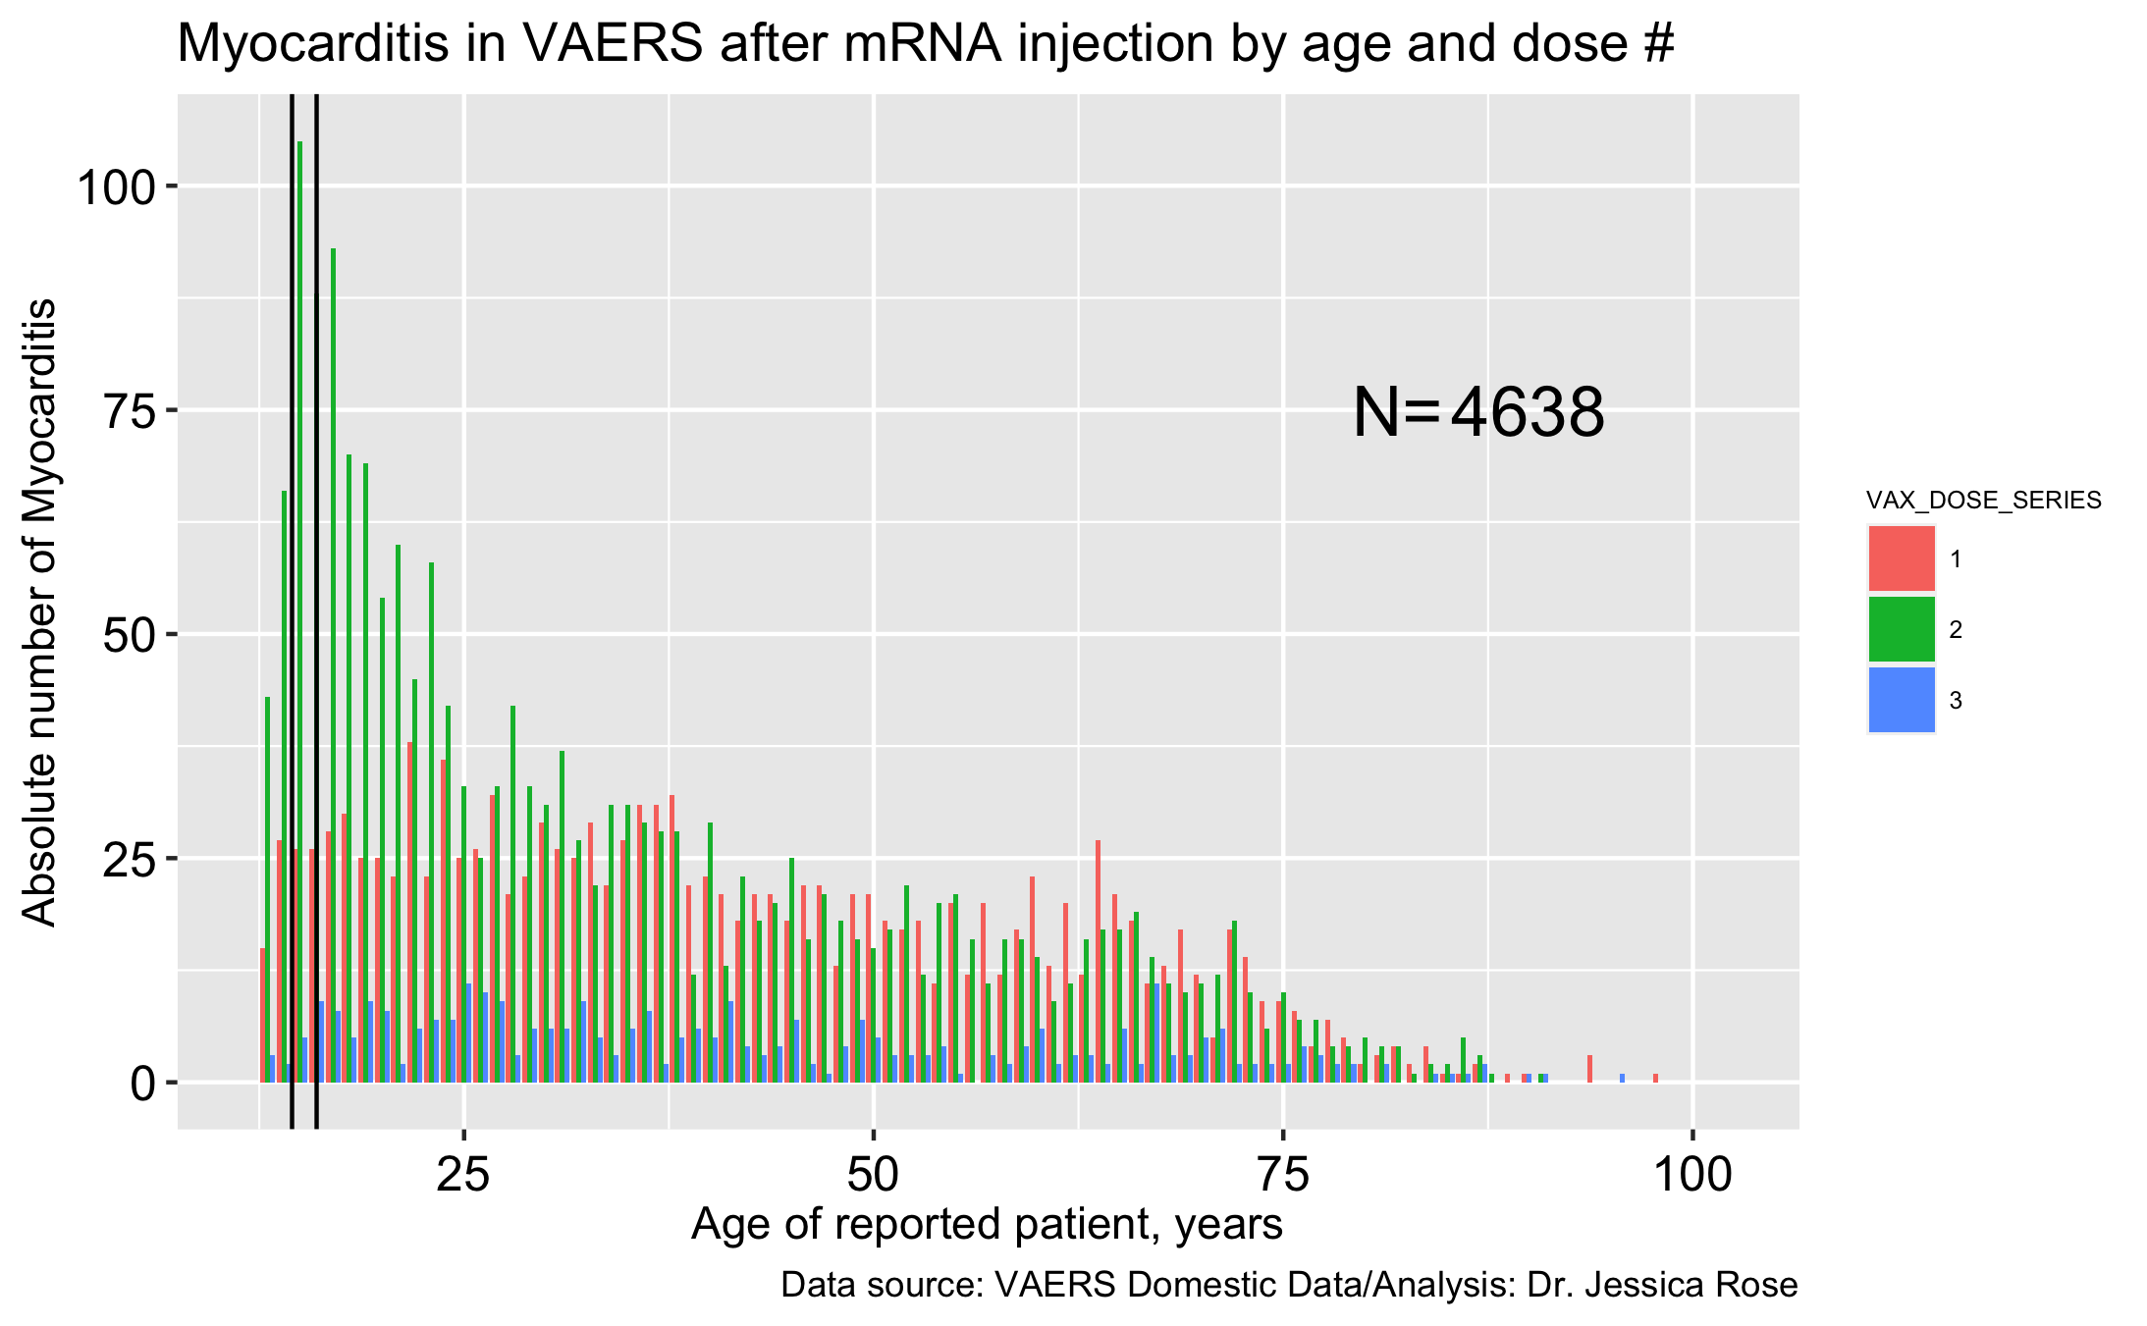
Dose effect in VAERS Domestic Data
Second dose frequency reporting strong evidence to support causation of Myocarditis

Slide 25
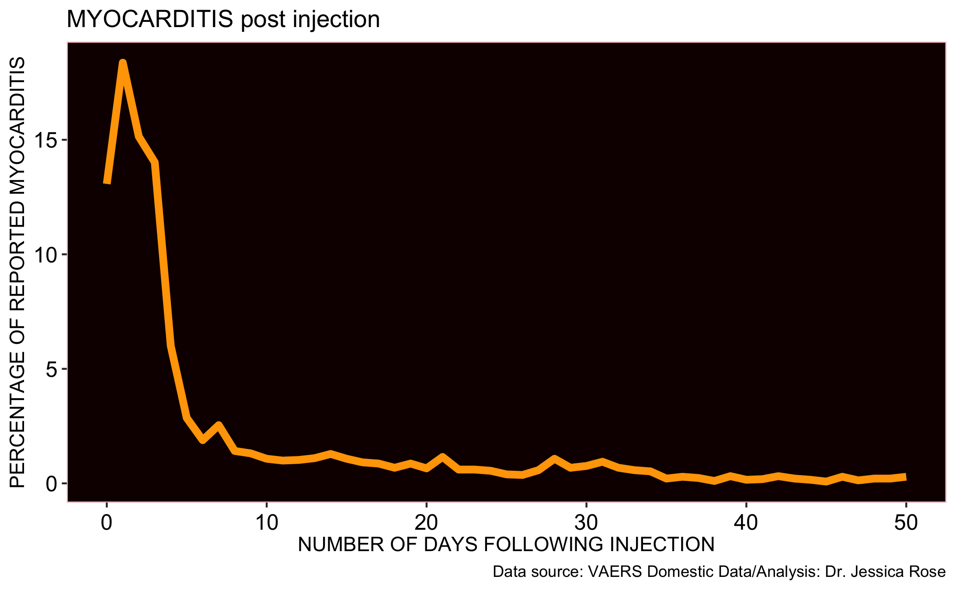
ALL DOSE ALL AGE frequency reporting strong evidence to support causation of Myocarditis
31% of reports were made within 24 hours
46% of reports were made within 48 hours
24% of myocarditis reports are made for 12-20 year-olds
  41% of reports were made within 24 hours
  66% reports were made within 48 hours

Slide 26

KIDS

Slide 27
Three reasons NOT to give the kids these shots
Never mass vaccinate a population with a non-sterilizing product across all age groups during a pandemic.
Geert Vanden Bossche, DVM, PhD
Needless COVID-19 is not a childhood disease
Harmful Adverse events/no safety data
Dangerous Potential for driving variants of concern

Slide 28
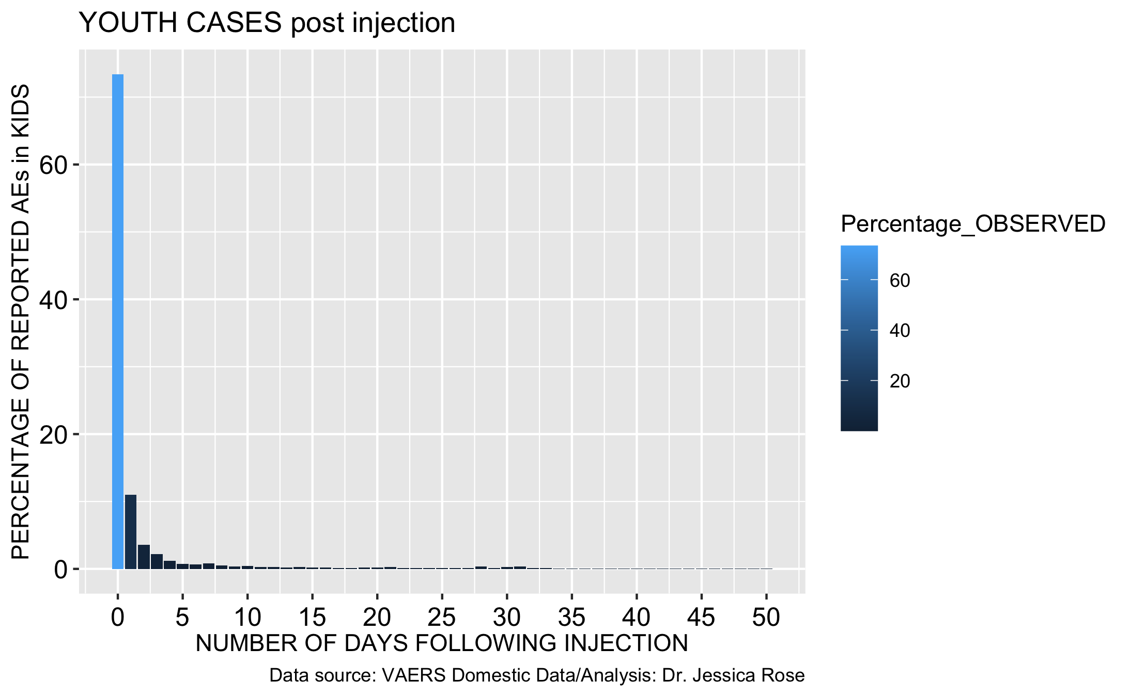
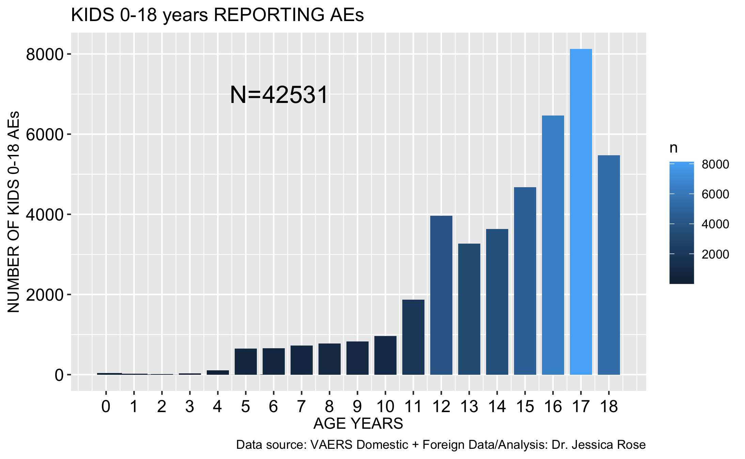
KIDS
AEs in children aged 5-11 years are on the rise and being reported immediately
Children aged 0-18: 42,531
Children aged 5-11: 6,487

Slide 29
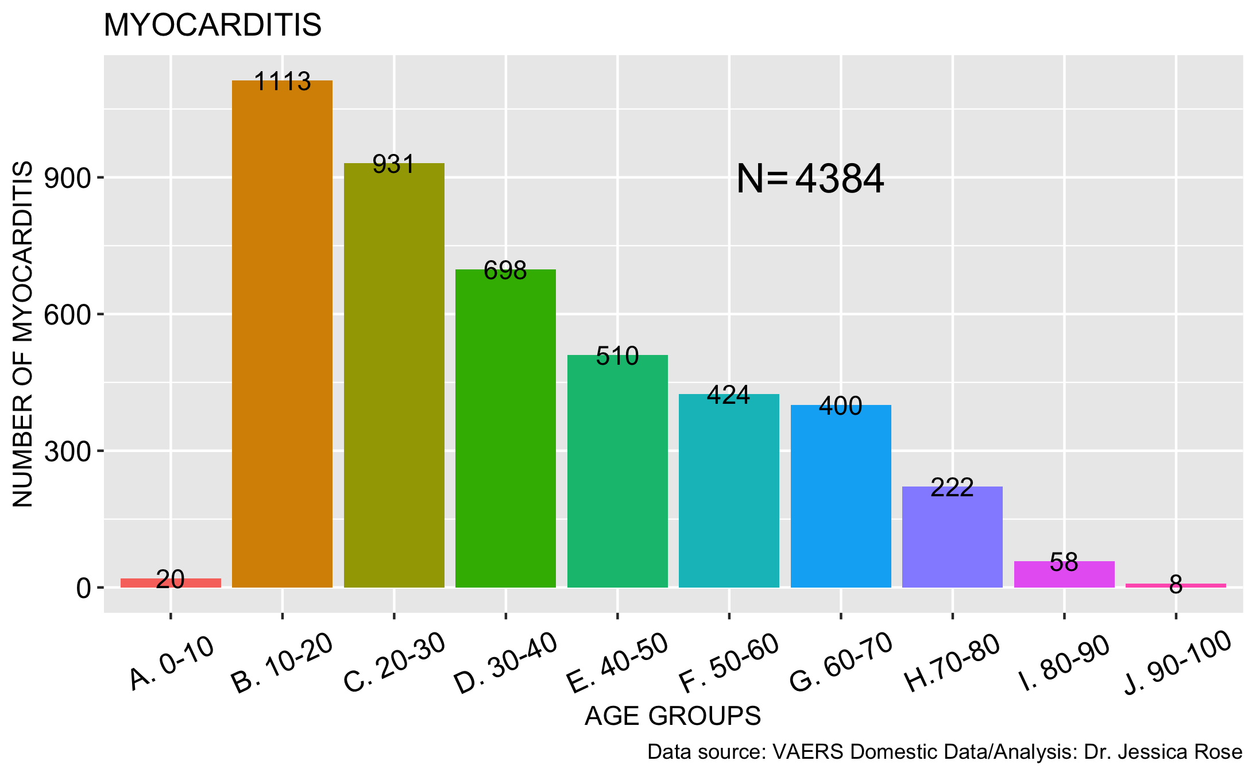
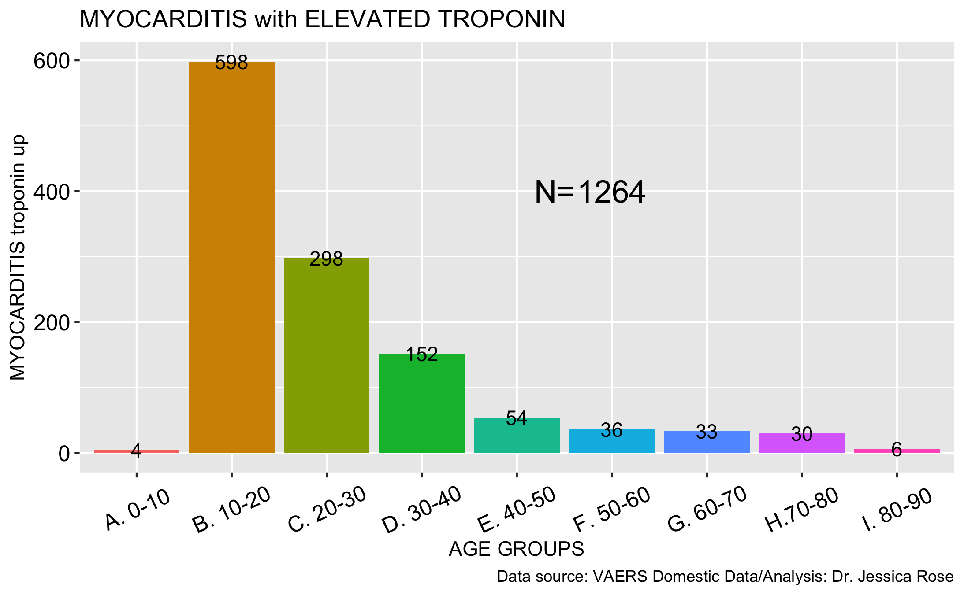
Myocarditis associated with elevated troponin in 28.8% of Domestic reports

Slide 30
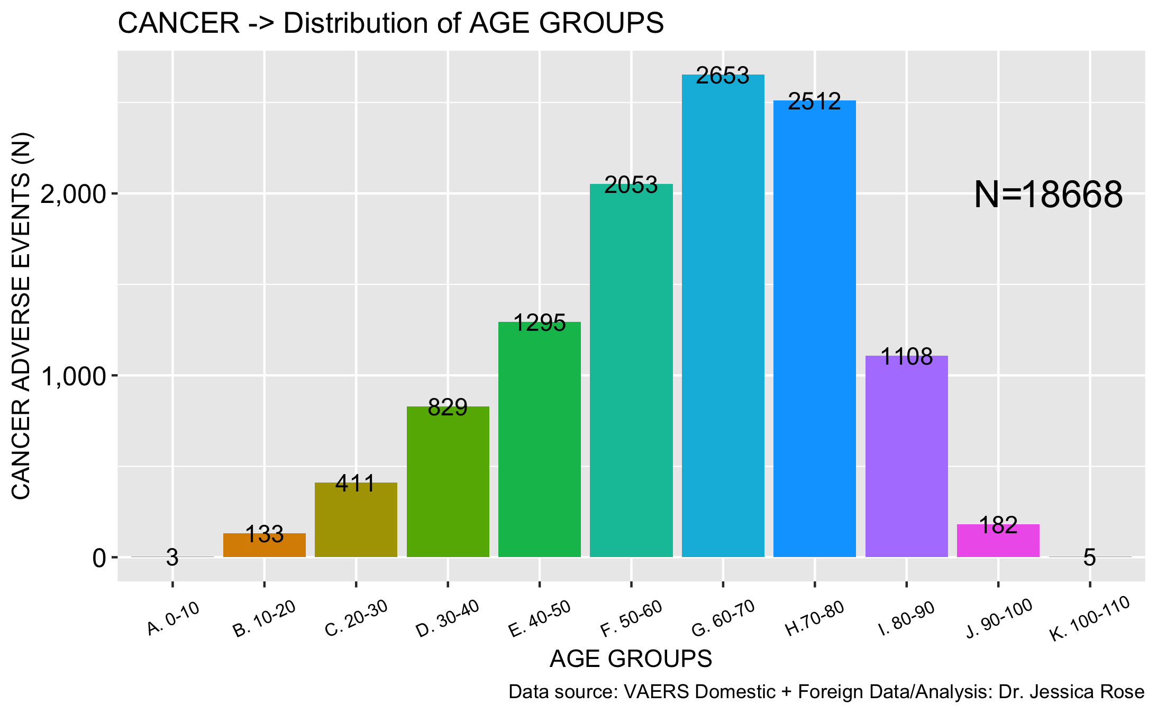
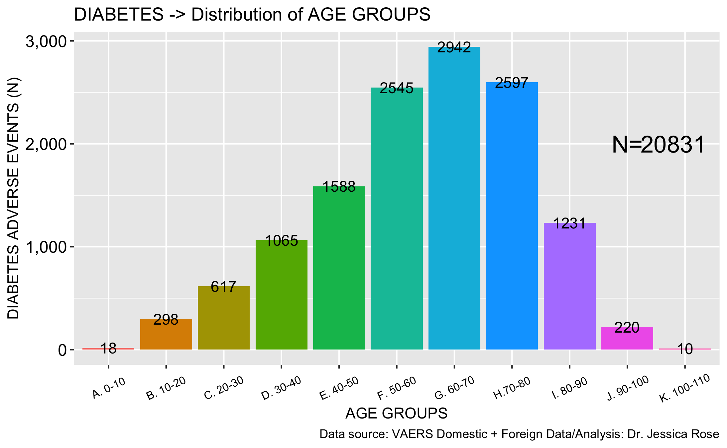
Cancer AND Diabetes in VAERS

Slide 31
Talking points
SAFETY AND EFFICACY
GENERAL VAERS
SPECIFIC VAERS
WHAT CAN WE DO?

Slide 32
What can we do? Use Omicron…
STOP INJECTING! Let the immune system do what it does
Usher in the age of true herd immunity
Release us from the grips of nonsensical control measures
Treatment using repurposed SAFE drugs
Listen to doctors

Slide 33
Talking points
SAFETY AND EFFICACY
GENERAL VAERS
SPECIFIC VAERS
WHAT CAN WE DO?

Slide 34
Conclusions
Use early treatment in the context of the vulnerable
Stop injection roll-out until safety and efficacy can properly be assessed
Develop treatment options for the injection-injured
Leave the kids alone – opt for true herd immunity

