Slide 1


Viable solutions to the COVID-19 problem: interventions stratified to risks
Dr. Jessica Rose
November, 2021

Slide 2

Nature is non-linear – and so should we be with our approaches to COVID-19 care.
The way forward commands CAUTION and cooperation.

Slide 3
The Precautionary Principle
The Precautionary Principle in its simplest form states: "When an activity raises threats of harm to human health or the environment, precautionary measures should be taken even if some cause-and-effect relationships are not fully established scientifically".
Hayes AW. The precautionary principle. Arh Hig Rada Toksikol. 2005 Jun;56(2):161-6. PMID: 15968832.
deFur PL, Kaszuba M. Implementing the precautionary principle. Sci Total Environ. 2002 Apr 8;288(1-2):155-65. doi: 10.1016/s0048-9697(01)01107-x. PMID: 12013543.

Slide 4
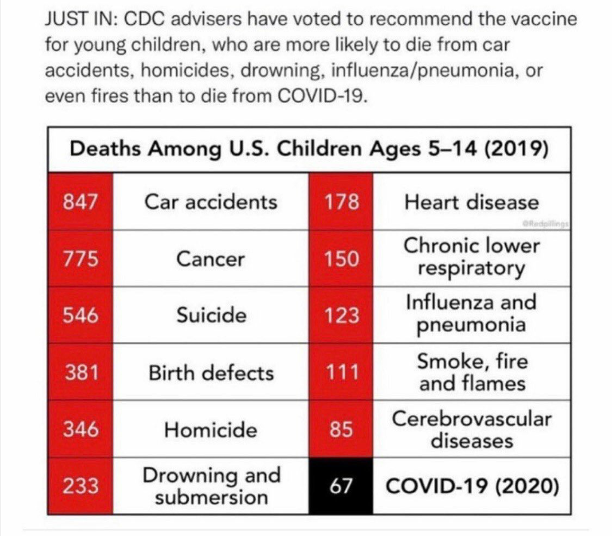
Perspective
With Under reporting factor of 31 – the most conservative estimate:
403
13
COVID-19 injections (2021)

Slide 5
What problem are we trying to solve?
Protect Children?
Protect Others (families/teachers)?
In either case vaccinating children is unnecessary
  Protecting children is unnecessary as they have effectively zero risk from the virus, and by vaccinating miss the opportunity to develop long-lasting herd natural immunity
  Immune pressure towards escape variants and perpetuation of the problem, by vaccinating kids. Risk from infection is non-zero.
  Protecting others is unnecessary as they (theoretically) already benefit from the effect of reduced risk of severe outcomes due to injection and boosters (focus of injections should be at-risk populations i.e. to reduce effect of virus, as injections do little to mitigate transmission).
  Other tools include natural immunity with support and chemoprophylaxis (for rest of population, as children are not at risk).

Slide 6
What problem are we trying to solve?
Protect Children?
Protect Others (families/teachers)?
In either case vaccinating children is unnecessary
  Protecting children is unnecessary as they have effectively zero risk from the virus, and by vaccinating miss the opportunity to develop long-lasting herd natural immunity
  Immune pressure towards escape variants and perpetuation of the problem, by vaccinating kids. Risk from infection is non-zero.
  Protecting others is unnecessary as they (theoretically) already benefit from the effect of reduced risk of severe outcomes due to injection and boosters (focus of injections should be at-risk populations i.e. to reduce effect of virus, as injections do little to mitigate transmission).
  Other tools include natural immunity with support and chemoprophylaxis (for rest of population, as children are not at risk).
“In reviewing the medical literature and news reports, and in talking to pediatricians across the country, I am not aware of a single healthy child in the U.S. who has died of COVID-19 to date,” Marty Makary wrote in a recent essay at MedPage Today. He is the editor-in-chief of the medical news publication.

Slide 7
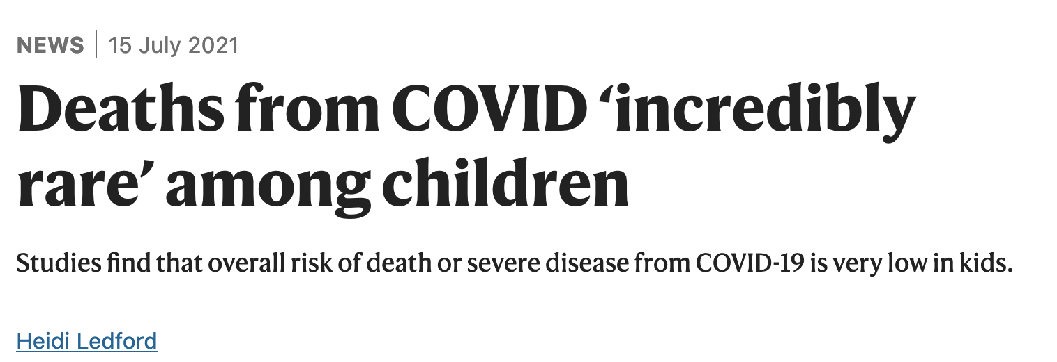
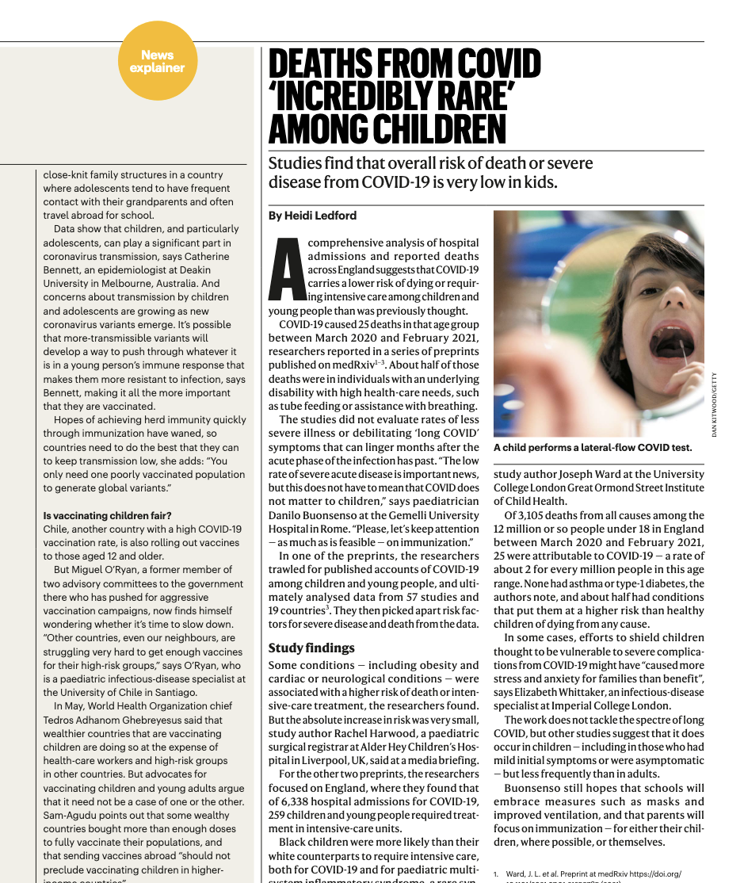
Healthy children are not at risk of severe prognosis from COVID-19
“Some conditions — including obesity and
cardiac or neurological conditions were
associated with a higher risk of death or intensive-care treatment, the researchers found. But the absolute increase in risk was very small, study author Rachel Harwood, a paediatric surgical registrar at Alder Hey Children’s Hospital in Liverpool, UK, said at a media briefing.”
Sunil S Bhopal, Jayshree Bagaria, Bayanne Olabi, Raj Bhopal. Children and young people remain at low risk of COVID-19 mortality. The Lancet/Child and Adolescent Health. Correspondence| Volume 5, ISSUE 5, e12-e13, May 01, 2021. Published:March 10, 2021. DOI:https://doi.org/10.1016/S2352-4642(21)00066-3.

Slide 8
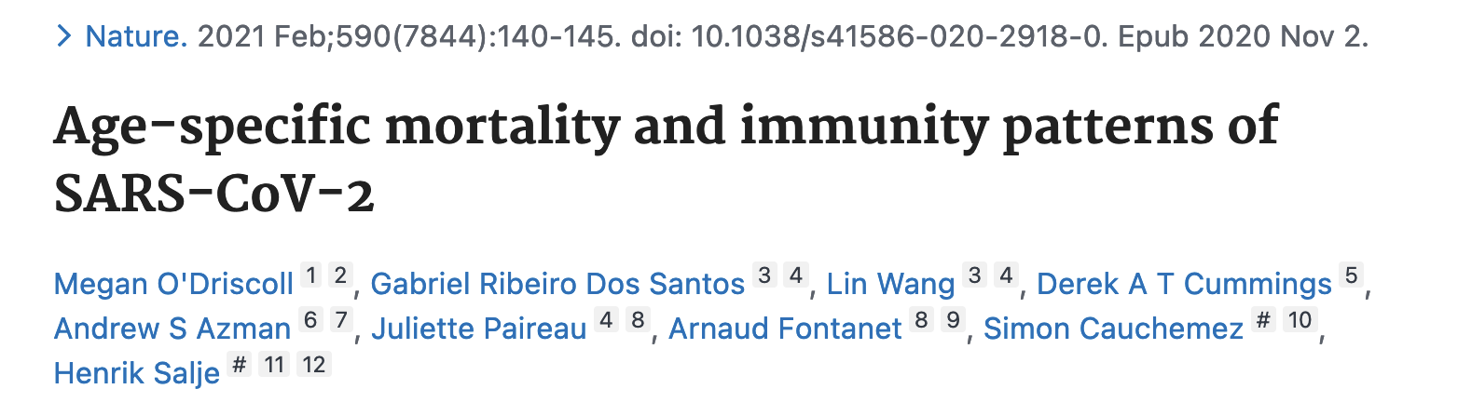
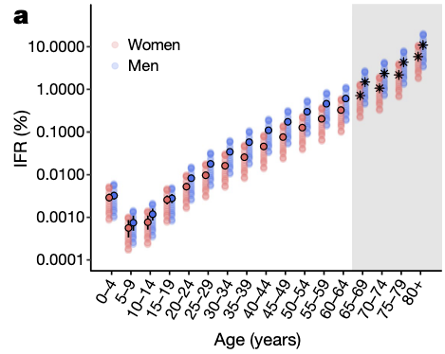
Infection Fatality Rate (IFR) for children is nil
“In the United States, a total of 335 children under 18 have died with a COVID-19 diagnosis on their death certificate.⁵”
*Makary shares that no one at Johns Hopkins has systematically investigated the cause of each child's death, in an effort to determine if COVID was actually involved or if the death was the result of a preexisting condition.
*Dr. Marty Makary, a professor at Johns Hopkins University School of Medicine and editor-in chief of MedPage Today
O’Driscoll, M., Ribeiro Dos Santos, G., Wang, L. et al. Age-specific mortality and immunity patterns of SARS-CoV-2. Nature 590, 140–145 (2021). https://doi.org/10.1038/s41586-020-2918-0

Slide 9
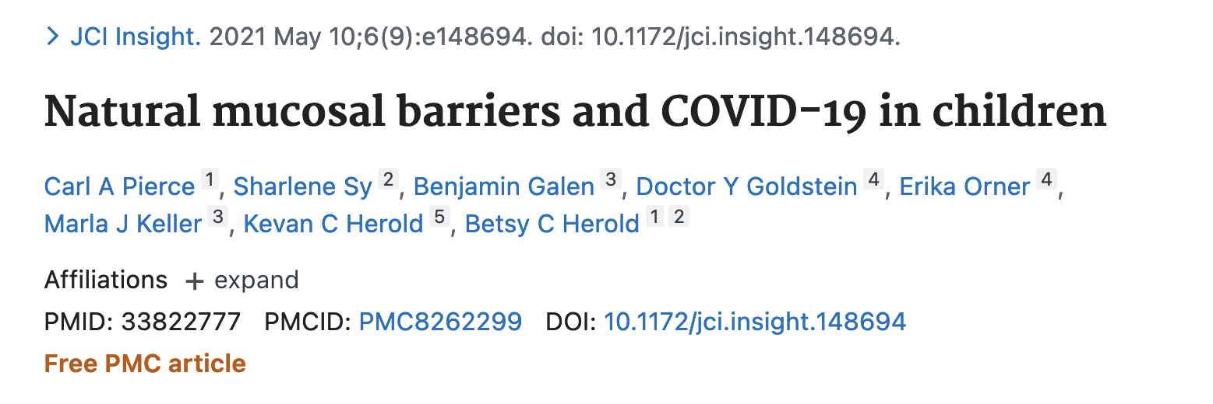
Mass injection campaign - miss the opportunity to develop long-lasting herd natural immunity
“a more robust early innate immune response to SARS coronavirus 2 (SARS-CoV-2) protects against severe disease”
“children displayed higher expression of genes associated with IFN signaling, NLRP3 inflammasome, and other innate pathways. Higher levels of IFN-α2, IFN-γ, IP-10, IL-8, and IL-1β protein were detected in nasal fluid in children versus adults”
“children also expressed higher levels of genes associated with immune cells, whereas expression of those associated with epithelial cells did not differ in children versus adults”
Pierce CA, Sy S, Galen B, Goldstein DY, Orner E, Keller MJ, Herold KC, Herold BC. Natural mucosal barriers and COVID-19 in children. JCI Insight. 2021 May 10;6(9):e148694. doi: 10.1172/jci.insight.148694. PMID: 33822777; PMCID: PMC8262299.

Slide 10
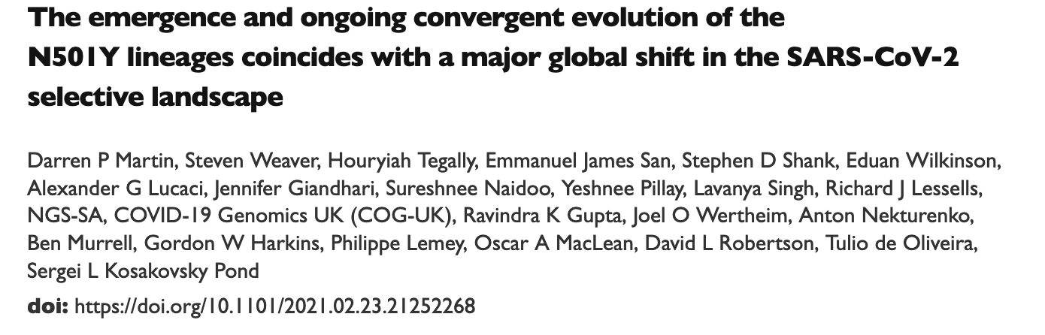
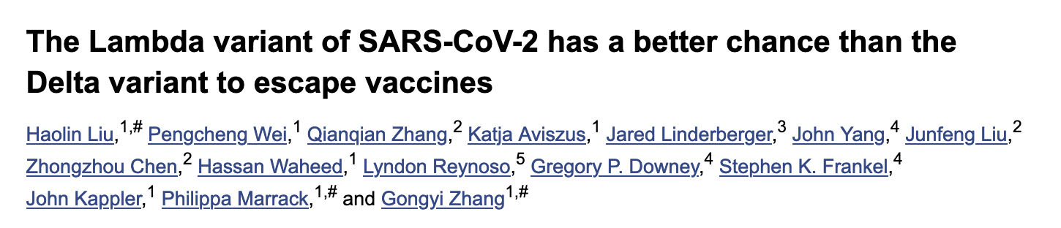
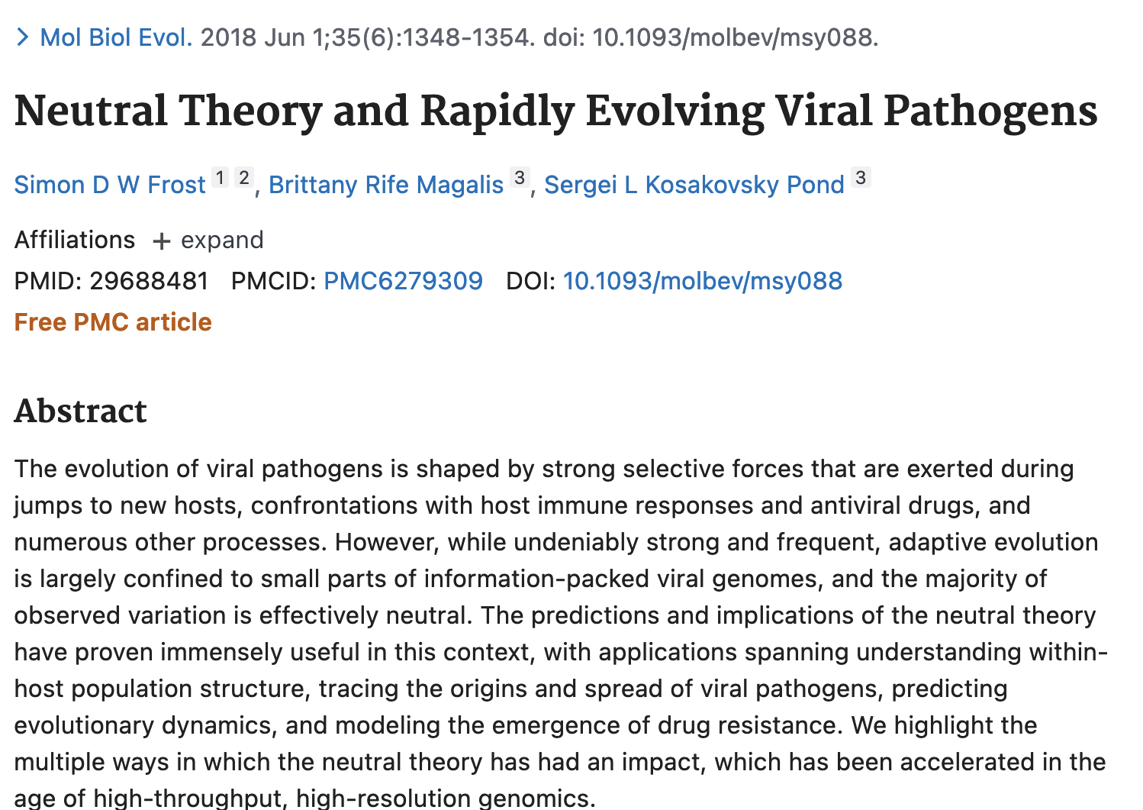
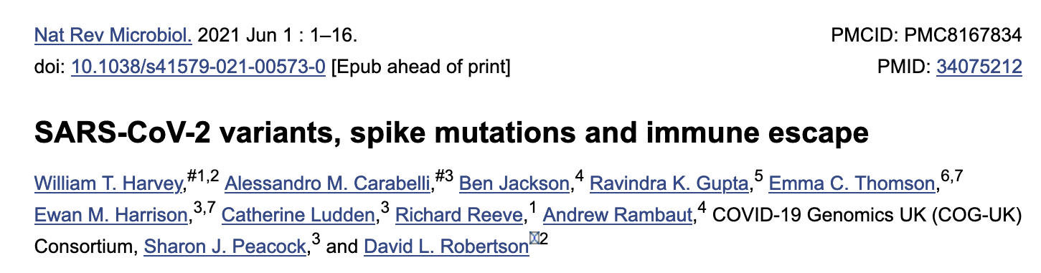
Immune pressure towards escape variants and perpetuation of the problem, by injecting children
“Viruses giving rise to the different 501Y lineages have, presumably under intense natural selection following a shift in host environment, independently acquired multiple unique and convergent mutations. As a consequence, all have gained epidemiological and immunological properties that will likely complicate the control of COVID-19.”
Darren P Martin, et al., The emergence and ongoing convergent evolution of the N501Y lineages coincides with a major global shift in the SARS-CoV-2 selective landscape. medRxiv 2021.02.23.21252268; doi: https://doi.org/10.1101/2021.02.23.21252268.
Frost SDW, Magalis BR, Kosakovsky Pond SL. Neutral Theory and Rapidly Evolving Viral Pathogens. Mol Biol Evol. 2018 Jun 1;35(6):1348-1354. doi: 10.1093/molbev/msy088. PMID: 29688481; PMCID: PMC6279309.

Slide 11
Children are NOT vectors for COVID-19
Children are immune – they do not spread COVID-19
Children are asymptomatic non-viral shedders
Dr. Geert Vanden Bossche* writes that children’s innate immunity:
“… normally/naturally largely protects them and provides a kind of herd immunity in that it dilutes infectious CoV pressure at the level of the population, whereas mass vaccination turns them into shedders of more infectious variants.”
“Children who get COVID-19 develop mild to moderate disease and as a result continue to contribute to herd immunity by developing broad and long-lived immunity.”
Dr. Klara M. Posfay-Barbe concludes in the journal Pediatrics:
“…that children infrequently transmit COVID-19 to adults.”
*Geert Vanden Bossche, DMV, PhD, independent virologist and vaccine expert, formerly employed at GAVI and The Bill & Melinda Gates Foundation, sends open call to all authorities, scientists and experts around the world, to whom this concerns: the entire world population.

Slide 12
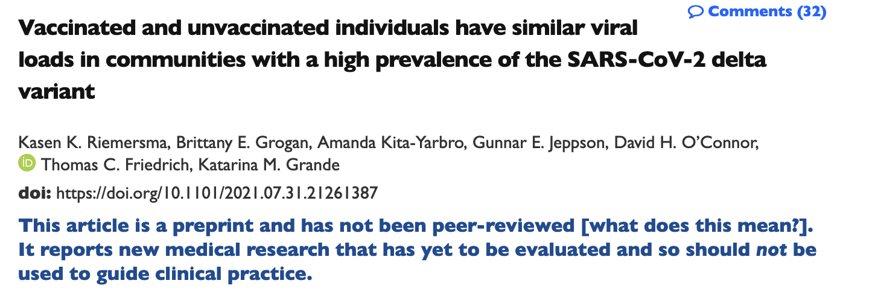
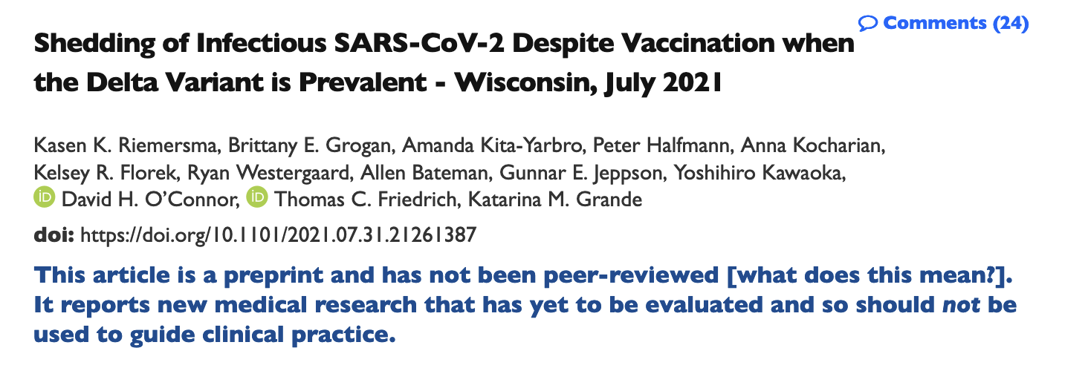
Children are NOT vectors for COVID-19 - YET
“If vaccinated individuals become infected with the delta variant, they may be sources of SARS-CoV-2 transmission to others.”
“Moreover, in the asymptomatic persons, they uncovered elevated viral loads (29% and 82% respectively) in the unvaccinated and the vaccinated respectively. This suggests that the vaccinated can be infected, harbor, cultivate and transmit the virus readily and can be doing this unknowingly.”
Kasen K. Riemersma, et al., Vaccinated and unvaccinated individuals have similar viral loads in communities with a high prevalence of the SARS-CoV-2 delta variant. medRxiv 2021.07.31.21261387; doi: https://doi.org/10.1101/2021.07.31.21261387
Kasen K. Riemersma et al., Shedding of Infectious SARS-CoV-2 Despite Vaccination when the Delta Variant is Prevalent - Wisconsin, July 2021. medRxiv 2021.07.31.21261387; doi: https://doi.org/10.1101/2021.07.31.21261387

Slide 13
What problem are we trying to solve?

Slide 14
What problem are we trying to solve?
Protect Children?
Protect Others (families/teachers)?
In either case vaccinating children is unnecessary
  Protecting children is unnecessary as they have effectively zero risk from the virus, and by vaccinating miss the opportunity to develop long-lasting herd natural immunity
  Immune pressure towards escape variants and perpetuation of the problem, by vaccinating kids. Risk from infection is non-zero.
  Protecting others is unnecessary as they (theoretically) already benefit from the effect of reduced risk of severe outcomes due to injection and boosters (focus of injections should be at-risk populations i.e. to reduce effect of virus, as injections do little to mitigate transmission).
  Other tools include natural immunity with support and chemoprophylaxis (for rest of population, as children are not at risk).

Slide 15
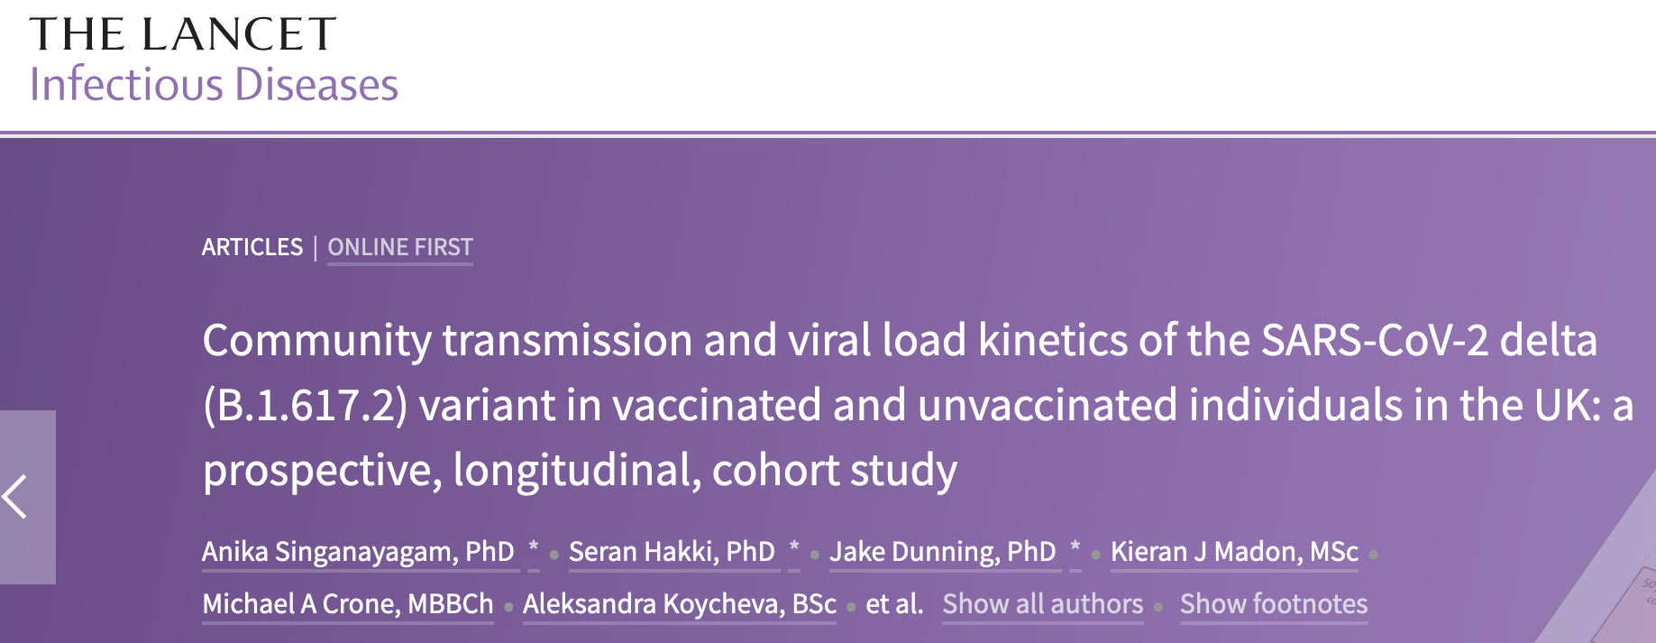
Injections do little to mitigate transmission
“our findings suggest that vaccination is not sufficient to prevent transmission of the delta variant in household settings with prolonged exposures”
“our findings highlight the importance of community studies to characterize the epidemiological phenotype of new SARS-CoV-2 variants in increasingly highly vaccinated populations”
“the delta variant continues to cause a high burden of cases even in countries with high vaccination coverage”

Slide 16
Other tools include natural immunity with support and chemoprophylaxis
Prophylactic treatments – off-label pharmaceuticals
Natural immunity course with support – vitamin D, zinc, quercetin, etc…

Slide 17


Off-label re-purposed drug effectiveness

Slide 18
ie: Ivermectin
Ivermectin is an anti-parasitic medicine whose discovery won the Nobel Prize in 2015 for its impacts in ridding large parts of the globe of parasitic diseases via distribution of over 3.7 billion doses within public health campaigns since 1987.
Safety profile is exceedingly good.
Since 2012, numerous in-vitro studies began to report highly potent anti-viral effects against a diverse array of viruses, including SARS-CoV-2 along with numerous anti-inflammatory and immuno-modulating effects.

Slide 19
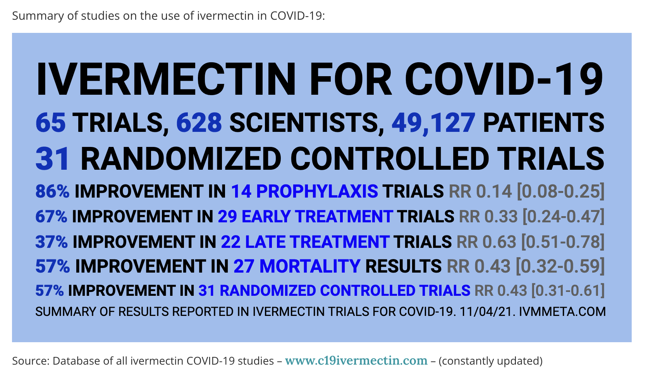

Many studies have been done…

Slide 20
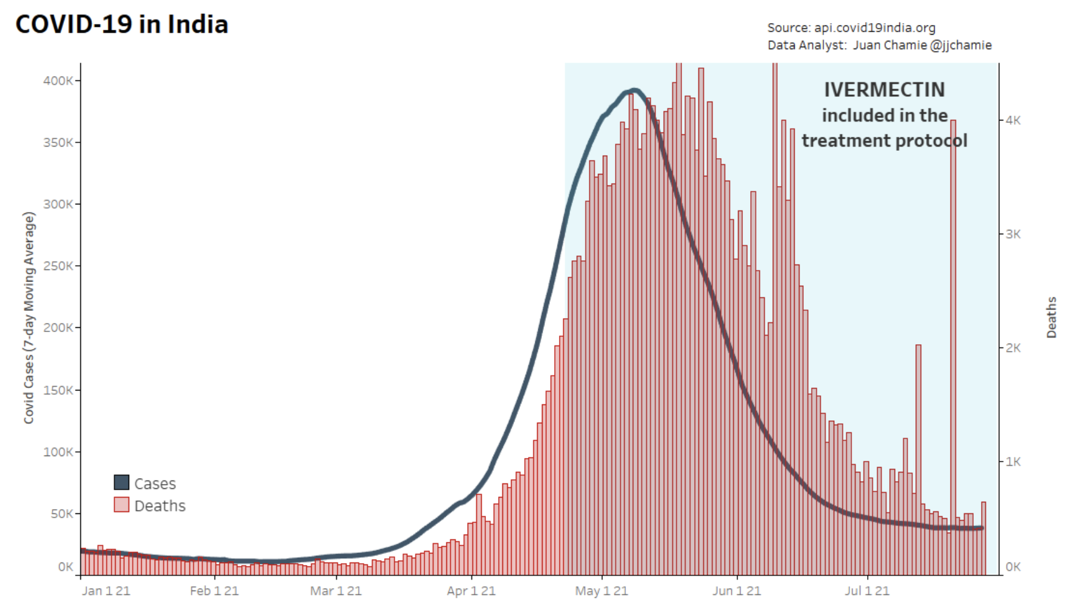
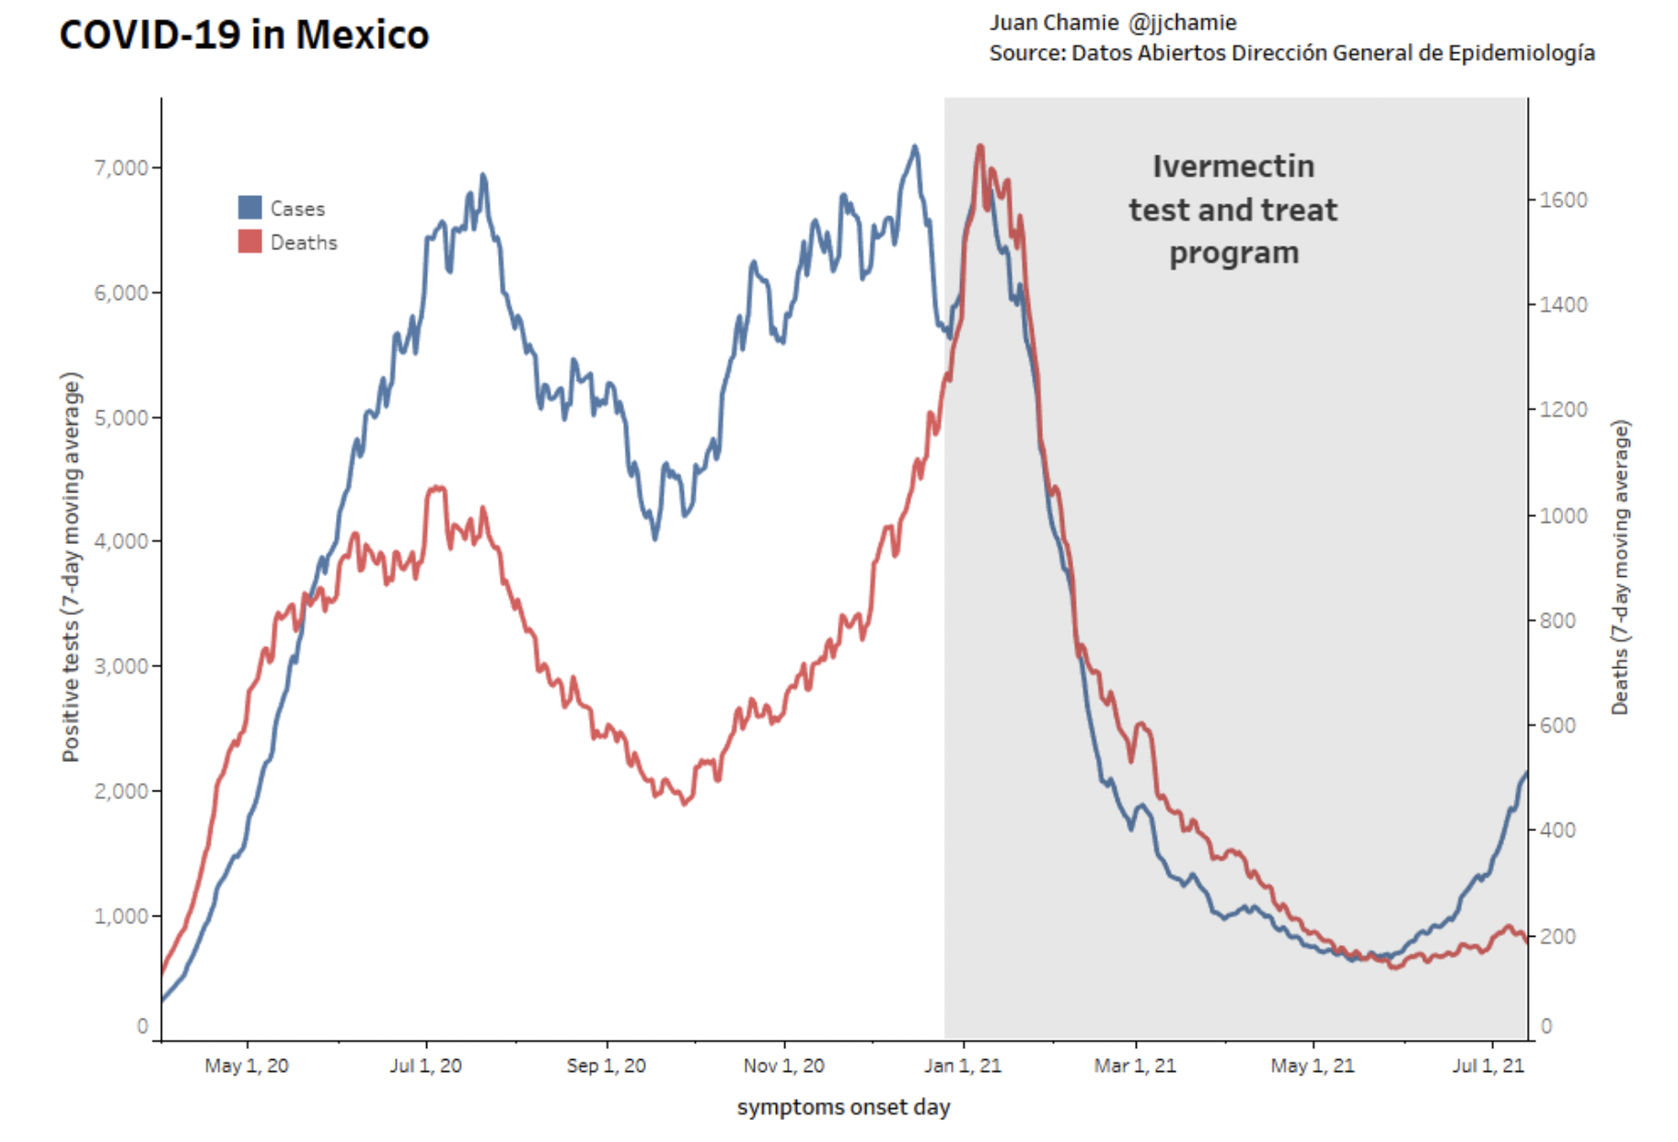

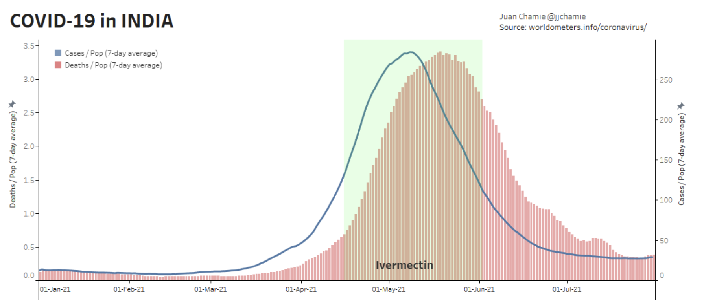
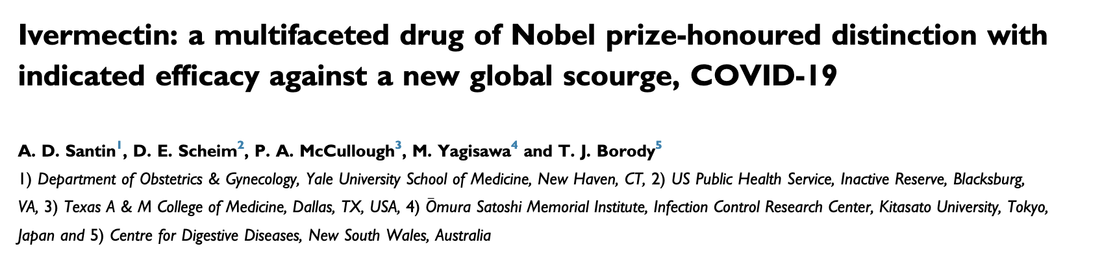
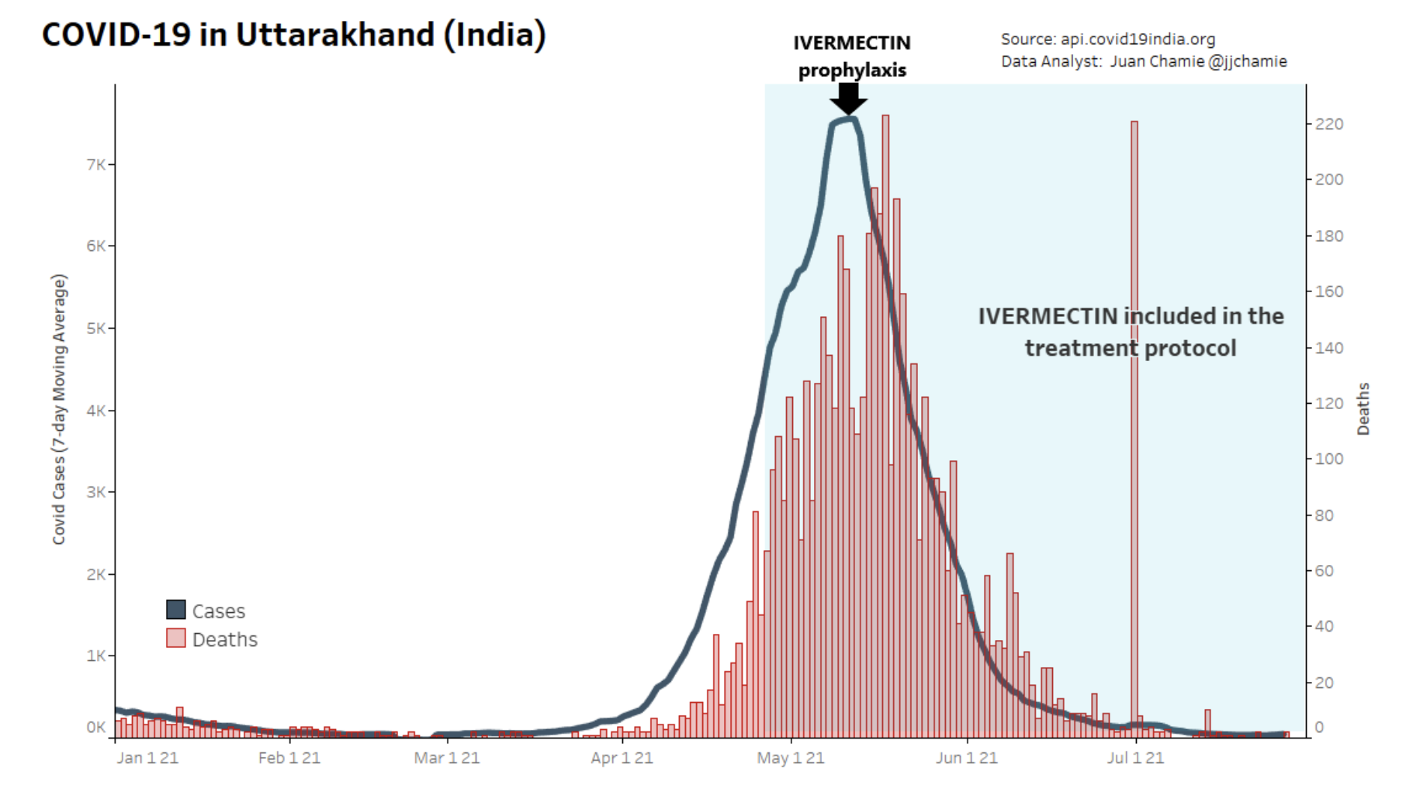
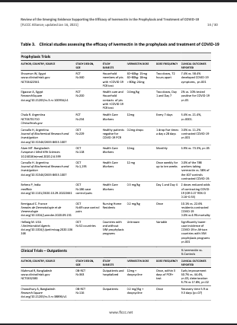
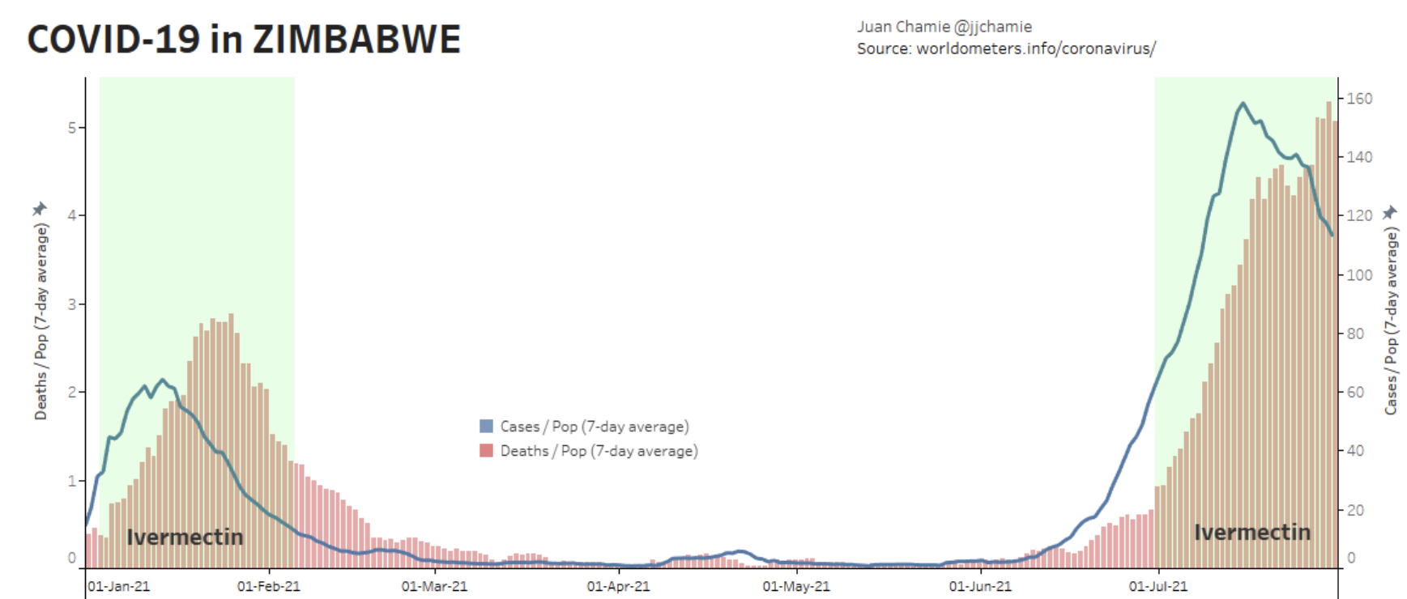
Effectiveness of Ivermectin in COVID-19 treatment protocol: PROVEN

Slide 21
Potential dangers associated with injecting children with COVID-19 products as seen in VAERS

Slide 22
Accelerated clinical trials – children < 12 not included = NO SAFETY DATA for small children = NO PREDICTABILITY OF OUTCOME
Phase I -> Phase II -> Phase III
Safety, Dosing, and Immune Responses -> Assessment of Safety and Immune Responses -> Assessment of Safety and Efficacy
*https://coronavirus.jhu.edu/vaccines/timeline

Slide 23
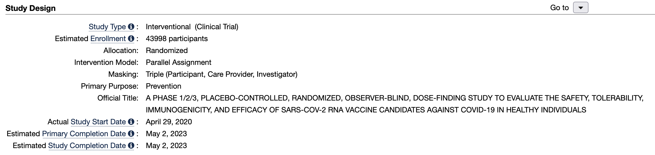
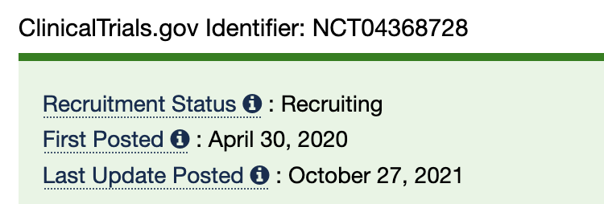
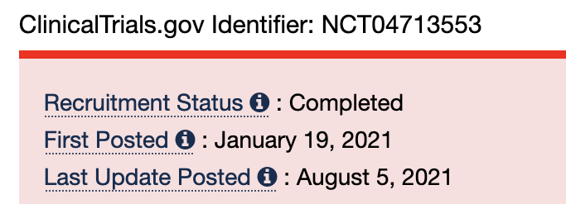
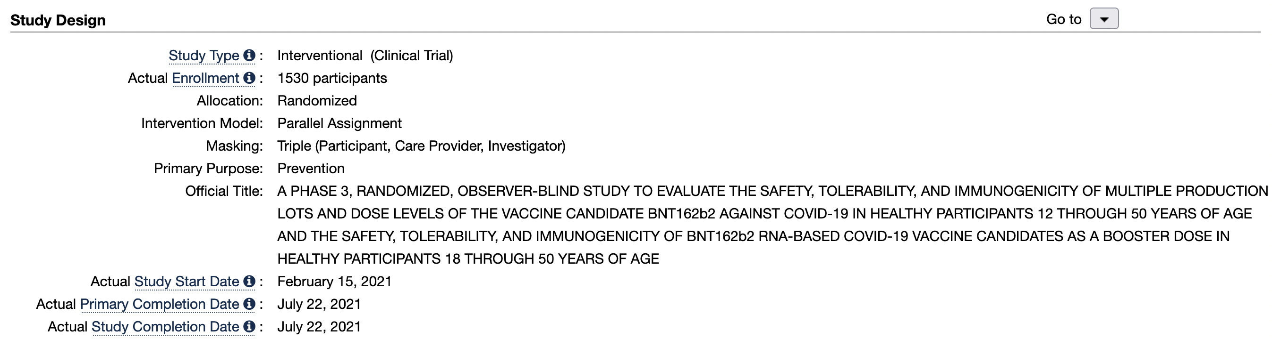
exclusion criteria list of Phase III Pfizer trial NCT04368728 and NCT04713553
The ‘safety’ studies lasted <5 months and children < 13 years of age were NOT INCLUDED.

Slide 24
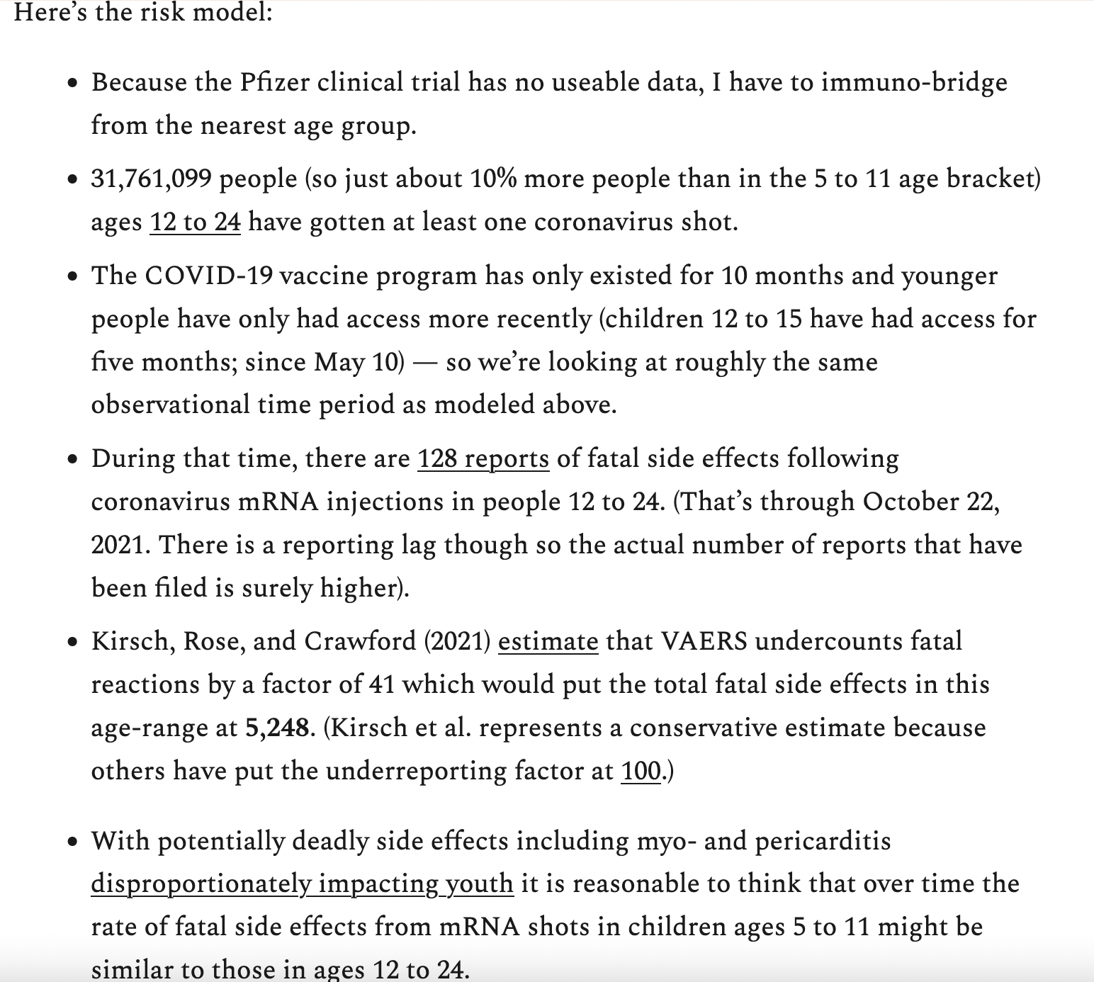
Number needed to vaccinate (NNTV) calculation
“For every one child saved by the shot, another 117 would be killed by the shot.”
Toby Rogers, ‘What is the Number Needed to Vaccinate (NNTV) to prevent a single COVID-19 fatality in kids 5 to 11 based on the Pfizer EUA application?’ 2021

Slide 25
Total VAERS counts for the past decade
This is a 1,514% increase. Since the excess in AEs are NOT due to excess in doses administered*, what explains this?
mean for the past decade = 39,218
Atypical is an understatement…
*Josh Guetzkow. Adverse Events Reported Following COVID-19 Vaccinations (unpublished data). https://tinyurl.com/CovidvFluReport

Slide 26
Total VAERS death counts for the past decade
This is a 6,050% increase. Since the excess in AEs are NOT due to excess in doses administered*, what explains this?
mean for the past decade = 155
Atypical is an understatement…
*Josh Guetzkow. Adverse Events Reported Following COVID-19 Vaccinations (unpublished data). https://tinyurl.com/CovidvFluReport

Slide 27
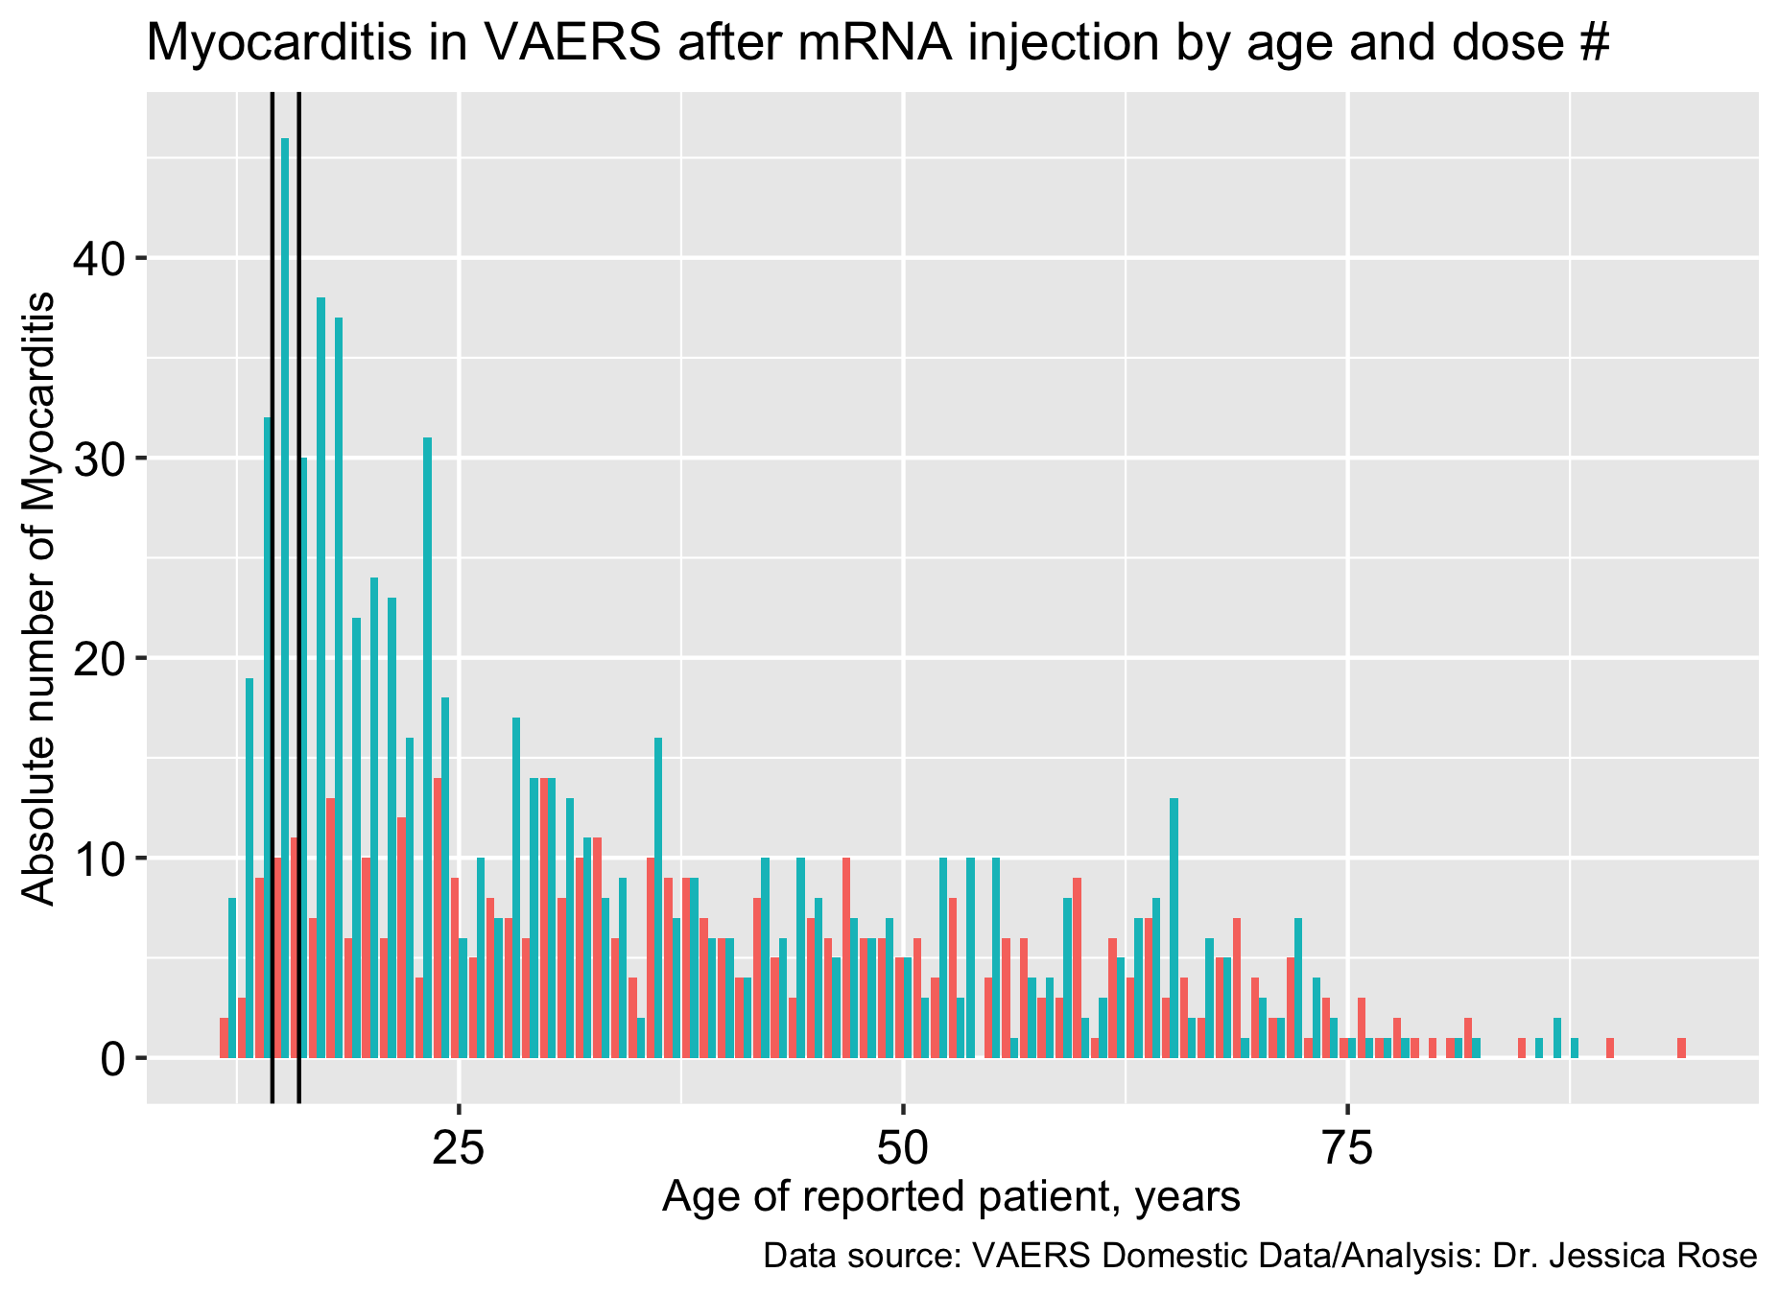
Boys: 15 years old
Dose 1
Dose 2
Updated: NOVEMBER 5th, 2021

Slide 28
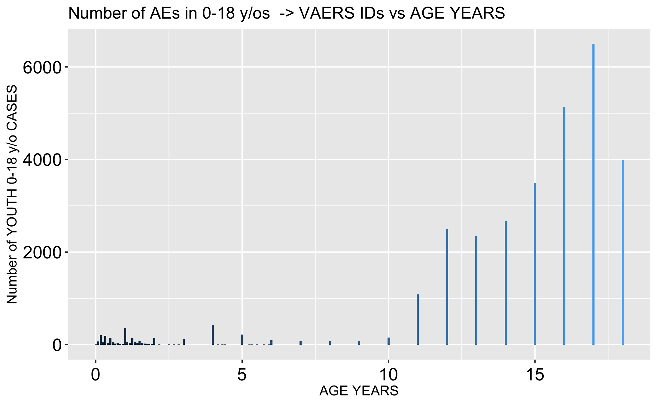
Tens of thousands of reports have been filed to VAERS for children aged 0-18
7547 children aged 0-18 reported “Product administered to patient of inappropriate age” – 2 died (11 and 13 years old)
68 children have died -
(30%) of them were less than 2 years old

Slide 29
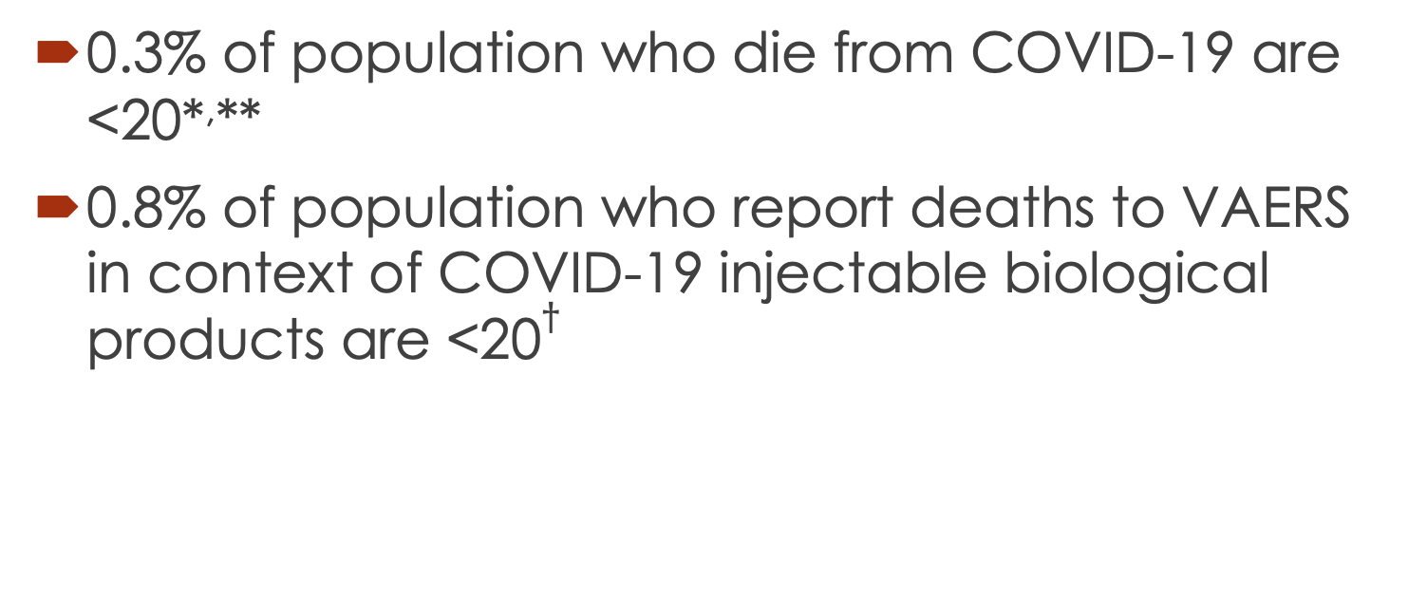
Risk of death in children higher from injections than from COVID-19
0.3% of population who die from COVID-19 are <20*,**
0.8% of population who report deaths to VAERS in context of COVID-19 injectable biological products are <20$†$
*Bhopal S, Bagaria J, Bhopal R. Children's mortality from COVID-19 compared with all-deaths and other relevant causes of death: epidemiological information for decision-making by parents, teachers, clinicians and policymakers. Public Health. 2020;185:19-20. doi:10.1016/j.puhe.2020.05.047
** https://data.unicef.org/topic/child-survival/covid-19/
$†$VAERS Domestic Data Analysis: Dr. Jessica Rose

Slide 30
Risk of death in children higher from injections than from COVID-19
THE INJECTIONS ARE ASSOCIATED WITH 2.7 TIMES MORE DEATH and we have only just started the roll-out into young people.

Slide 31
What problem are we trying to solve?
Protect Children?
Protect Others (families/teachers)?
In either case vaccinating children is unnecessary
  Protecting children is unnecessary as they have effectively zero risk from the virus, and by vaccinating miss the opportunity to develop long-lasting herd natural immunity
  Immune pressure towards escape variants and perpetuation of the problem, by vaccinating kids. Risk from infection is non-zero.
  Protecting others is unnecessary as they (theoretically) already benefit from the effect of reduced risk of severe outcomes due to injection and boosters (focus of injections should be at-risk populations i.e. to reduce effect of virus, as injections do little to mitigate transmission).
  Other tools include natural immunity with support and chemoprophylaxis (for rest of population, as children are not at risk).

Slide 32
Recommendations
immune system = best
promote early treatment with known efficacious and safe drugs
Acknowledgements
Enormous thanks to Steve Kirsch, Dr. Peter McCullough, Dr. Robert Malone, Dr. Byram Bridle, Dr. Stephanie Seneff, Mathew Crawford, Dr. Ira Bernstein, Robert Kennedy, Dr. Pierre Kory, Tess Lawrie, Shabnam Palesa Mohamed, Dr. Bret Weinstein, Dr. Andy Wakefield, Jilly Rubenstein, Joshua Guetzkow, Dr. James Lyons Weiler, Dr. Rafael Zioni, Ilana Rachel Daniel, Matthew Guthrie, Liz Willner and all the others who are trying to keep doing science properly. I really appreciate you.

