Slide 1

If you care about Israel: do not mass vaccinate the children - an immunological perspective.
Dr. Jessica Rose
December, 2021

Slide 2
Today
Never mass vaccinate a population with a non-sterilizing product across all age groups during a pandemic.
Geert Vanden Bossche, DVM, PhD
Needless COVID-19 is not a childhood disease
Harmful Adverse events/no safety data
Dangerous Potential for driving variants of concern

Slide 3
Today
Never mass vaccinate a population with a non-sterilizing product across all age groups during a pandemic.
Geert Vanden Bossche, DVM, PhD
Needless COVID-19 is not a childhood disease
Harmful Adverse events/no safety data
Dangerous Potential for driving variants of concern

Slide 4
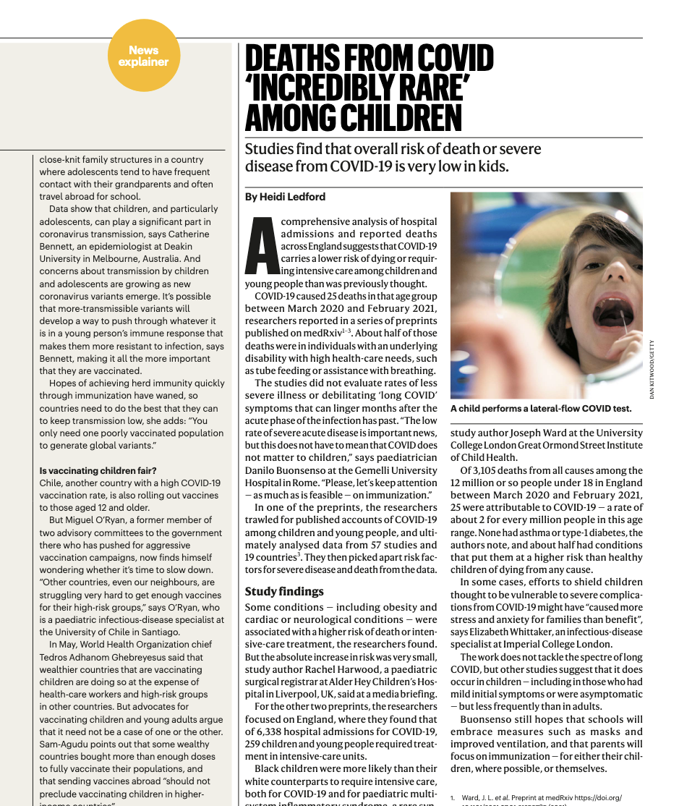
Why is it Needless?
“In reviewing the medical literature and news reports, and in talking to pediatricians across the country, I am not aware of a single healthy child in the U.S. who has died of COVID-19 to date,” Marty Makary (Johns Hopkins) wrote in a recent essay at MedPage Today. He is the editor-in-chief of the medical news publication.
COVID-19 does not affect children
Powerful FIRST LINE OF IMMUNE DEFENSE
These include pre-(existing)/primed antibodies (from B1 cells) and Natural Killer cells
Results in PREVENTION OF INFECTION OF CELLS -> PREVENTION OF DISEASE
Sunil S Bhopal, Jayshree Bagaria, Bayanne Olabi, Raj Bhopal. Children and young people remain at low risk of COVID-19 mortality. The Lancet/Child and Adolescent Health. Correspondence| Volume 5, ISSUE 5, e12-e13, May 01, 2021. Published:March 10, 2021. DOI:https://doi.org/10.1016/S2352-4642(21)00066-3.

Slide 5
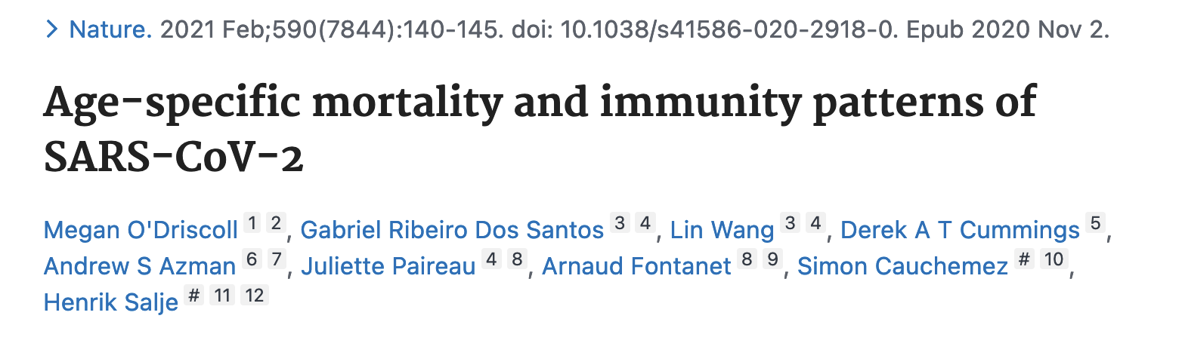
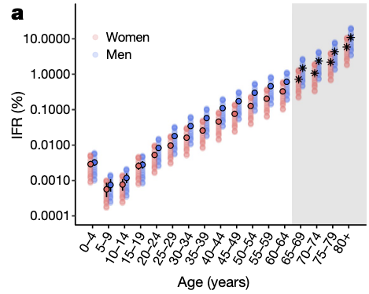
Why is it Needless?
*Makary shares that no one at Johns Hopkins has systematically investigated the cause of each child's death, in an effort to determine if COVID was actually involved or if the death was the result of a preexisting condition.
Infection Fatality Rate (IFR) for children is nil
“In the United States, a total of 335 children under 18 have died with a COVID-19 diagnosis on their death certificate.⁵”
*Dr. Marty Makary, a professor at Johns Hopkins University School of Medicine and editor-in chief of MedPage Today
O’Driscoll, M., Ribeiro Dos Santos, G., Wang, L. et al. Age-specific mortality and immunity patterns of SARS-CoV-2. Nature 590, 140–145 (2021). https://doi.org/10.1038/s41586-020-2918-0

Slide 6
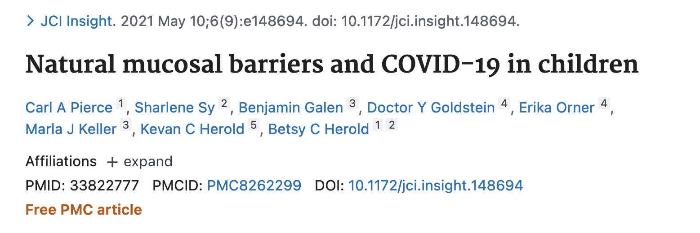
Why is it Needless?
“the more robust early innate immune response to SARS coronavirus 2 (SARS-CoV-2) as observed in children protects against severe disease”
“Children displayed higher expression of genes associated with IFN signaling, NLRP3 inflammasome, and other innate pathways.”
“Higher levels of IFN-α2, IFN-γ, IP-10, IL-8, and IL-1β protein were detected in nasal fluid in children versus adults”
“Children also expressed higher levels of genes associated with immune cells, whereas expression of those associated with epithelial cells did not differ in children versus adults.”
Pierce CA, Sy S, Galen B, Goldstein DY, Orner E, Keller MJ, Herold KC, Herold BC. Natural mucosal barriers and COVID-19 in children. JCI Insight. 2021 May 10;6(9):e148694. doi: 10.1172/jci.insight.148694. PMID: 33822777; PMCID: PMC8262299.

Slide 7
Why is it Needless?
“Children who get COVID-19 develop mild to moderate disease and as a result continue to contribute to herd immunity by developing broad and long-lived immunity.”
Dr. Geert Vanden Bossche*
Children are NOT vectors for COVID-19
“… normally/naturally largely protects them and provides a kind of herd immunity in that it dilutes infectious CoV pressure at the level of the population, whereas mass vaccination turns them into shedders of more infectious variants.”
Dr. Klara M. Posfay-Barbe concludes in the journal Pediatrics:
“…that children infrequently transmit COVID-19 to adults.”
*Geert Vanden Bossche, DMV, PhD, independent virologist and vaccine expert, formerly employed at GAVI and The Bill & Melinda Gates Foundation, sends open call to all authorities, scientists and experts around the world, to whom this concerns: the entire world population.

Slide 8
Today
Never mass vaccinate a population with a non-sterilizing product across all age groups during a pandemic.
Geert Vanden Bossche, DVM, PhD
Needless COVID-19 is not a childhood disease
Harmful Adverse events/no safety data
Dangerous Potential for driving variants of concern

Slide 9
Why is it Harmful?
In the phase 2-3 trial, a total of 2268 children were randomly assigned to receive the BNT162b2 vaccine (1517 children) or placebo (751 children). They were only followed for 2 months.
Accelerated clinical trials – children < 13 not included = NO SAFETY DATA for small children = NO PREDICTABILITY OF OUTCOME
*https://coronavirus.jhu.edu/vaccines/timeline
Phase I -> Phase II -> Phase III
Safety, Dosing, and Immune Responses -> Assessment of Safety and Immune Responses -> Assessment of Safety and Efficacy
Walter EB, et al.; C4591007 Clinical Trial Group. Evaluation of the BNT162b2 Covid-19 Vaccine in Children 5 to 11 Years of Age. N Engl J Med. 2021 Nov 9:NEJMoa2116298. doi: 10.1056/NEJMoa2116298. Epub ahead of print. PMID: 34752019; PMCID: PMC8609605.

Slide 10
Why is it Harmful?
Vaccine Adverse Events Reporting System (VAERS) – U.S. government database (CDC/FDA)

Slide 11
Why is it Harmful?

Slide 12
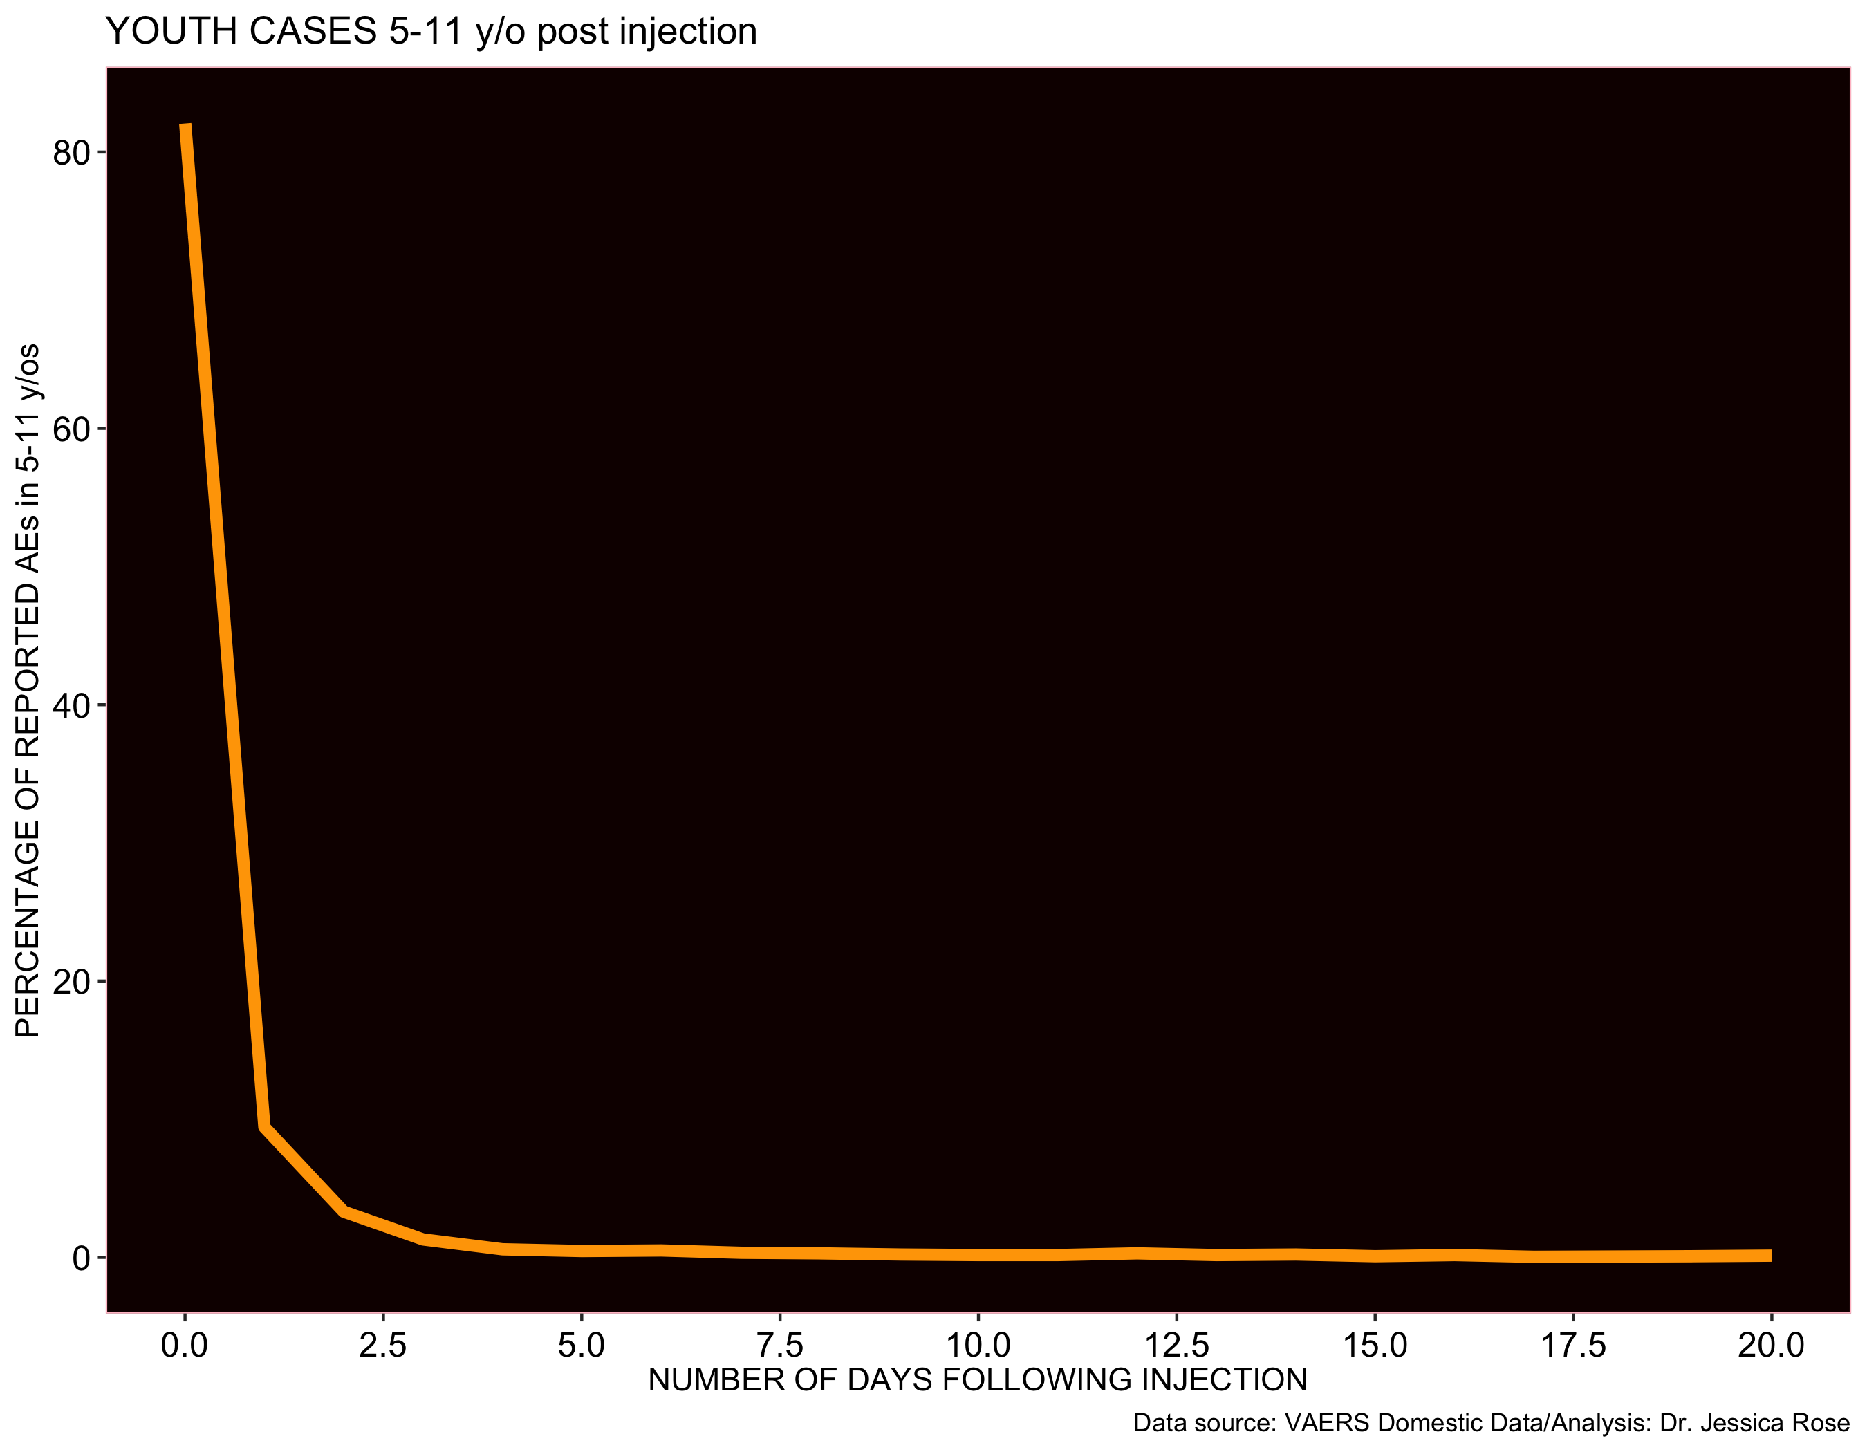
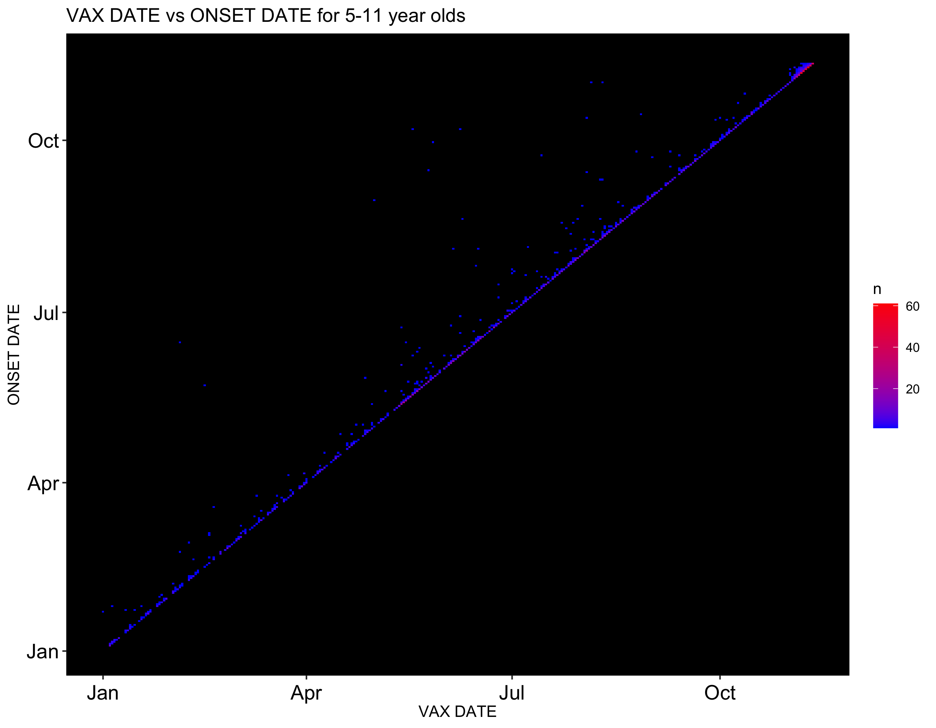
Why is it Harmful?
Potential dangers associated with injecting children with COVID-19 products as seen in VAERS
Temporal association – 82% of reports filed to VAERS for children aged 5-11 were made IMMEDIATELY

Slide 13
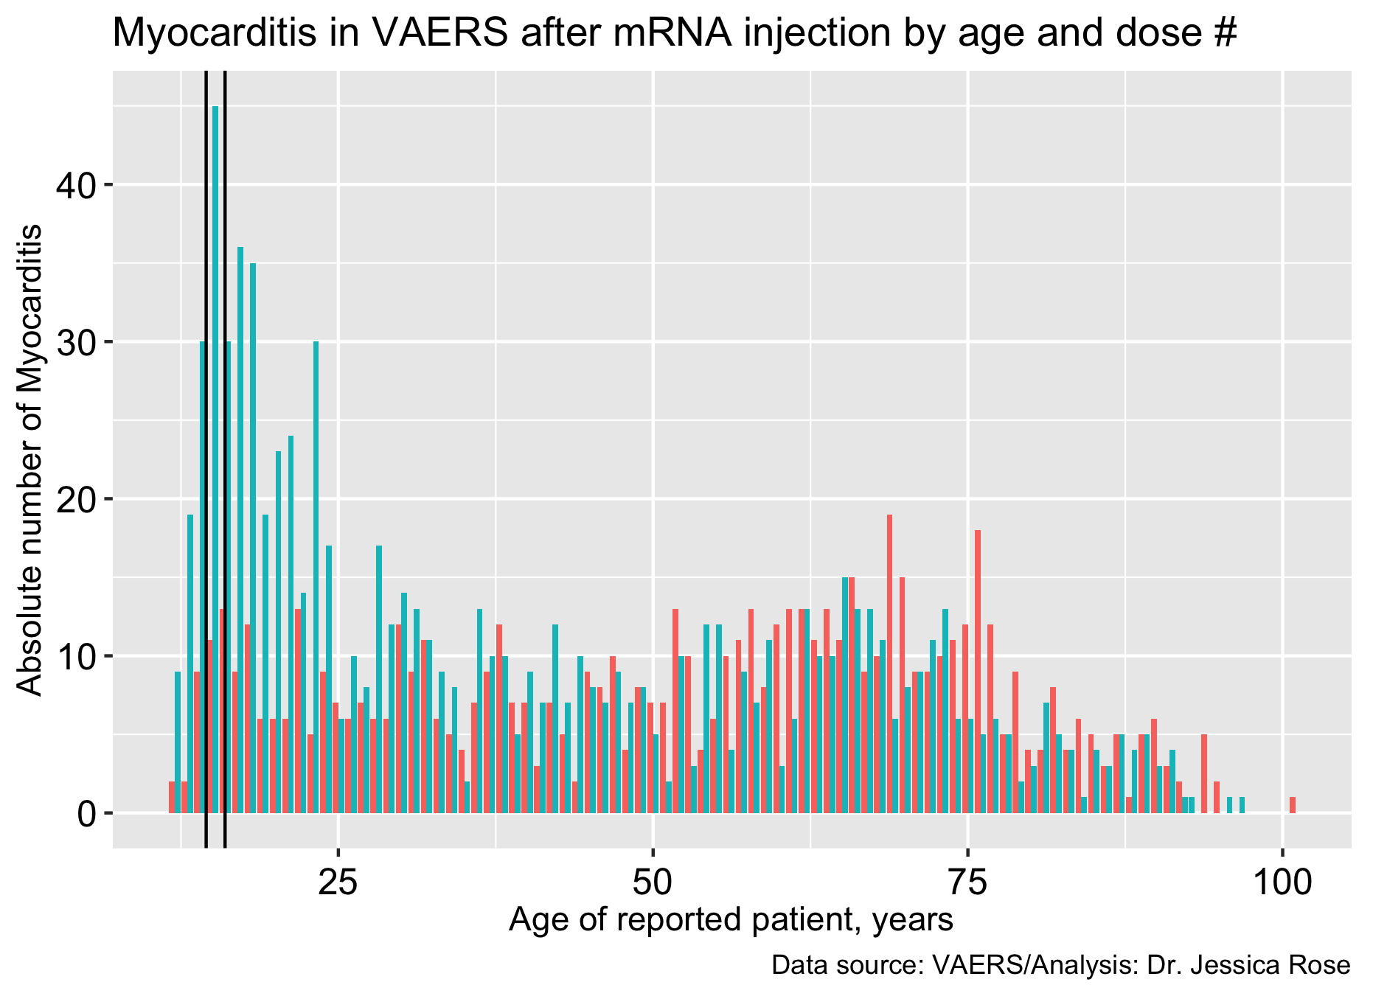
Why is it Harmful?
Myocarditis in young boys (androgens)
Dose 2 effect
NOT MILD AND NOT TRANSIENT
Boys: 15 years old
Dose 1
Dose 2

Slide 14
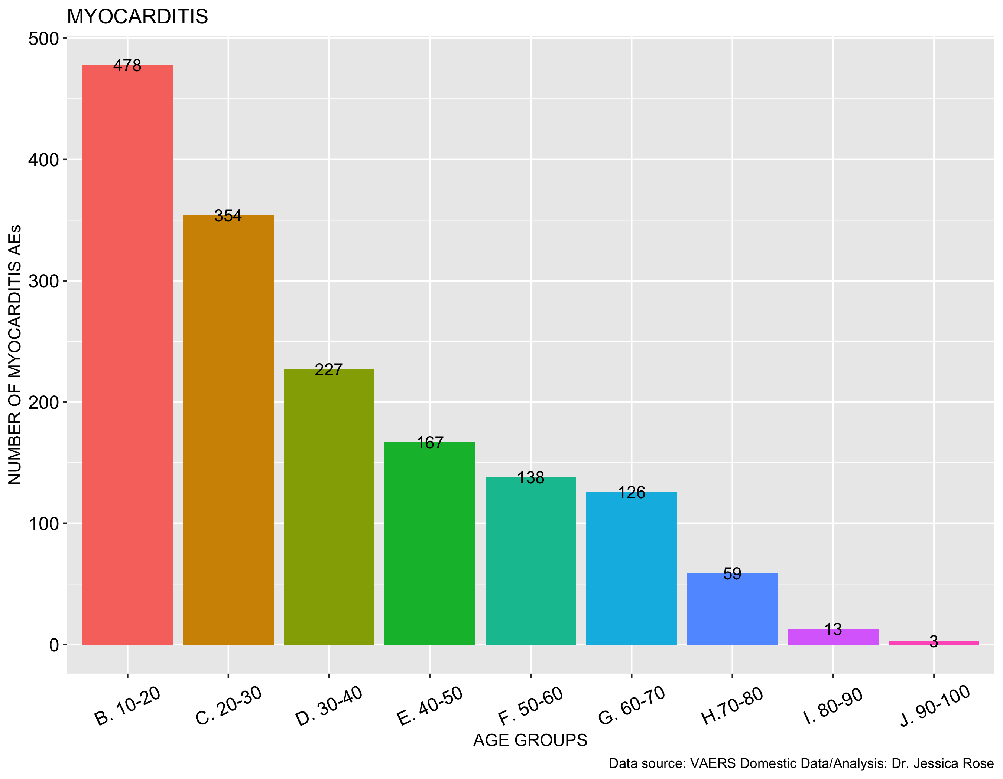
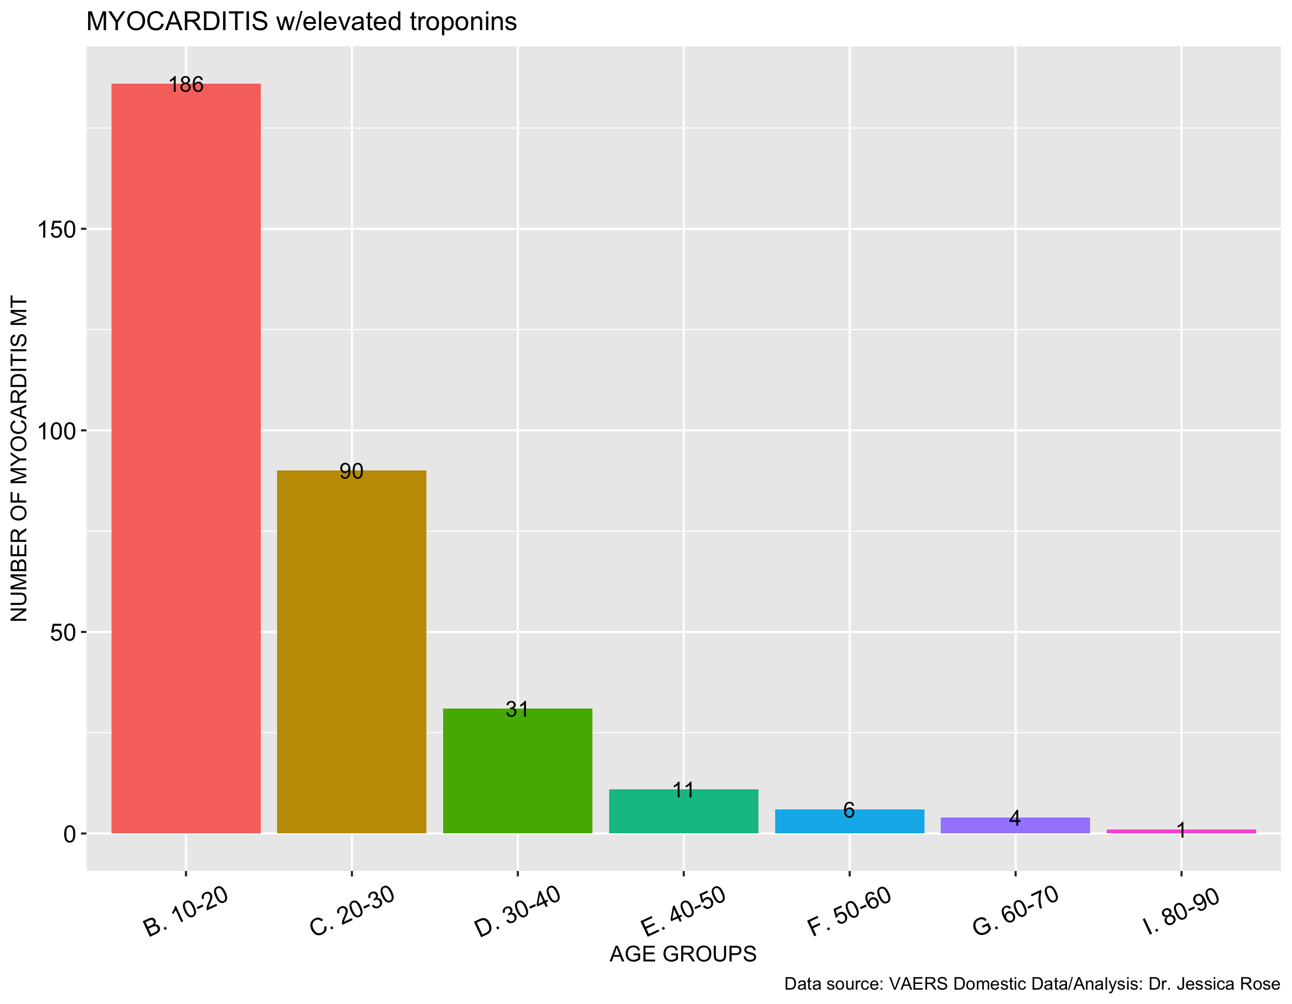
Why is it Harmful?
Myocarditis associated with elevated troponins (markers of heart damage)
N=1,742
N=341
Histogram showing all myocarditis reports in VAERS by age group
Histogram showing all myocarditis reports in VAERS by age group associated with elevated troponins

Slide 15
Why is it Harmful?
Myocarditis not MILD – 69% of reports are associated with HOSPITALIZATION
Variable N (% total) | Myocarditis N = 1743 | Myocarditis w/elevated troponin N = 341 | Myocarditis w/o elevated troponin N = 1402 | Myocarditis Children 0-20 N = 489
Death | 34 (2) | 0 (0) | 34 (2.4) | 1 (0.2)
Hospital | 941 (54) | 252 (74) | 689 (49) | 338 (69.1)
ER | 727 (42) | 124 (36.4) | 603 (43) | 192 (39.3)
Covid Cases§ | 12 (0.7) | 1 (0.3) | 11 (0.8) | 1 (0.2)
Chest Pain | 696 (40) | 174 (51) | 522 (37.2) | 278 (56.9)

