Slide 1
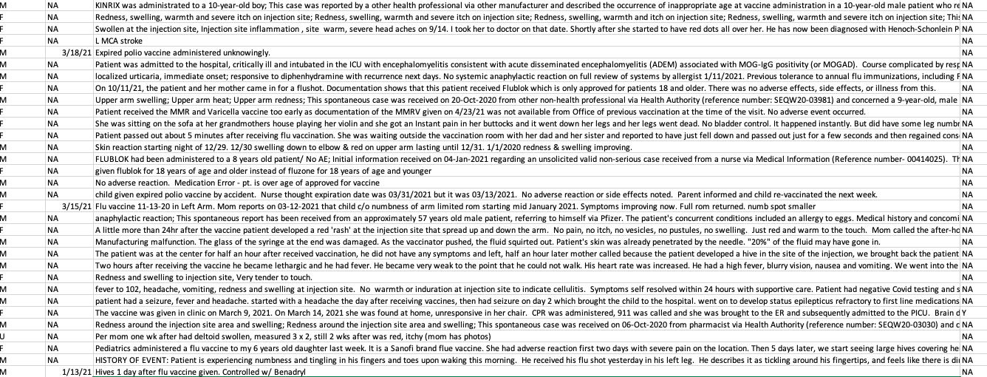
Slides for video presentation for unreasonable failure by the Secretary of the Therapeutic Goods
Administration to stop injection roll outs
Dr. Jessica Rose
December 2021

Slide 2
Background
What is VAERS?
What is an adverse event (AE)?
What is a severe adverse event (SAE)?
Pharmacovigilance in VAERS – detection of AEs not recognized in pre-market testing
Under-reporting and under-recording a problem
HUNDREDS OF THOUSANDS of AEs have been reported to VAERS in the context of the COVID-19 injectable products

Slide 3
Talking points
SAFETY - AE counts/ratios, the backlog and the URF/PRR/Causation
Myocarditis/Female Reproductive Issues/Kids
EFFICACY - Variants -> Delta
Breakthrough infections/Epigenetic pressure/Why it is a bad idea to inject kids

Slide 4
Safety and efficacy in biologicals development and administration
*https://coronavirus.jhu.edu/vaccines/timeline
Notes:
Risk: A measure of the probability of an adverse event or untoward outcome occurring and the severity of the resultant harm to health of individuals in a defined population associated with use of a medical technology applied for a given medical problem under specified conditions of use.
Safety: A judgement of the acceptability of risk in a specified situation.
Efficacy: The probability of benefit to individuals in a defined population from a medical technology applied for a given medical problem under ideal conditions of use.
Preclinical testing of vaccine candidates typically starts in animal models, first in small mammals such as mice or rats and then non-human primates such as monkeys. Preclinical studies are important for eliminating potential vaccines that are either toxic or do not induce protective immune responses. But many vaccines that appear to be safe and induce protective immune responses in animals fail in human studies. Only vaccine candidates that are very promising in preclinical testing move forward into phase I clinical trials.
Phase I clinical trials are the first step in assessing vaccines in people. Typically involving one to several dozen healthy volunteers, phase I trials assess short-term safety (e.g., soreness at the site of injection, fever, muscle aches) and immune responses, often with different vaccine dosages. Only if a vaccine candidate is shown to be safe in phase I trials will it move to larger phase II trials.
Phase II clinical trials continue to assess safety and immune responses but in a larger number and more diverse group of volunteers, typically one to several hundred people. Phase II trials may include target populations of a specific age or sex, or those with underlying medical conditions. Vaccines for children start with adult volunteers and move to progressively younger groups of children. Different types of immune responses are often measured, including antibodies and cell-mediated immunity, but phase II trials do not assess how well a vaccine actually works. Only in phase III trials is vaccine efficacy assessed.
Phase III clinical trials are critical to understanding whether vaccines are safe and effective. Phase III trials often include tens of thousands of volunteers. Participants are chosen at random to receive the vaccine or a placebo. In Phase III, participants and most of the study investigators do not know who has received the vaccine and who received the placebo. Participants are then followed to see how many in each group get the disease. Assessing short- and long-term safety is also a major goal of phase 3 trials.

Slide 5
A typical vaccine development timeline takes 5 to 10 years, and sometimes longer, to assess whether the vaccine is safe and efficacious in clinical trials, complete the regulatory approval processes, and manufacture sufficient quantity of vaccine doses for widespread distribution.*
*https://coronavirus.jhu.edu/vaccines/timeline
Notes:
Risk: A measure of the probability of an adverse event or untoward outcome occurring and the severity of the resultant harm to health of individuals in a defined population associated with use of a medical technology applied for a given medical problem under specified conditions of use.
Safety: A judgement of the acceptability of risk in a specified situation.
Efficacy: The probability of benefit to individuals in a defined population from a medical technology applied for a given medical problem under ideal conditions of use.
Preclinical testing of vaccine candidates typically starts in animal models, first in small mammals such as mice or rats and then non-human primates such as monkeys. Preclinical studies are important for eliminating potential vaccines that are either toxic or do not induce protective immune responses. But many vaccines that appear to be safe and induce protective immune responses in animals fail in human studies. Only vaccine candidates that are very promising in preclinical testing move forward into phase I clinical trials.
Phase I clinical trials are the first step in assessing vaccines in people. Typically involving one to several dozen healthy volunteers, phase I trials assess short-term safety (e.g., soreness at the site of injection, fever, muscle aches) and immune responses, often with different vaccine dosages. Only if a vaccine candidate is shown to be safe in phase I trials will it move to larger phase II trials.
Phase II clinical trials continue to assess safety and immune responses but in a larger number and more diverse group of volunteers, typically one to several hundred people. Phase II trials may include target populations of a specific age or sex, or those with underlying medical conditions. Vaccines for children start with adult volunteers and move to progressively younger groups of children. Different types of immune responses are often measured, including antibodies and cell-mediated immunity, but phase II trials do not assess how well a vaccine actually works. Only in phase III trials is vaccine efficacy assessed.
Phase III clinical trials are critical to understanding whether vaccines are safe and effective. Phase III trials often include tens of thousands of volunteers. Participants are chosen at random to receive the vaccine or a placebo. In Phase III, participants and most of the study investigators do not know who has received the vaccine and who received the placebo. Participants are then followed to see how many in each group get the disease. Assessing short- and long-term safety is also a major goal of phase 3 trials.

Slide 6
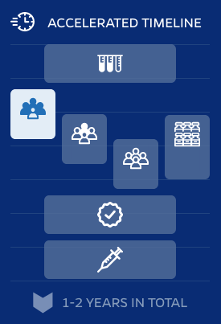
Phase I -> Phase II -> Phase III
Safety, Dosing, and Immune Responses -> Assessment of Safety and Immune Responses -> Assessment of Safety and Efficacy
TYPICAL TIMELINE
ACCELERATED TIMELINE
Typical
COVID
Animal testing – years
Phase I – 3 months
Phase II – 2 years
Phase III – several years
Manufacturing
FDA approval
Safety monitoring - years
The total amount of time taken for Pfizer/BioNTech Phase III trial was 6 months
Animal testing
Animal testing
Manufacturing
Manufacturing
Phase III
Phase III
Phase I
Phase I
Phase II
Phase II
FDA approval
FDA approval
Safety monitoring
Safety monitoring
5-10 YEARS IN TOTAL
1-2 YEARS IN TOTAL
*https://coronavirus.jhu.edu/vaccines/timeline
Notes:
Risk: A measure of the probability of an adverse event or untoward outcome occurring and the severity of the resultant harm to health of individuals in a defined population associated with use of a medical technology applied for a given medical problem under specified conditions of use.
Safety: A judgement of the acceptability of risk in a specified situation.
Efficacy: The probability of benefit to individuals in a defined population from a medical technology applied for a given medical problem under ideal conditions of use.
Preclinical testing of vaccine candidates typically starts in animal models, first in small mammals such as mice or rats and then non-human primates such as monkeys. Preclinical studies are important for eliminating potential vaccines that are either toxic or do not induce protective immune responses. But many vaccines that appear to be safe and induce protective immune responses in animals fail in human studies. Only vaccine candidates that are very promising in preclinical testing move forward into phase I clinical trials.
Phase I clinical trials are the first step in assessing vaccines in people. Typically involving one to several dozen healthy volunteers, phase I trials assess short-term safety (e.g., soreness at the site of injection, fever, muscle aches) and immune responses, often with different vaccine dosages. Only if a vaccine candidate is shown to be safe in phase I trials will it move to larger phase II trials.
Phase II clinical trials continue to assess safety and immune responses but in a larger number and more diverse group of volunteers, typically one to several hundred people. Phase II trials may include target populations of a specific age or sex, or those with underlying medical conditions. Vaccines for children start with adult volunteers and move to progressively younger groups of children. Different types of immune responses are often measured, including antibodies and cell-mediated immunity, but phase II trials do not assess how well a vaccine actually works. Only in phase III trials is vaccine efficacy assessed.
Phase III clinical trials are critical to understanding whether vaccines are safe and effective. Phase III trials often include tens of thousands of volunteers. Participants are chosen at random to receive the vaccine or a placebo. In Phase III, participants and most of the study investigators do not know who has received the vaccine and who received the placebo. Participants are then followed to see how many in each group get the disease. Assessing short- and long-term safety is also a major goal of phase 3 trials.

Slide 7
Safety and Efficacy*
Risk: A measure of the probability of an adverse event or untoward outcome occurring and the severity of the resultant harm to health of individuals in a defined population associated with use of a medical technology applied for a given medical problem under specified conditions of use.
Safety: A judgement of the acceptability of risk in a specified situation.
Efficacy: The probability of benefit to individuals in a defined population from a medical technology applied for a given medical problem under ideal conditions of use.
*Book: Assessing the Efficacy and Safety of Medical Technologies: The Concepts of Efficacy and Safety

Slide 8
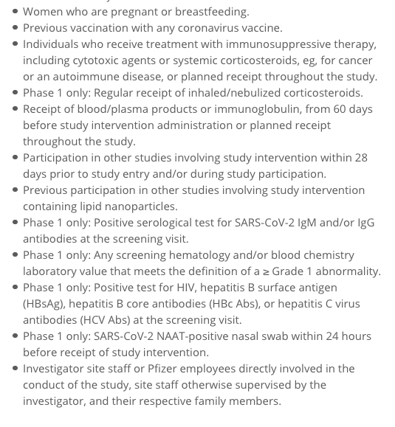
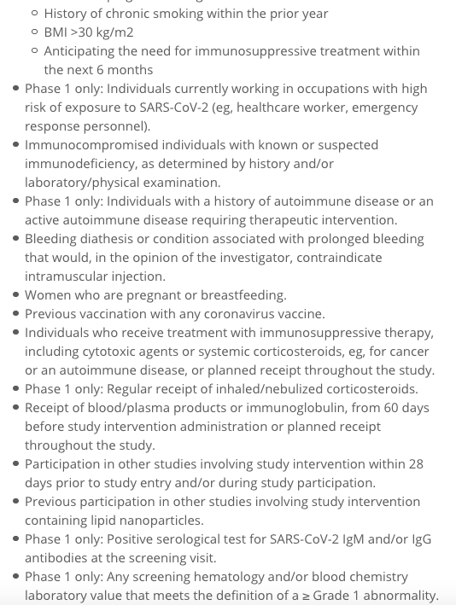
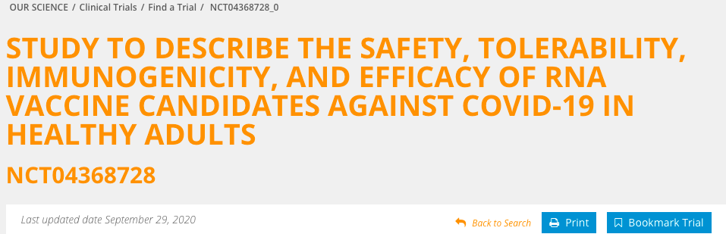
Exclusion criteria list of Phase III Pfizer trial NCT04368728
*https://coronavirus.jhu.edu/vaccines/timeline
Notes:
Risk: A measure of the probability of an adverse event or untoward outcome occurring and the severity of the resultant harm to health of individuals in a defined population associated with use of a medical technology applied for a given medical problem under specified conditions of use.
Safety: A judgement of the acceptability of risk in a specified situation.
Efficacy: The probability of benefit to individuals in a defined population from a medical technology applied for a given medical problem under ideal conditions of use.
Preclinical testing of vaccine candidates typically starts in animal models, first in small mammals such as mice or rats and then non-human primates such as monkeys. Preclinical studies are important for eliminating potential vaccines that are either toxic or do not induce protective immune responses. But many vaccines that appear to be safe and induce protective immune responses in animals fail in human studies. Only vaccine candidates that are very promising in preclinical testing move forward into phase I clinical trials.
Phase I clinical trials are the first step in assessing vaccines in people. Typically involving one to several dozen healthy volunteers, phase I trials assess short-term safety (e.g., soreness at the site of injection, fever, muscle aches) and immune responses, often with different vaccine dosages. Only if a vaccine candidate is shown to be safe in phase I trials will it move to larger phase II trials.
Phase II clinical trials continue to assess safety and immune responses but in a larger number and more diverse group of volunteers, typically one to several hundred people. Phase II trials may include target populations of a specific age or sex, or those with underlying medical conditions. Vaccines for children start with adult volunteers and move to progressively younger groups of children. Different types of immune responses are often measured, including antibodies and cell-mediated immunity, but phase II trials do not assess how well a vaccine actually works. Only in phase III trials is vaccine efficacy assessed.
Phase III clinical trials are critical to understanding whether vaccines are safe and effective. Phase III trials often include tens of thousands of volunteers. Participants are chosen at random to receive the vaccine or a placebo. In Phase III, participants and most of the study investigators do not know who has received the vaccine and who received the placebo. Participants are then followed to see how many in each group get the disease. Assessing short- and long-term safety is also a major goal of phase 3 trials.

Slide 9
Exclusion criteria list of Phase III Pfizer trial NCT04368728
Pregnant women, lactating women and women of childbearing age were on the exclusion criteria list.
The ‘safety’ studies lasted 6 months… How is it possible that pregnant woman are being injected now? There is NO SAFETY DATA pertaining to pregnant women or women of child-bearing age.
*https://coronavirus.jhu.edu/vaccines/timeline
Notes:
Risk: A measure of the probability of an adverse event or untoward outcome occurring and the severity of the resultant harm to health of individuals in a defined population associated with use of a medical technology applied for a given medical problem under specified conditions of use.
Safety: A judgement of the acceptability of risk in a specified situation.
Efficacy: The probability of benefit to individuals in a defined population from a medical technology applied for a given medical problem under ideal conditions of use.
Preclinical testing of vaccine candidates typically starts in animal models, first in small mammals such as mice or rats and then non-human primates such as monkeys. Preclinical studies are important for eliminating potential vaccines that are either toxic or do not induce protective immune responses. But many vaccines that appear to be safe and induce protective immune responses in animals fail in human studies. Only vaccine candidates that are very promising in preclinical testing move forward into phase I clinical trials.
Phase I clinical trials are the first step in assessing vaccines in people. Typically involving one to several dozen healthy volunteers, phase I trials assess short-term safety (e.g., soreness at the site of injection, fever, muscle aches) and immune responses, often with different vaccine dosages. Only if a vaccine candidate is shown to be safe in phase I trials will it move to larger phase II trials.
Phase II clinical trials continue to assess safety and immune responses but in a larger number and more diverse group of volunteers, typically one to several hundred people. Phase II trials may include target populations of a specific age or sex, or those with underlying medical conditions. Vaccines for children start with adult volunteers and move to progressively younger groups of children. Different types of immune responses are often measured, including antibodies and cell-mediated immunity, but phase II trials do not assess how well a vaccine actually works. Only in phase III trials is vaccine efficacy assessed.
Phase III clinical trials are critical to understanding whether vaccines are safe and effective. Phase III trials often include tens of thousands of volunteers. Participants are chosen at random to receive the vaccine or a placebo. In Phase III, participants and most of the study investigators do not know who has received the vaccine and who received the placebo. Participants are then followed to see how many in each group get the disease. Assessing short- and long-term safety is also a major goal of phase 3 trials.

Slide 10
Talking points
SAFETY - AE counts/ratios, the backlog and the URF/PRR/Causation
Myocarditis/Female Reproductive Issues/Kids
EFFICACY - Variants -> Delta
Breakthrough infections/Epigenetic pressure/Why it is a bad idea to inject kids

Slide 11
Total VAERS counts for the past decade
ALL VACCINES COMBINED

Slide 12
Total VAERS counts for the past decade
This is a 1,700% increase. Since the excess in AEs are NOT due to excess in doses administered*, what explains this?
ALL VACCINES COMBINED
mean for the past decade = 39,218

Slide 13
Total VAERS counts for the past decade
This is a 6,900% increase. Since the excess in AEs are NOT due to excess in doses administered*, what explains this?
ALL VACCINES COMBINED
mean for the past decade = 155

Slide 14
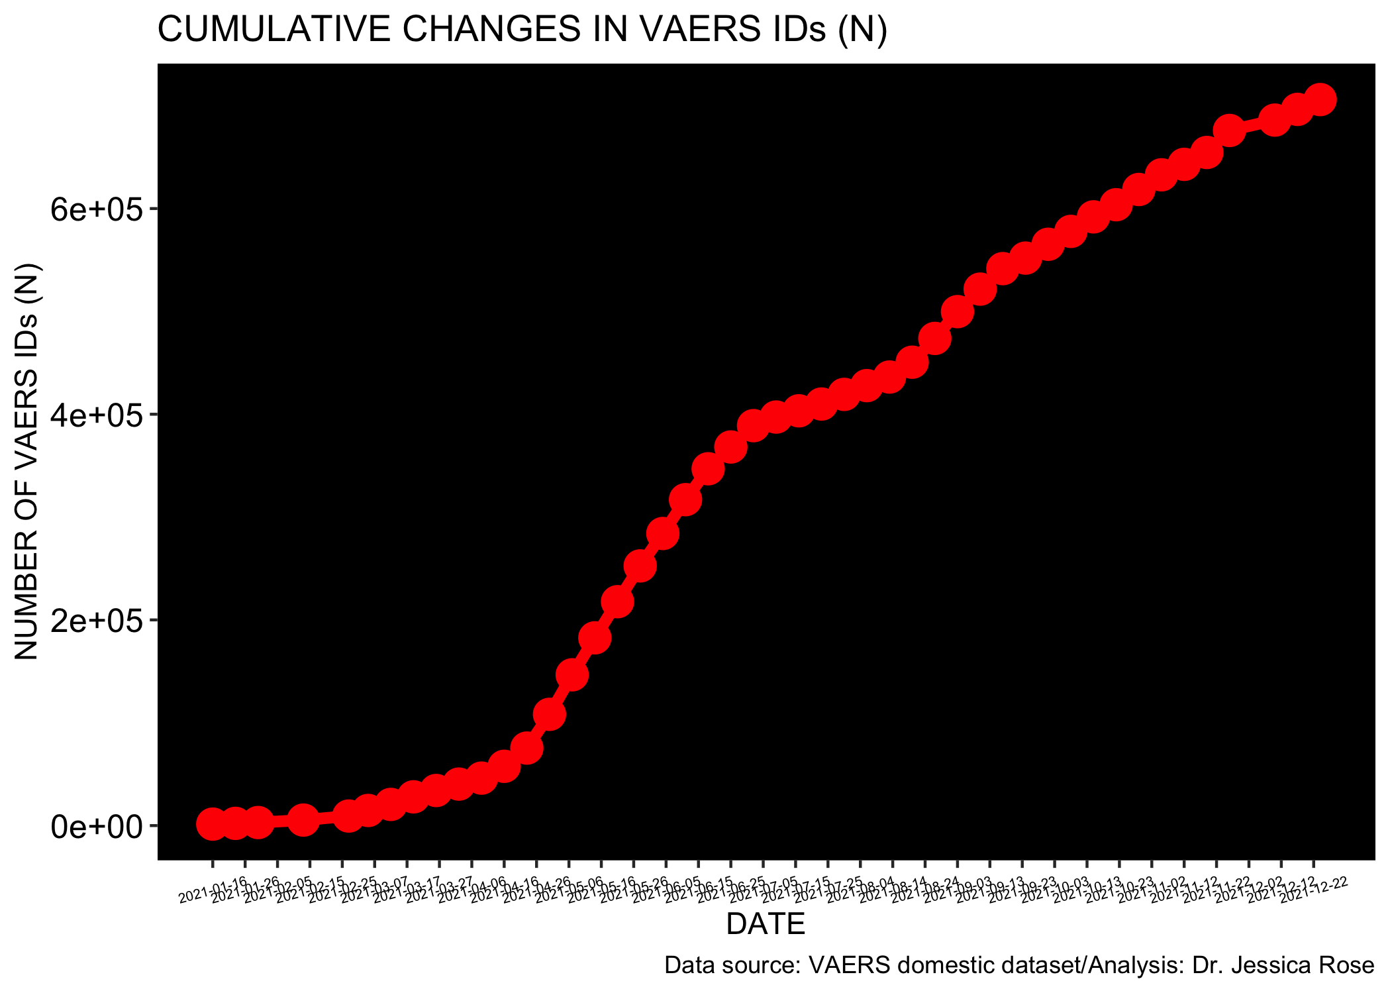
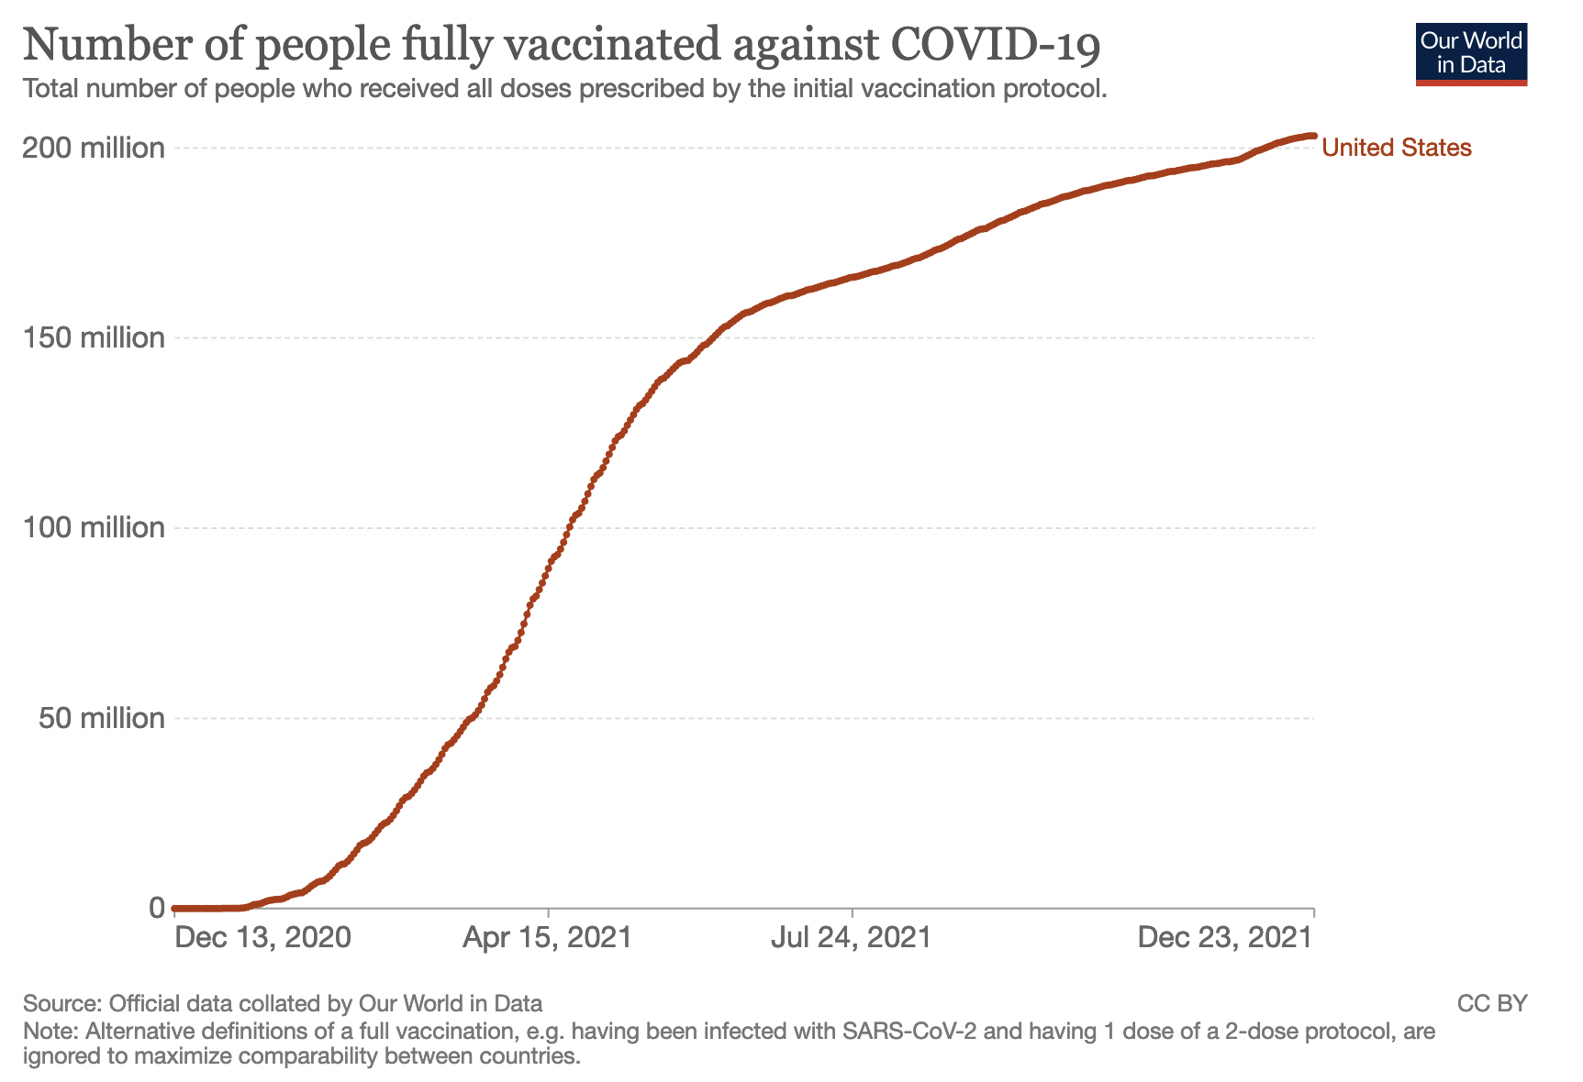
Comparison of cumulative AE counts from VAERS database

Slide 15
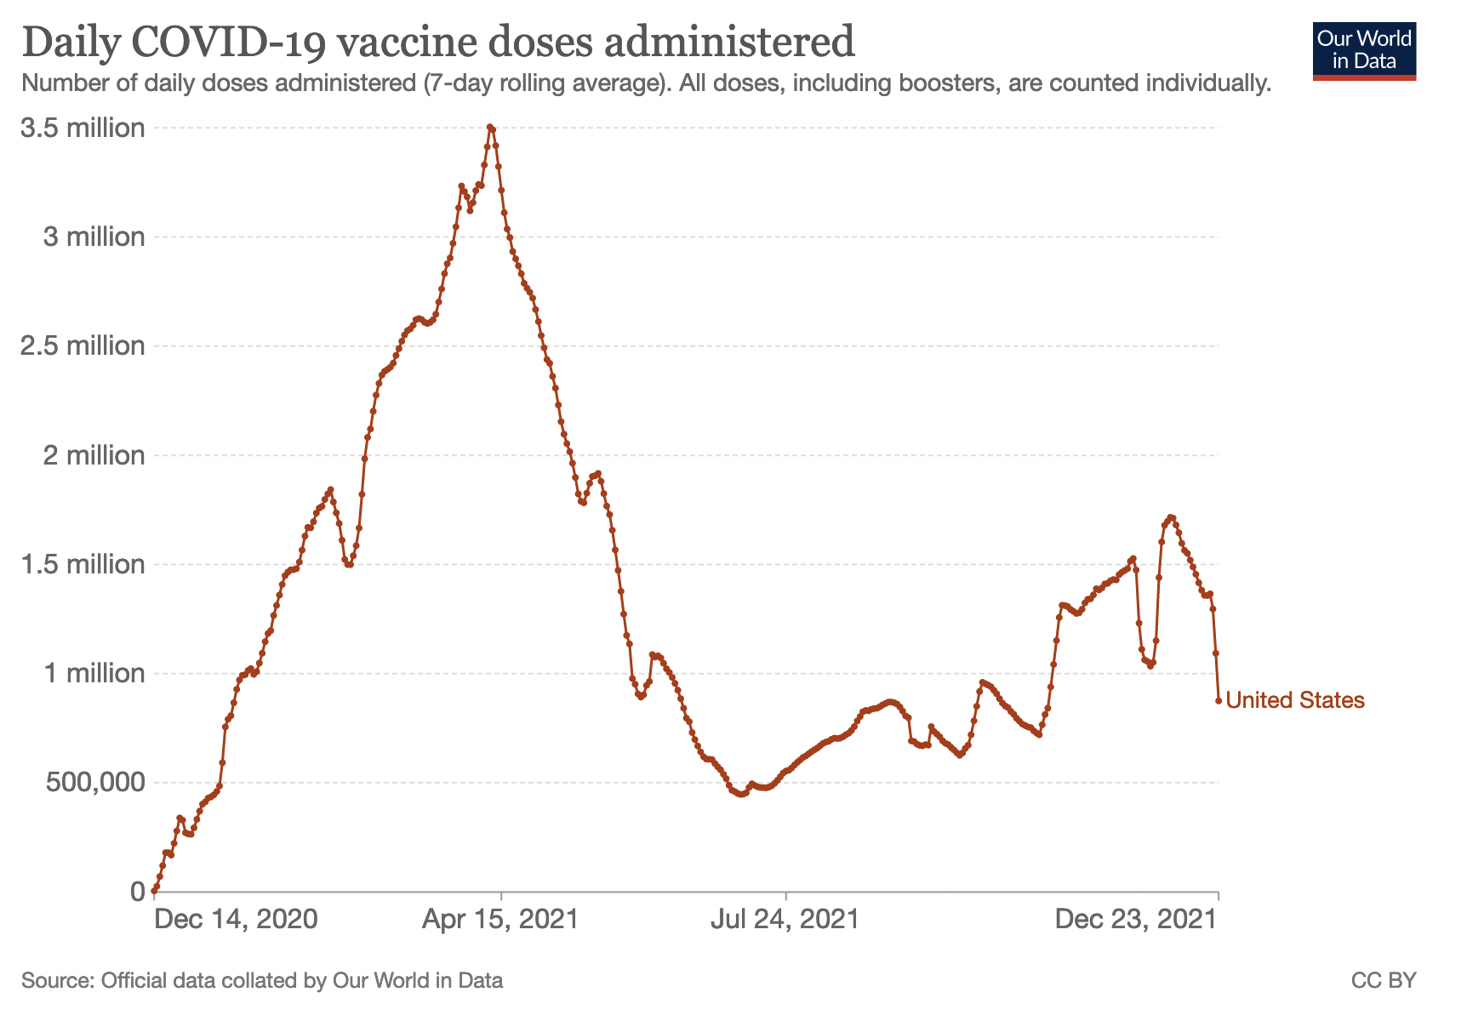
Comparison of cumulative AE counts from VAERS database
Rates of AE reports match rates of injection roll outs

Slide 16
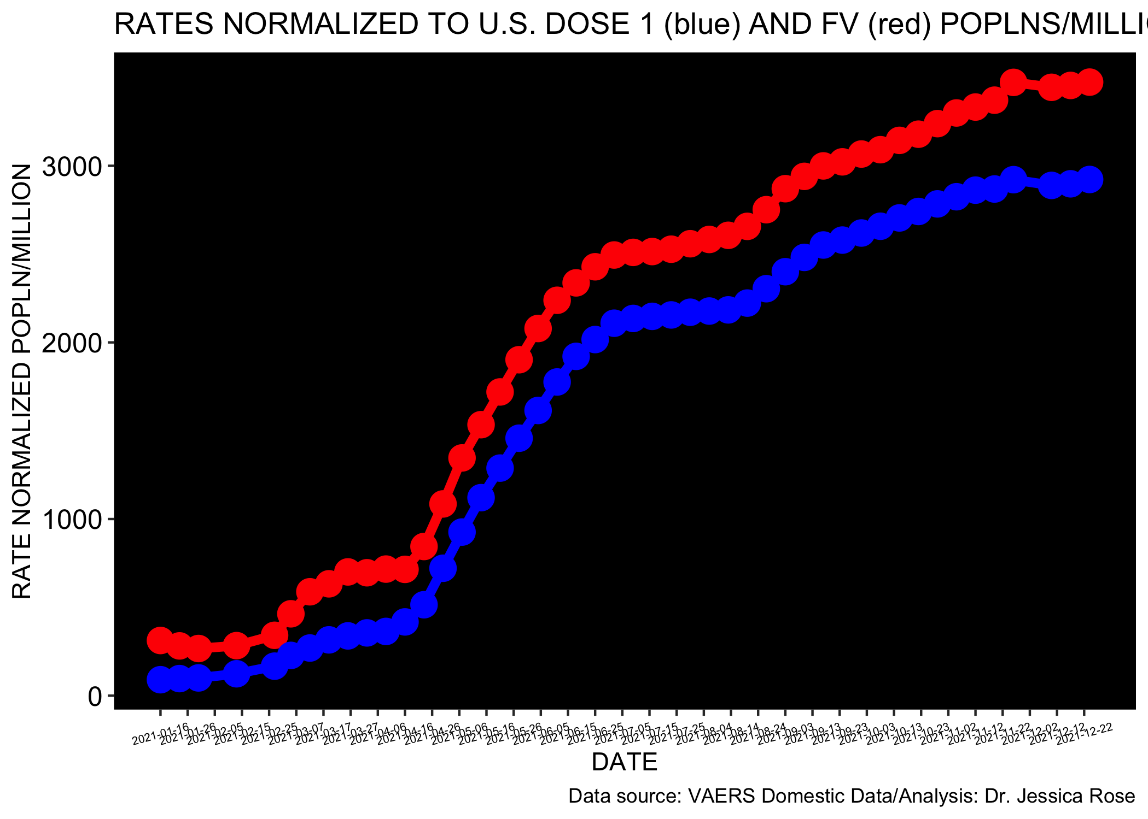
Comparison of cumulative AE counts from VAERS database normalized to FV population (2 doses)
But, the rates of AEs are also increasing – the proportionality constant is ~1/1000…
That’s ~1/400 individuals reporting an AE in context of COVID-19 products.

Slide 17
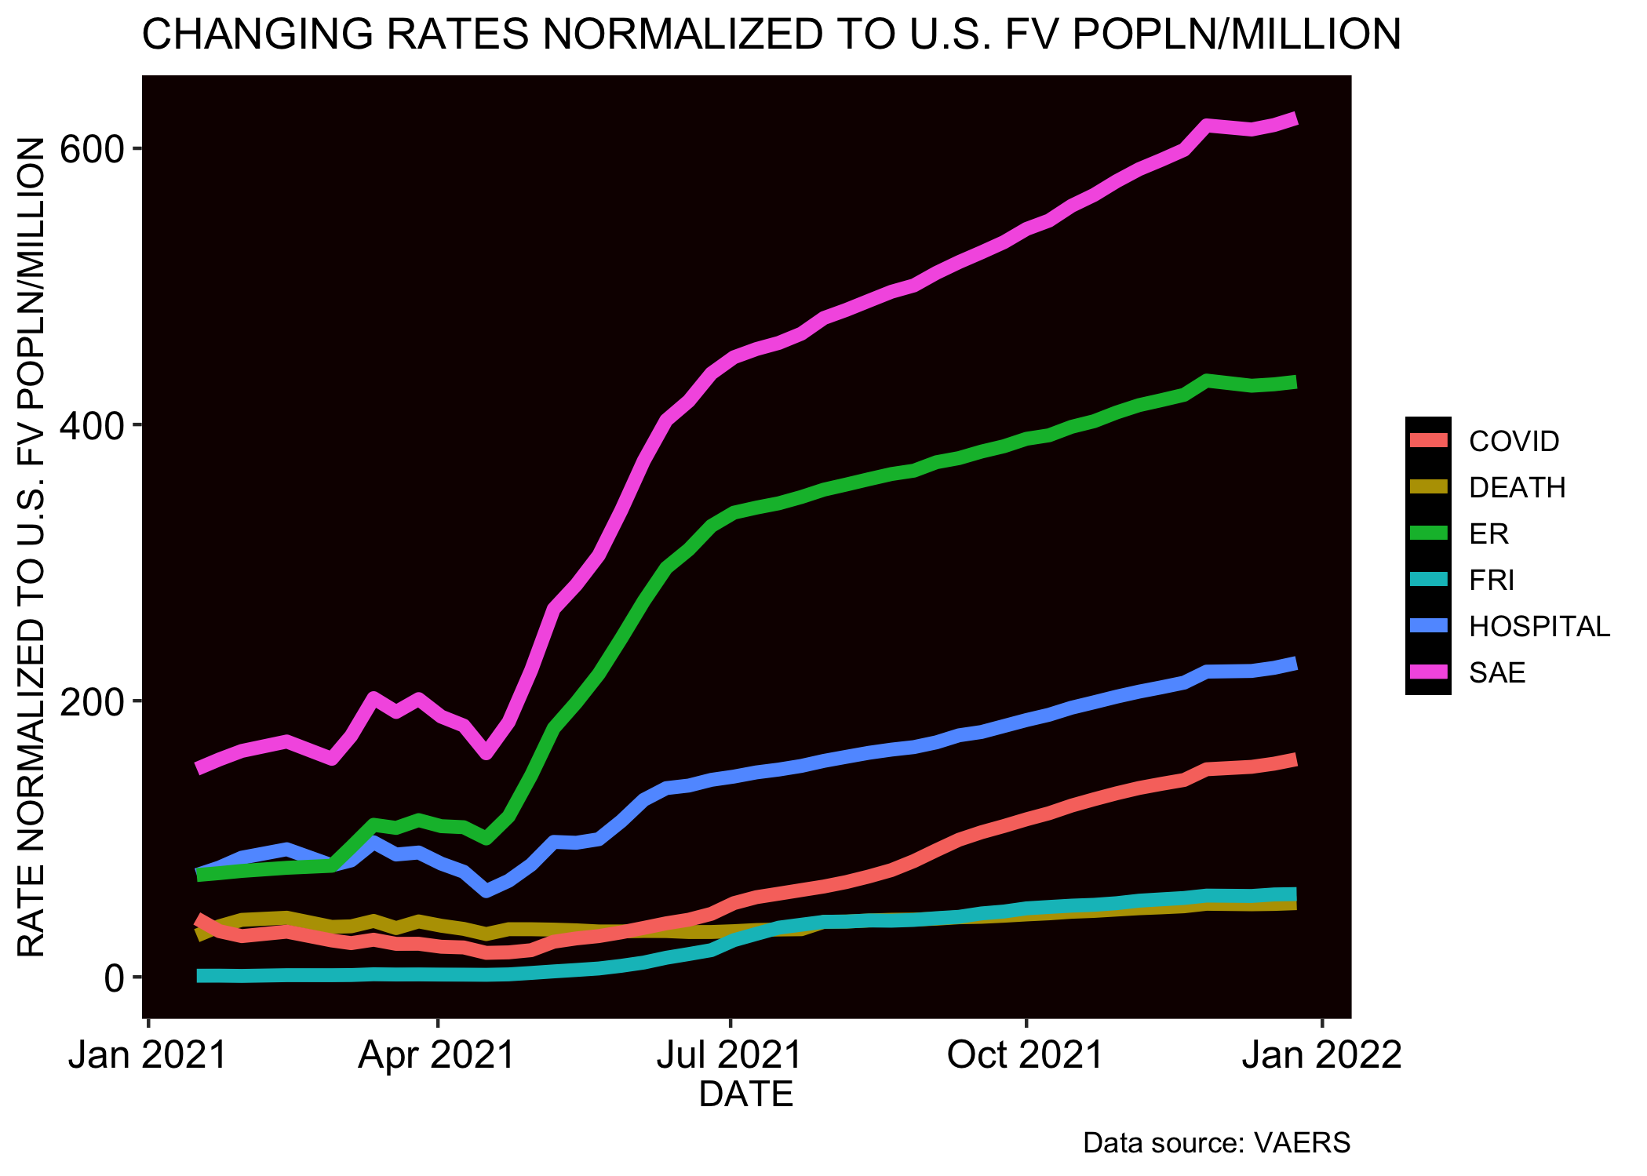
Comparison of cumulative AE counts from VAERS database normalized to FV population (2 doses)
There are ~600 SAEs occurring per million fully-injected people – that is a lot of SAEs...
That’s ~1/1,666 individuals reporting an SAE in context of COVID-19 products.

Slide 18
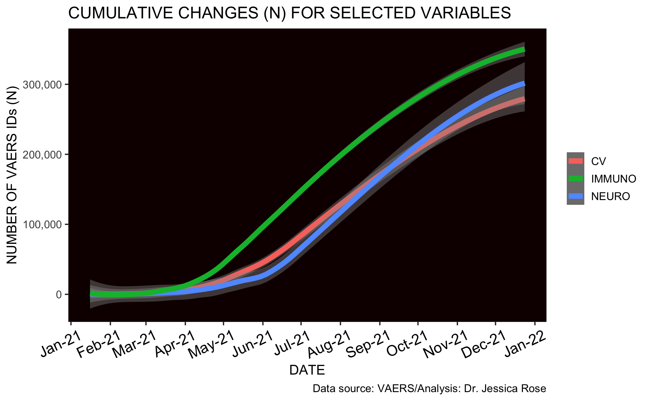
Cardiovascular, Neurological and Immunological AE reports are exploding
The rates of AEs are also increasing for Cardiovascular, Neurological and Immunological Categories
Notes:
By default, it is the 95% confidence level interval for predictions from a linear model ("lm"). A confidence interval is a range of values that describes the uncertainty surrounding an estimate. The confidence interval is the range of values that you expect your estimate to fall between a certain percentage of the time if you run your experiment again or re-sample the population in the same way.

Slide 19
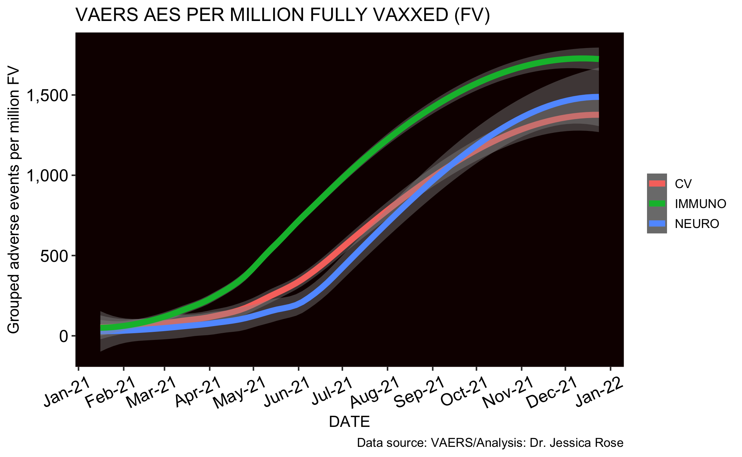
Normalized to Fully Injected
There are ~1700 Immunological AEs occurring per million fully-injected people – that is a lot of CV AEs...
1/582 individuals report an immunological AE in context of COVID-19 products

Slide 20
What are other adverse event reporting systems showing?

Slide 21
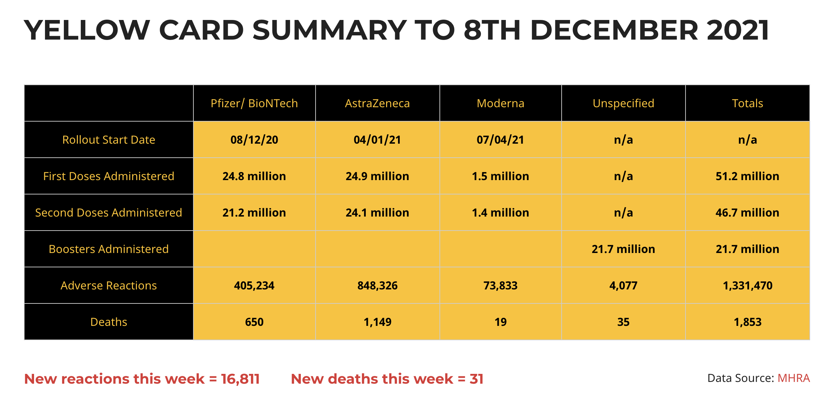
Yellowcard System – 1,331,470 reports

Slide 22
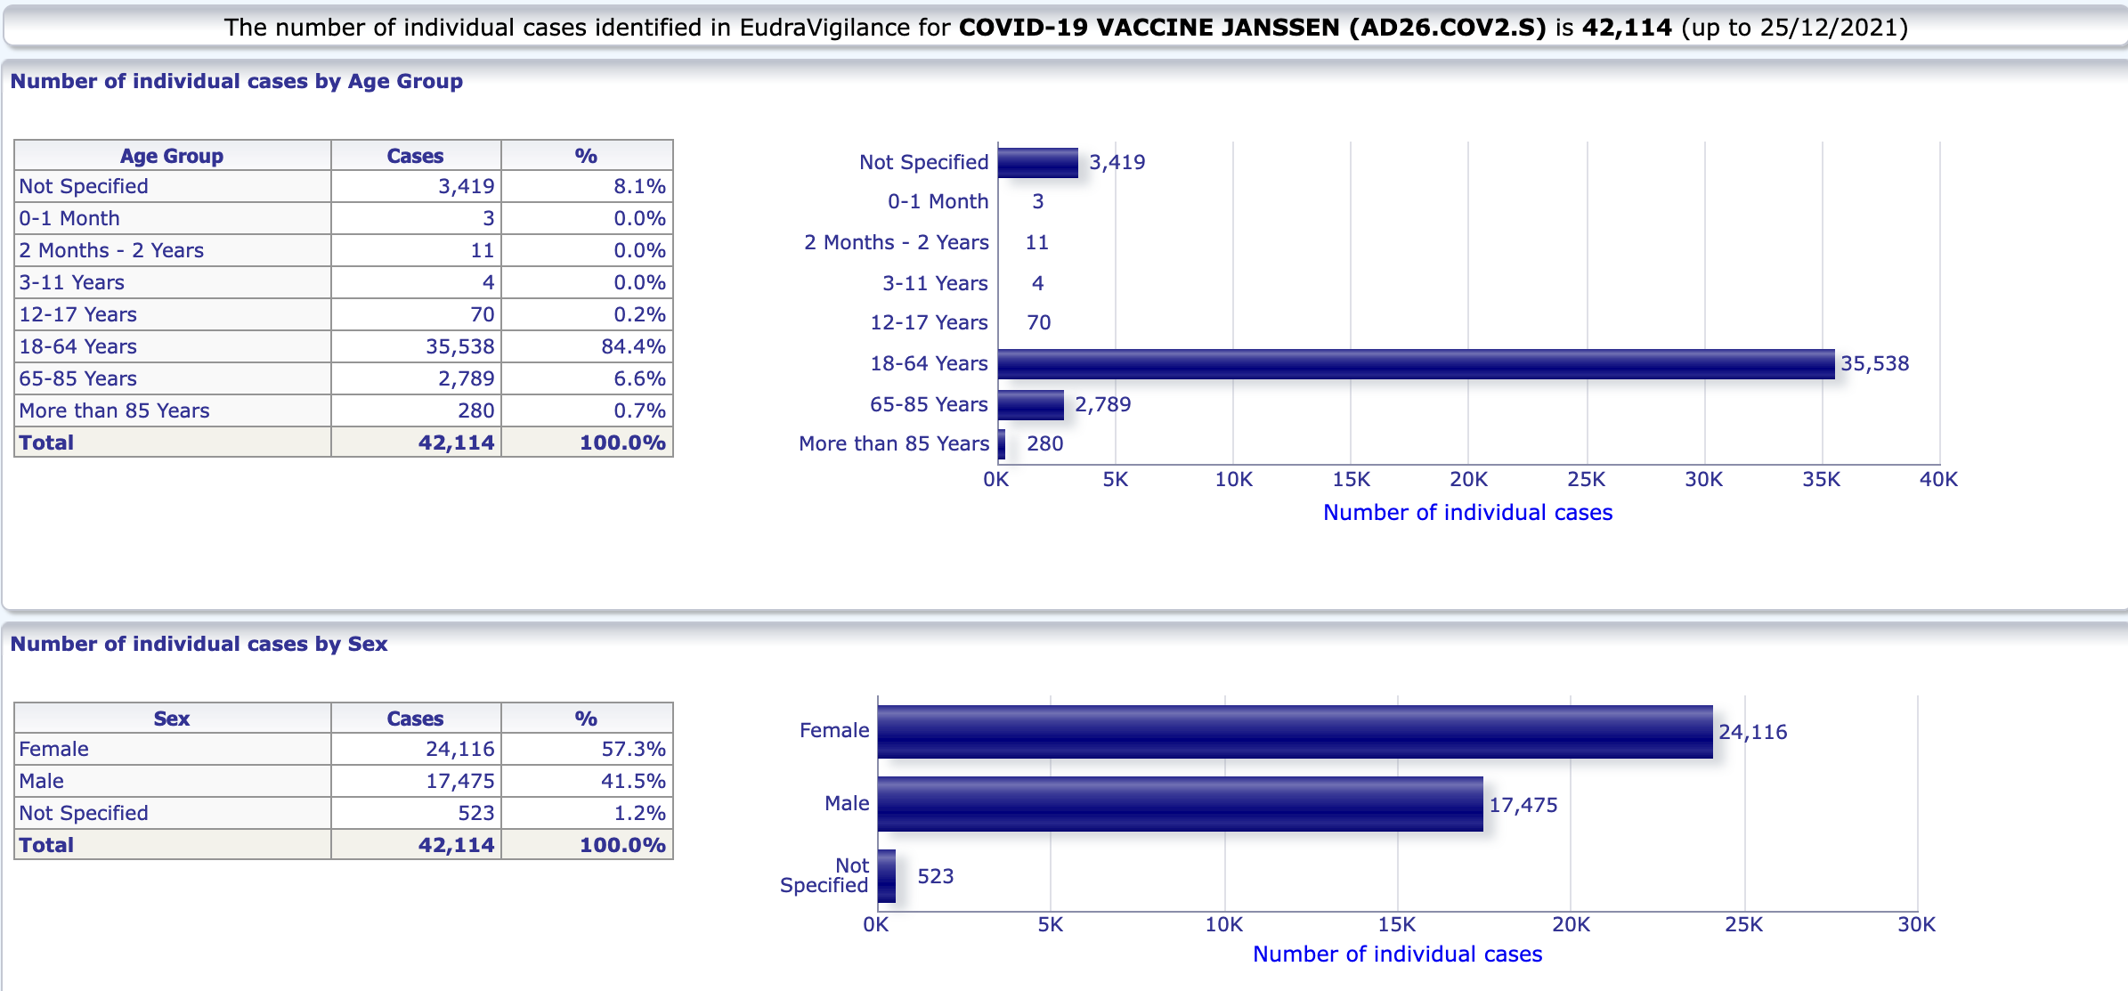
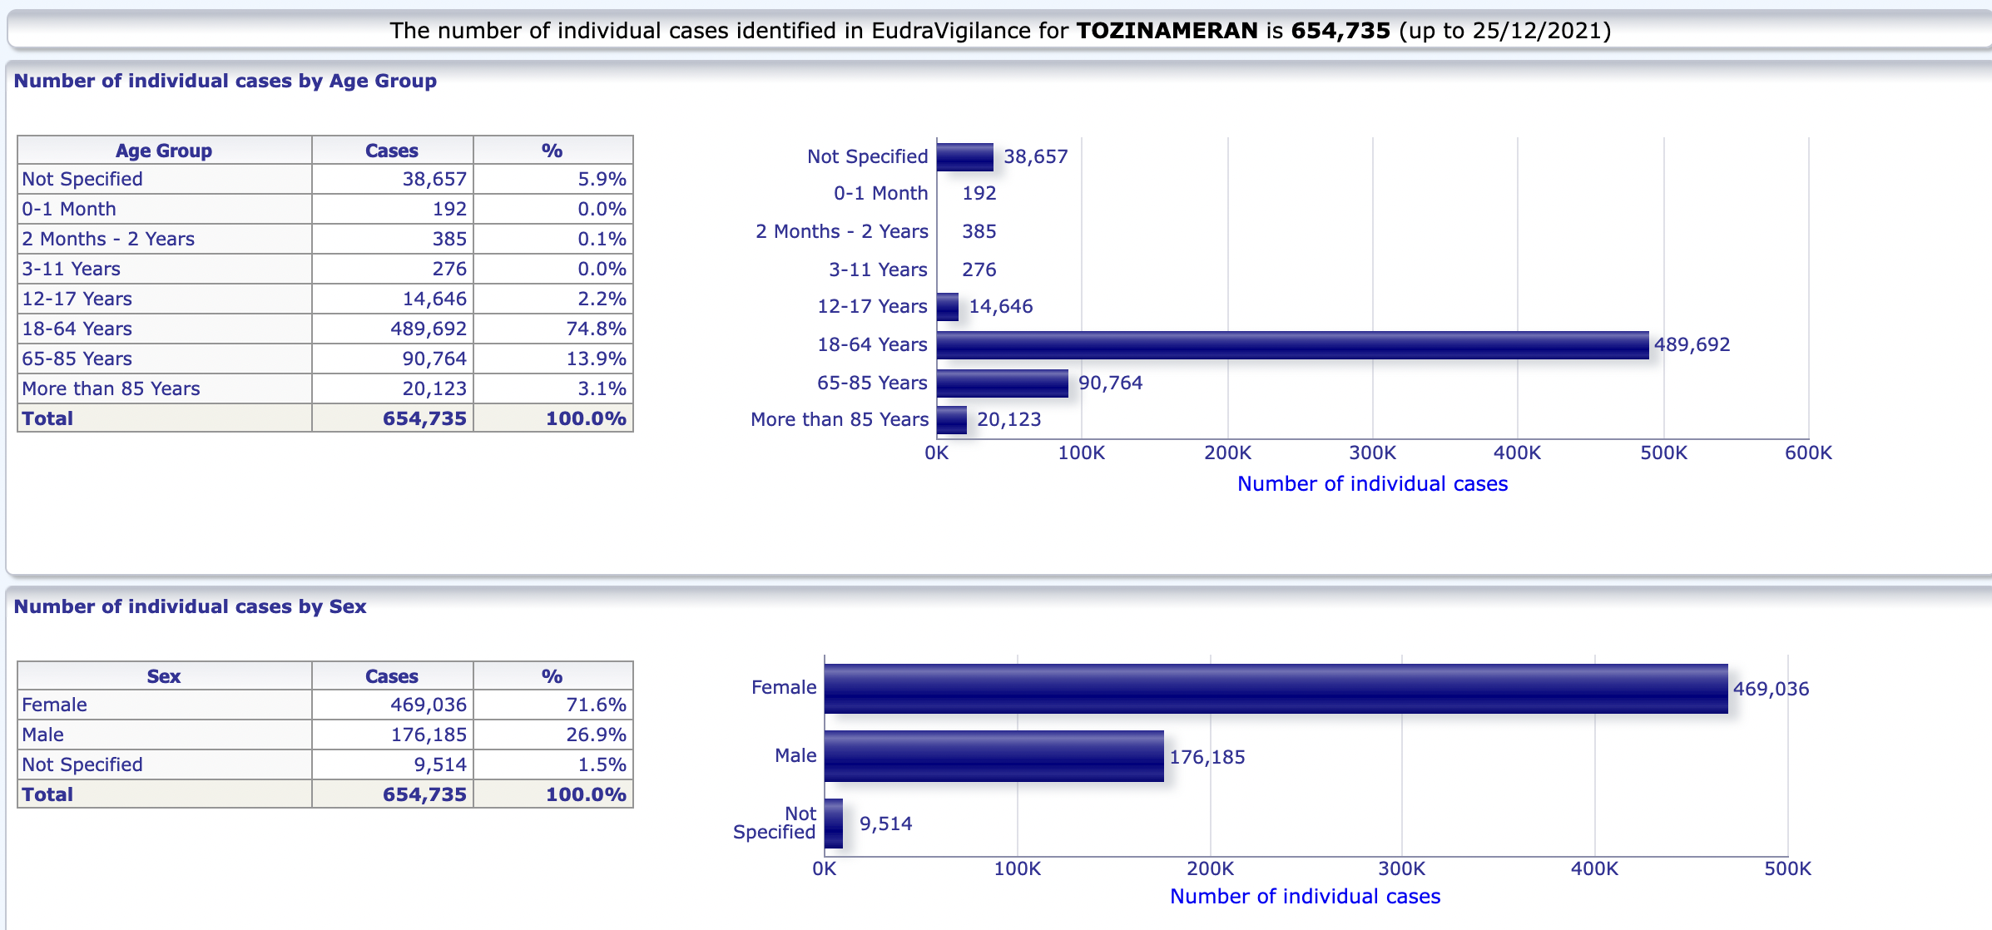
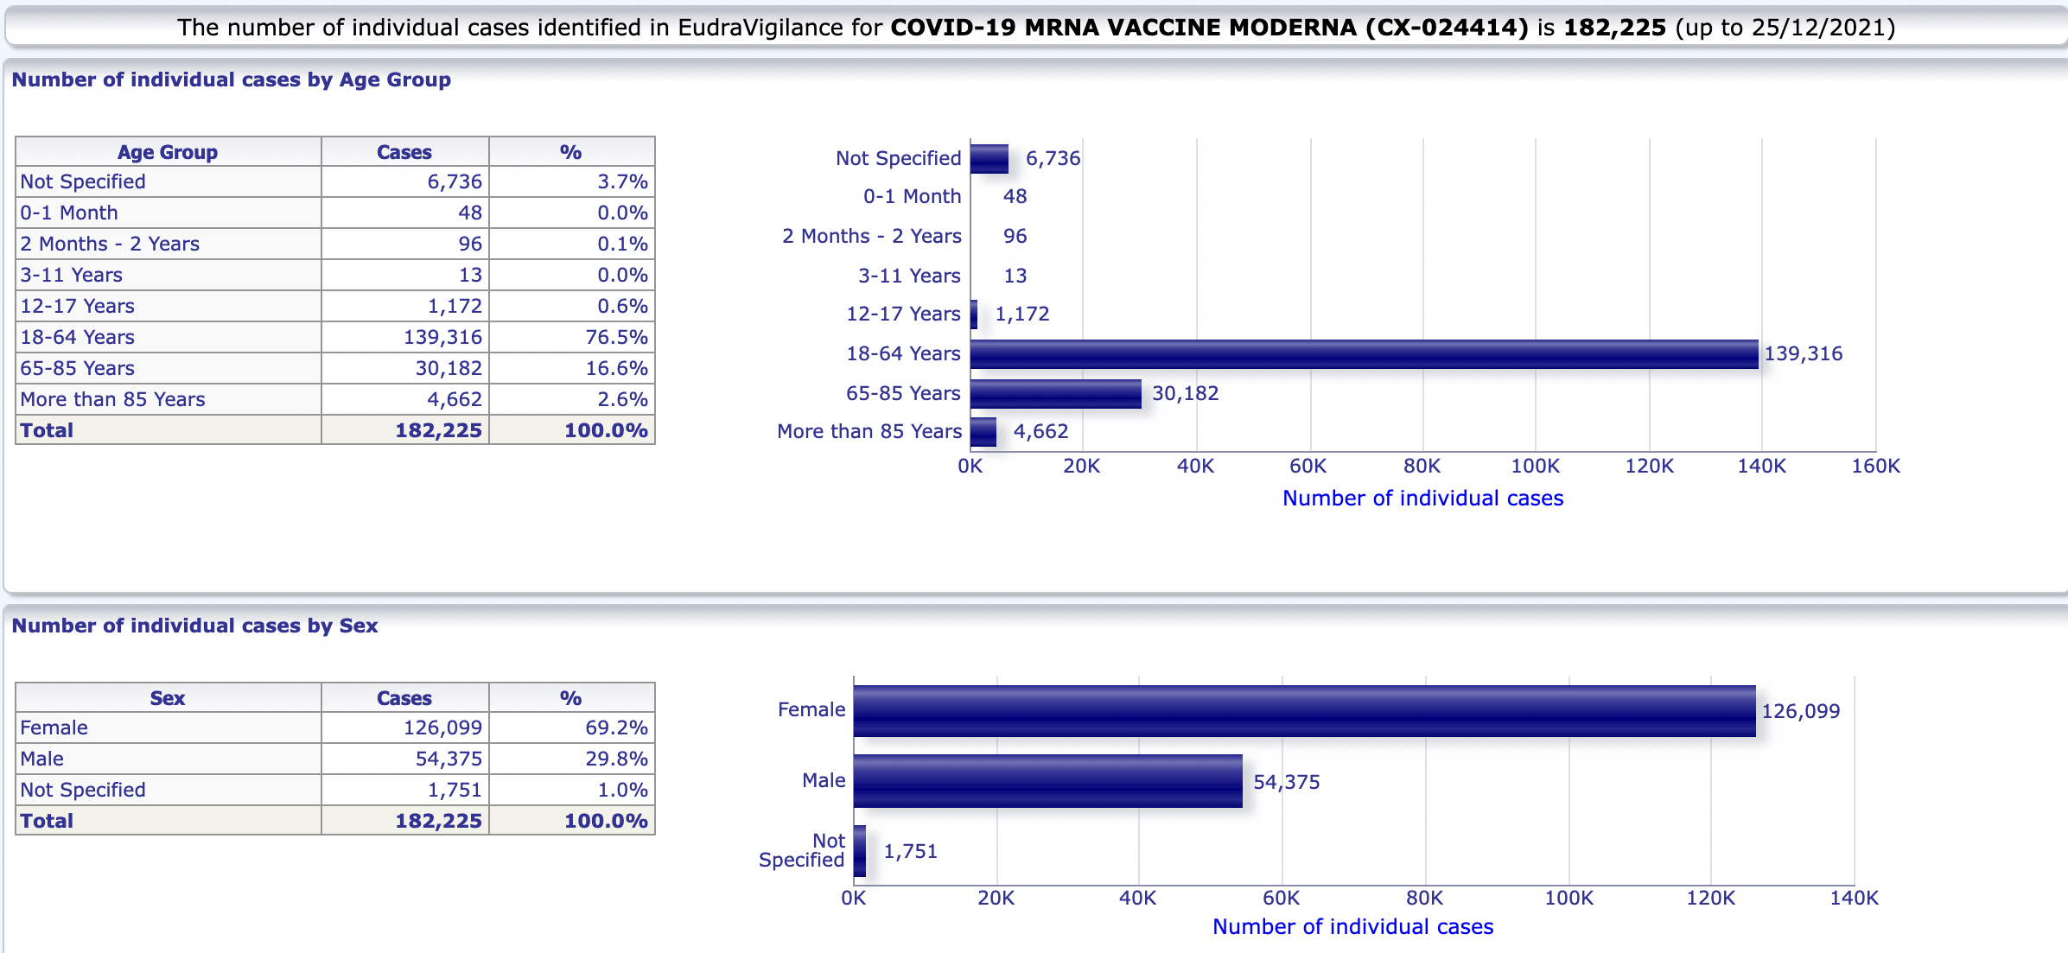
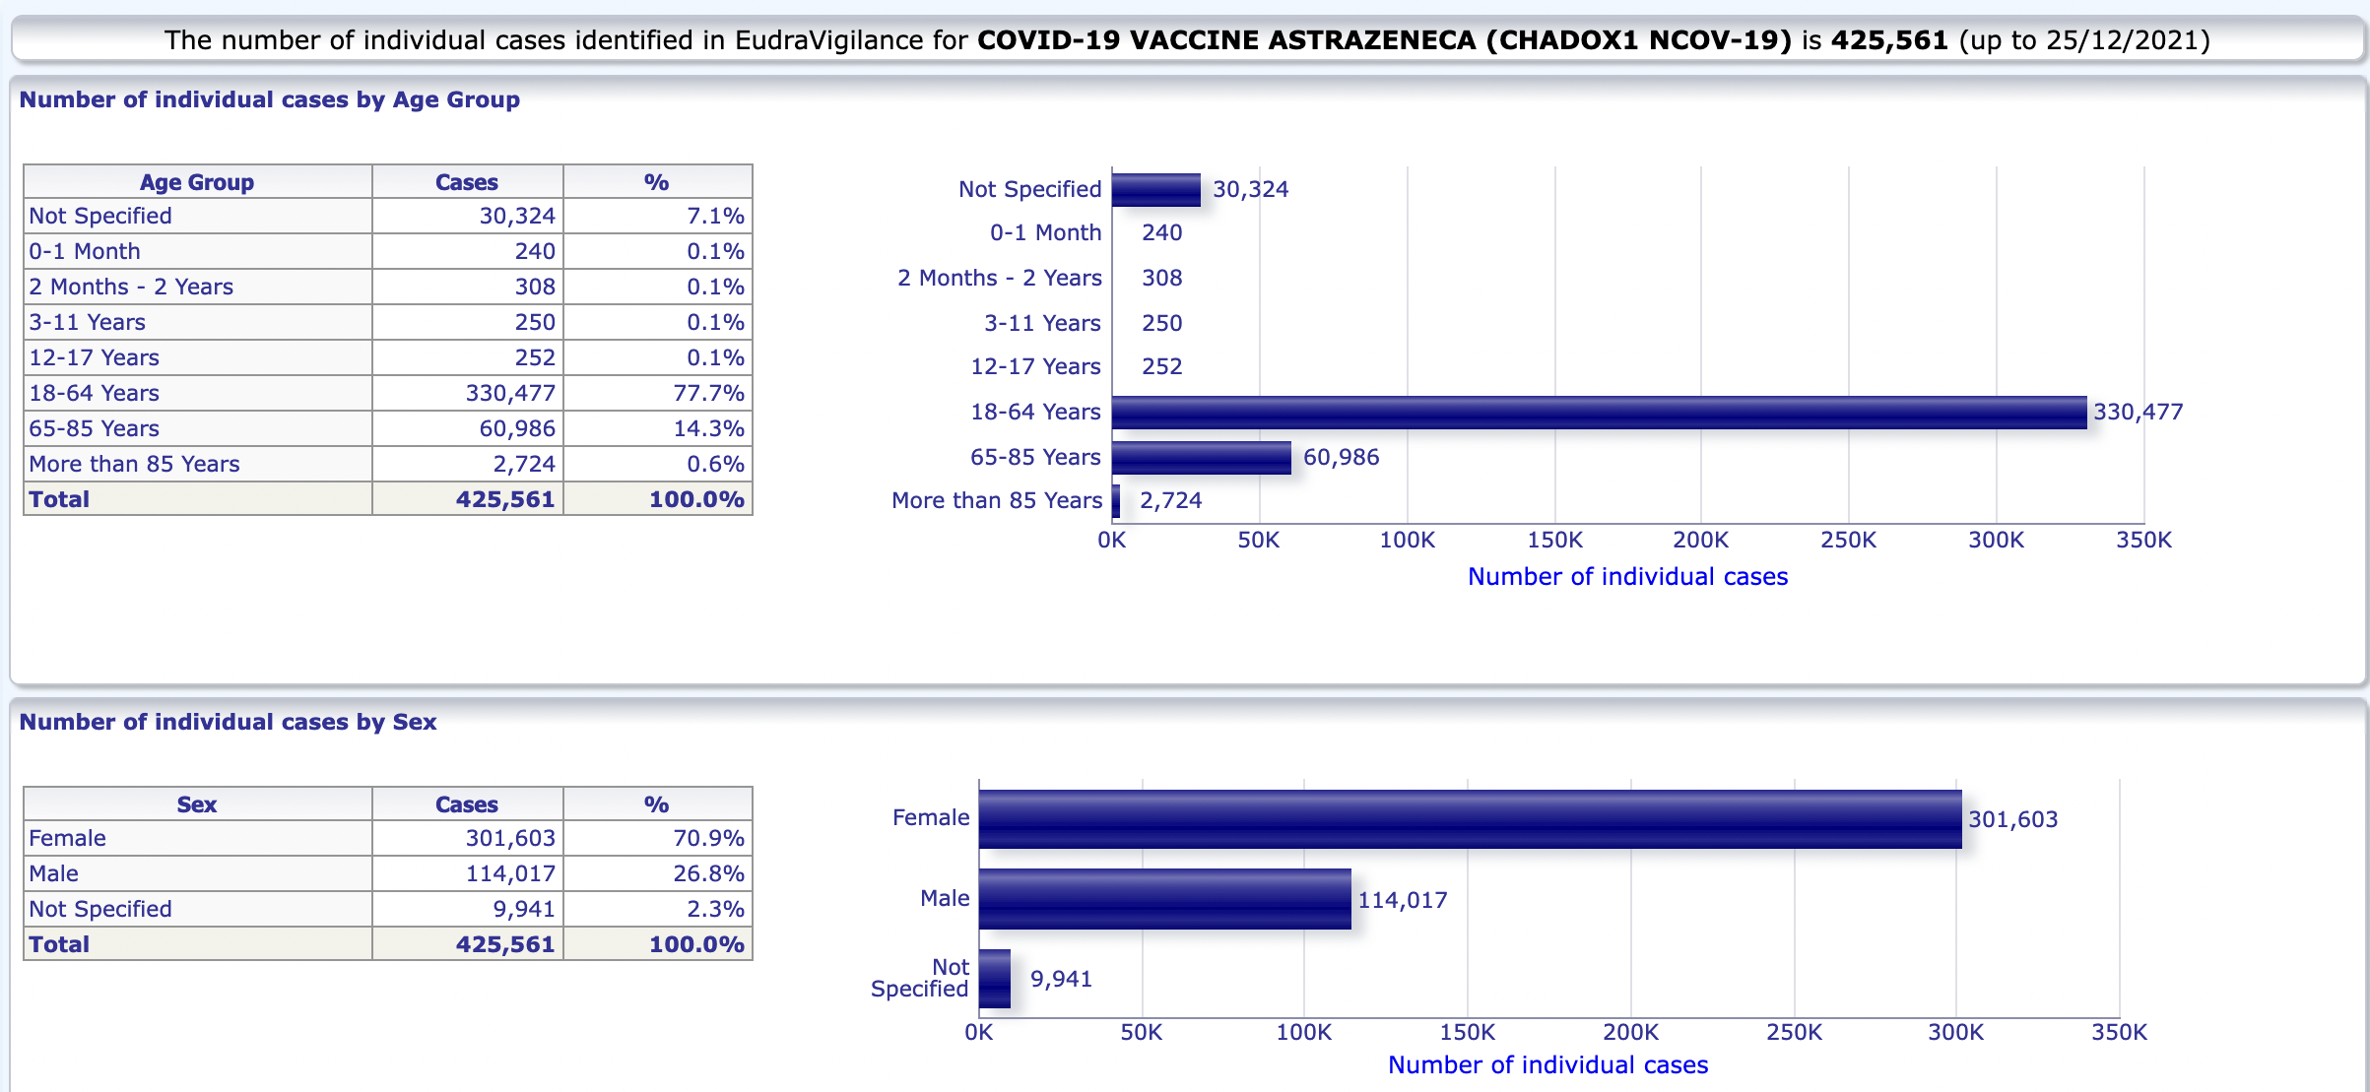
EudraVigilance System – 1,304,635 reports up to December 25th, 2021
Janssen - 42,114
Pfizer/BioNTech - 654,735
Moderna - 182,225
AstraZeneca - 425,561

Slide 23
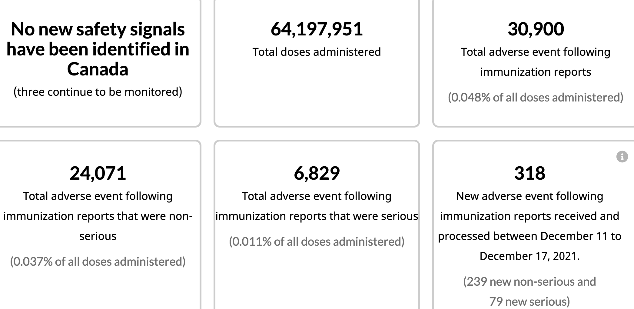
Canadian Adverse Events Following Immunization Surveillance System (CAEFISS) – 30,900 reports up to December 24th, 2021
Data in Canada indicate a higher number of myocarditis reports in younger people (i.e. less than 40 years of age) than would normally be expected in this age group in the general population.*
December 24, 2021
*https://health-infobase.canada.ca/covid-19/vaccine-safety/summary.html

Slide 24

Global AE data picture = same picture

Slide 25

Back to VAERS

Slide 26
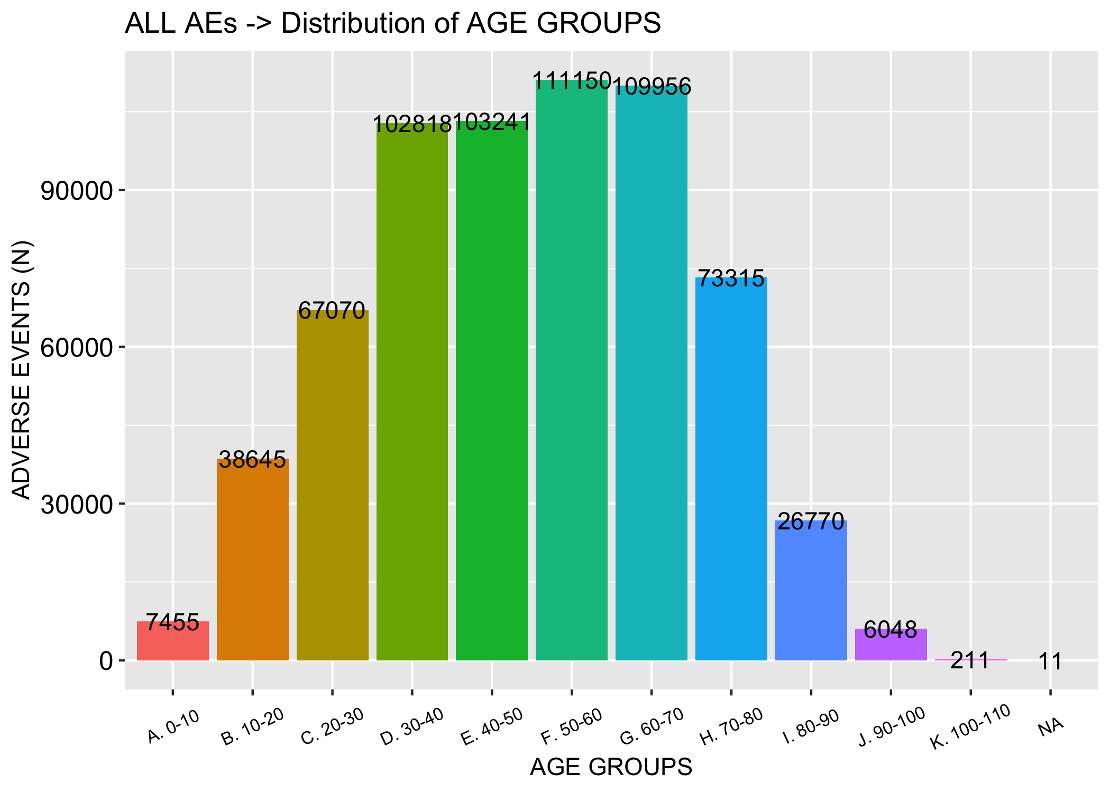
All age groups succumbing to AEs…
N = 705,991

Slide 27
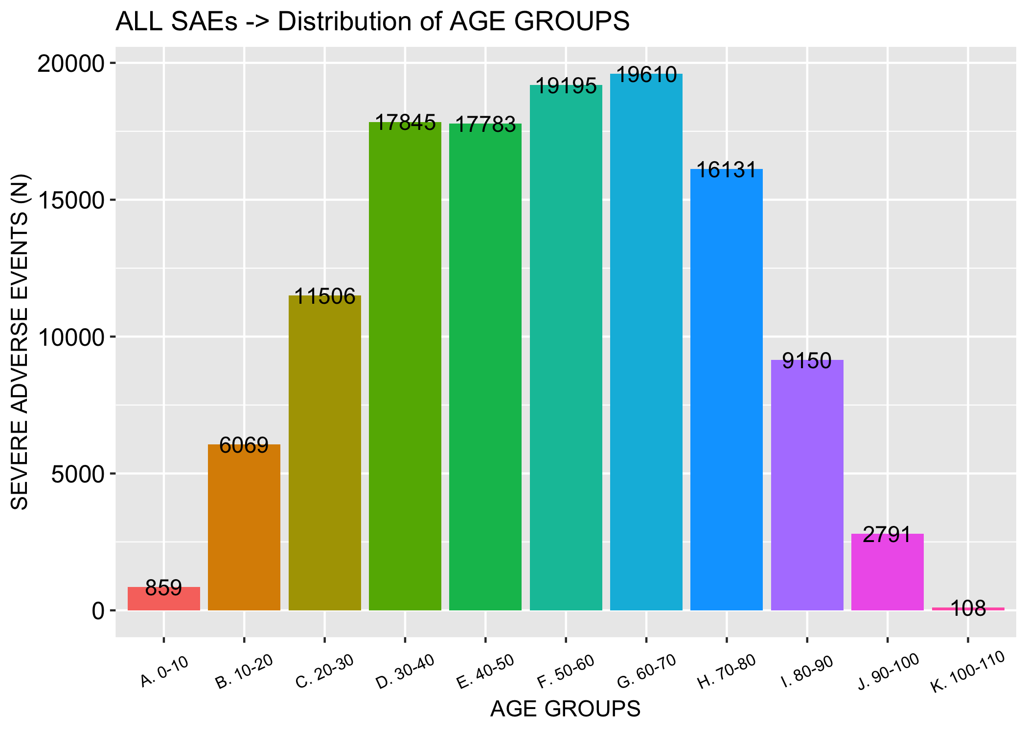
All age groups succumbing to AEs including SAEs…
N = 705,991
N = 126,418

Slide 28
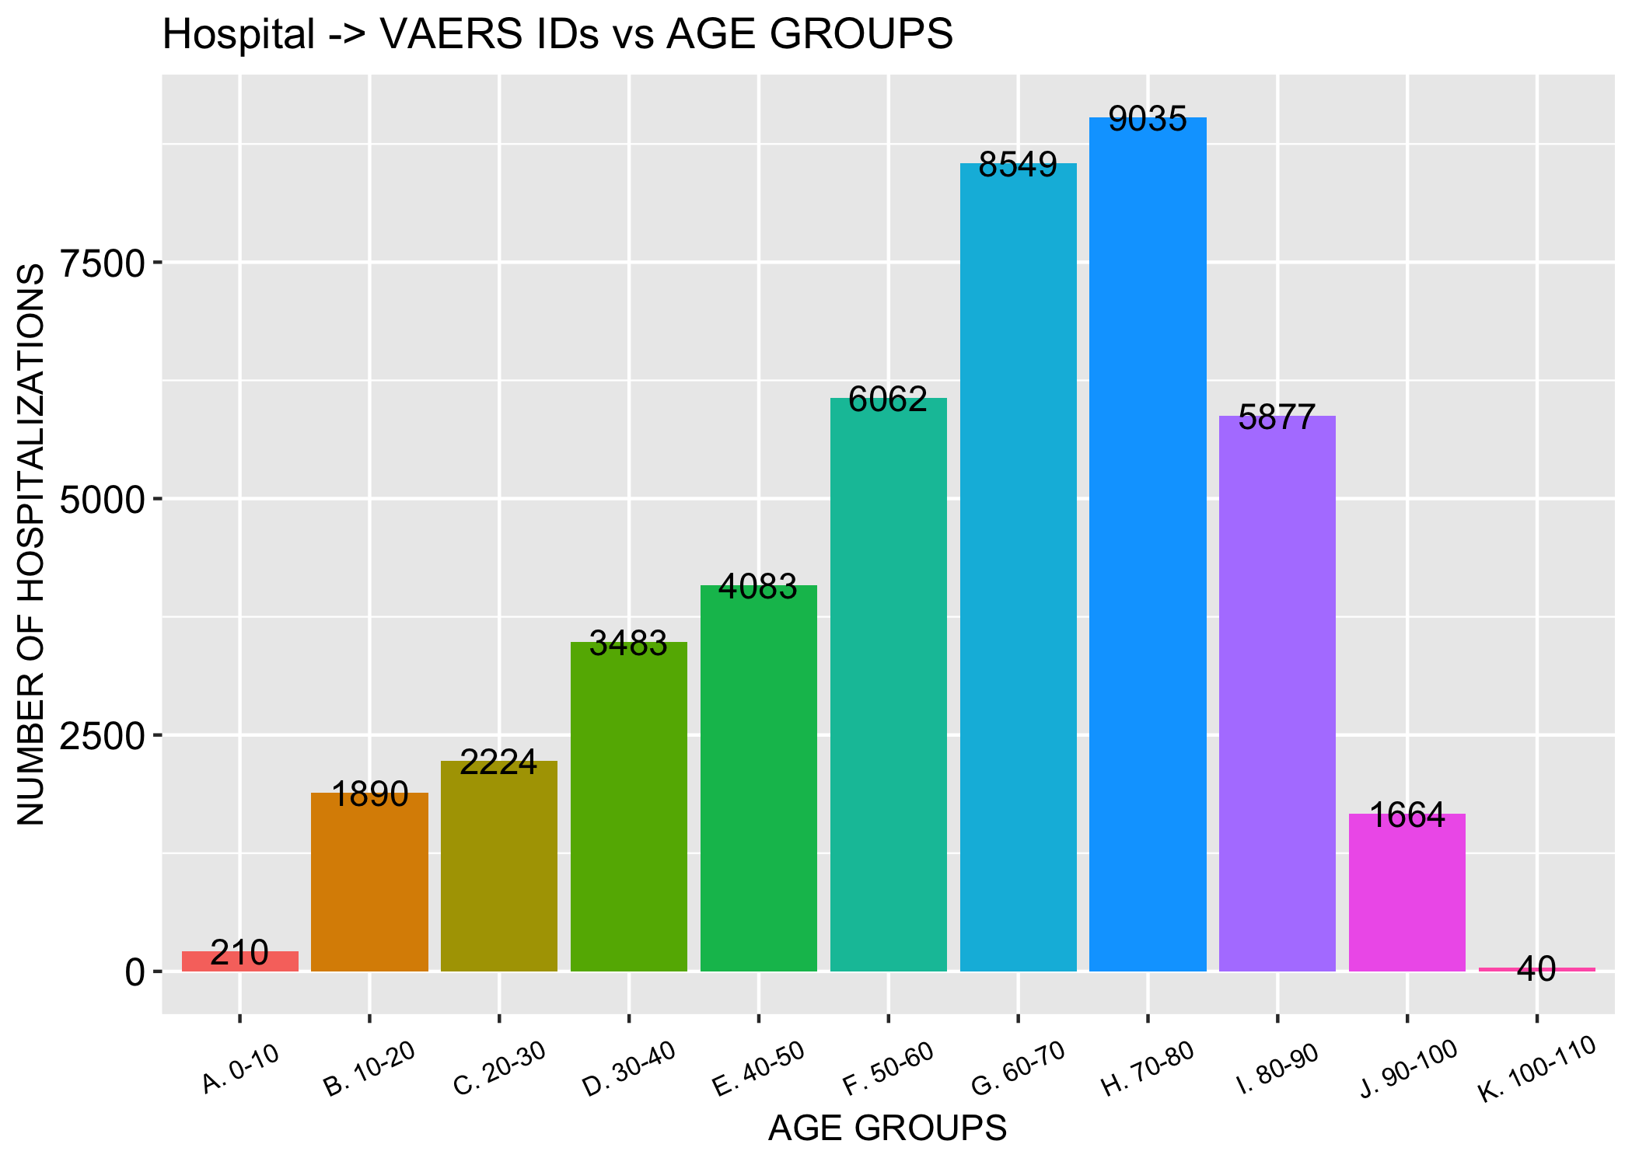
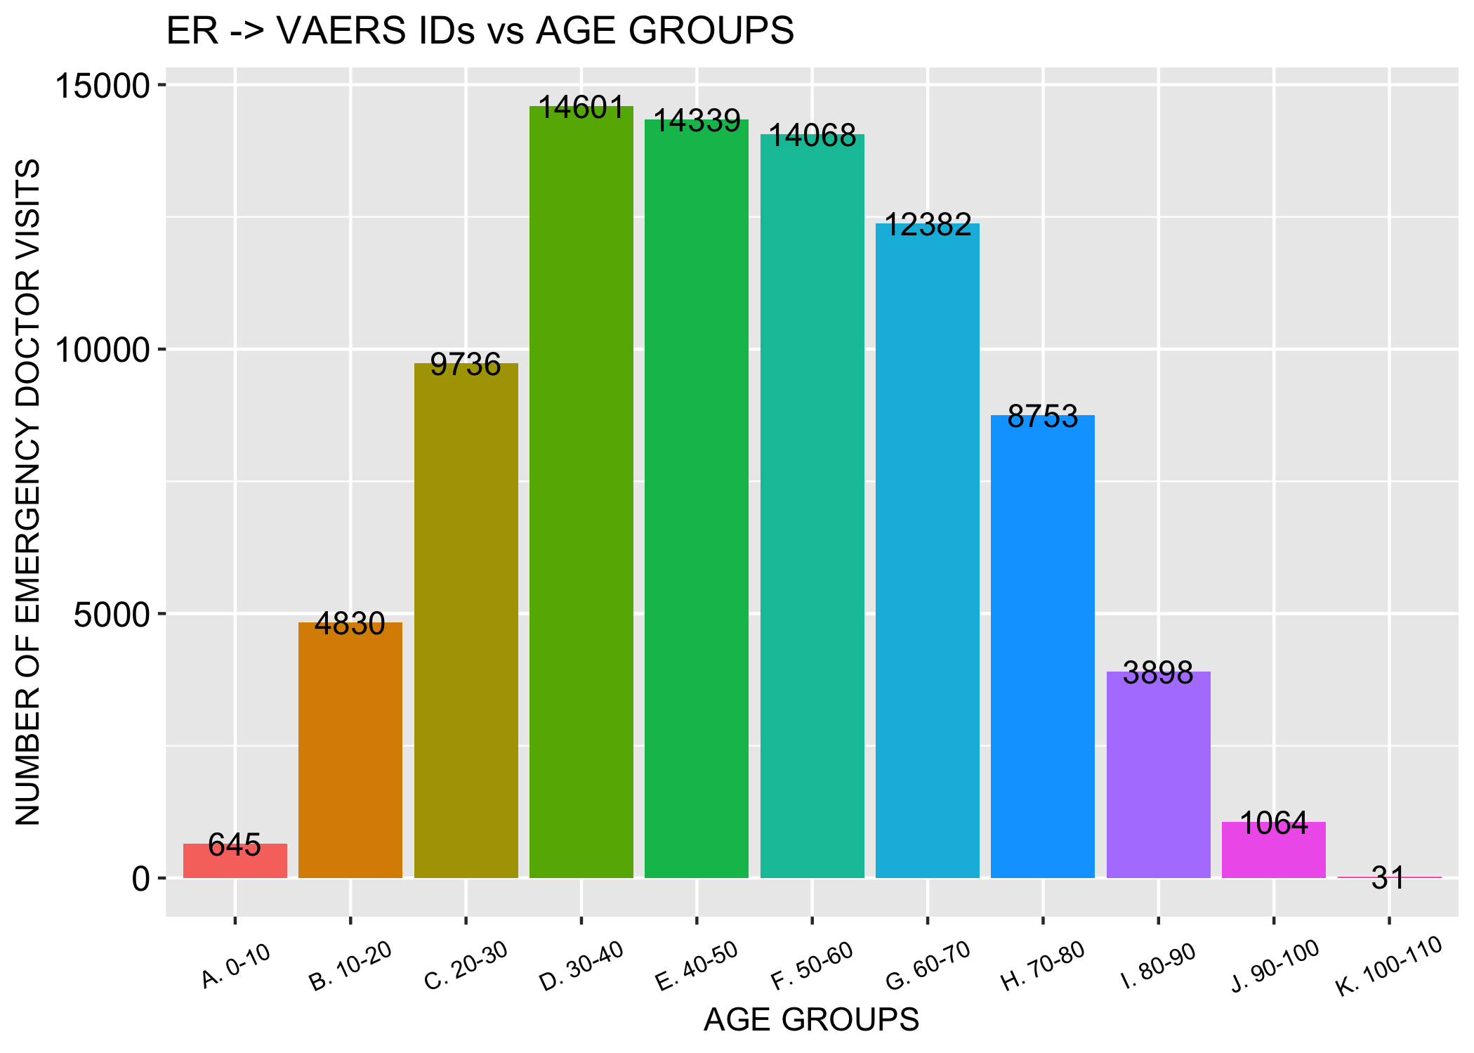
Hospitalizations and ER visits are being reported at rates not seen before…
N = 46,202
N = 87,586

Slide 29
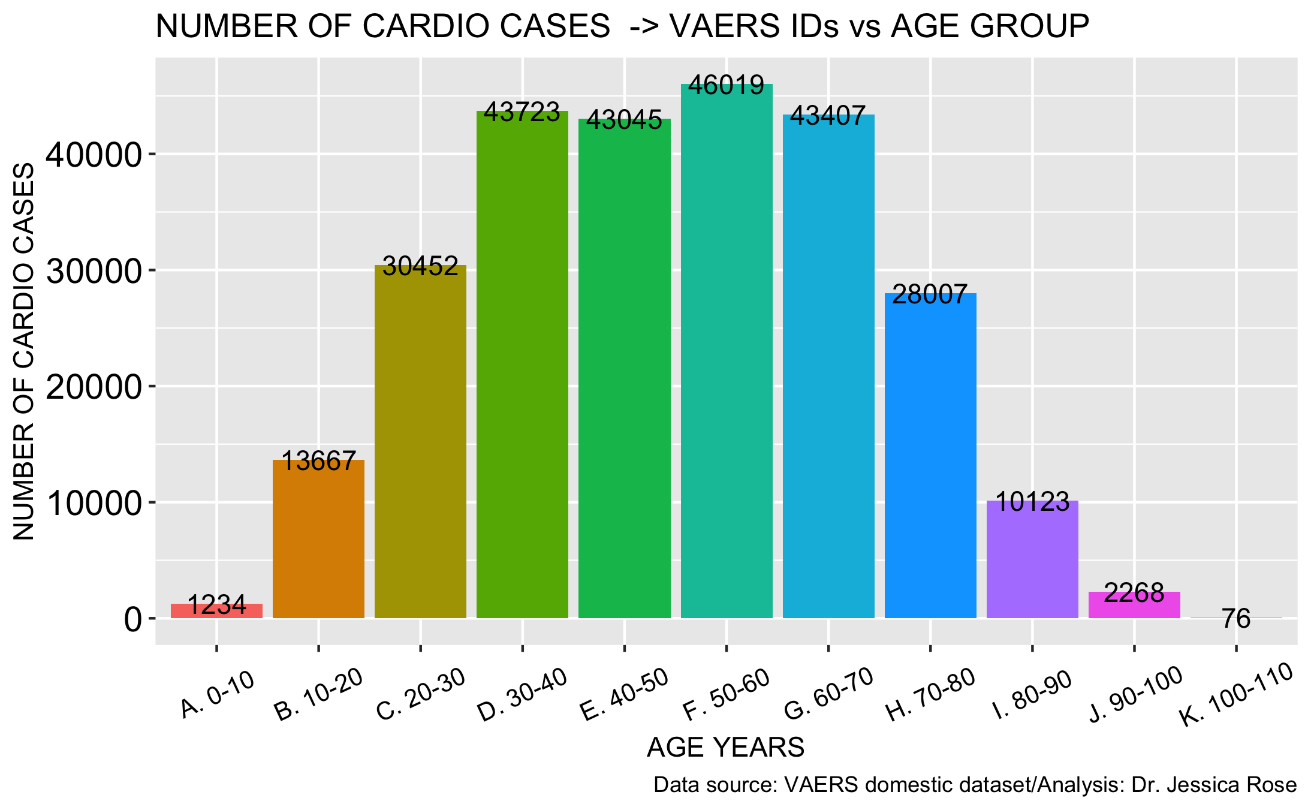
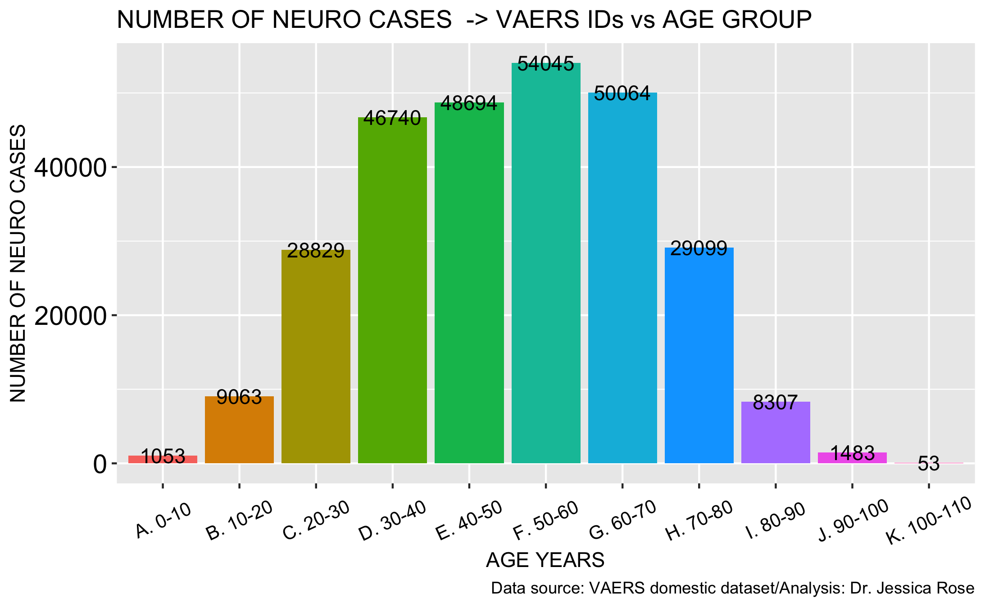
Cardiovascular and neurological AEs are being reported at rates not seen before…
N= 276,985
N = 297,527

Slide 30
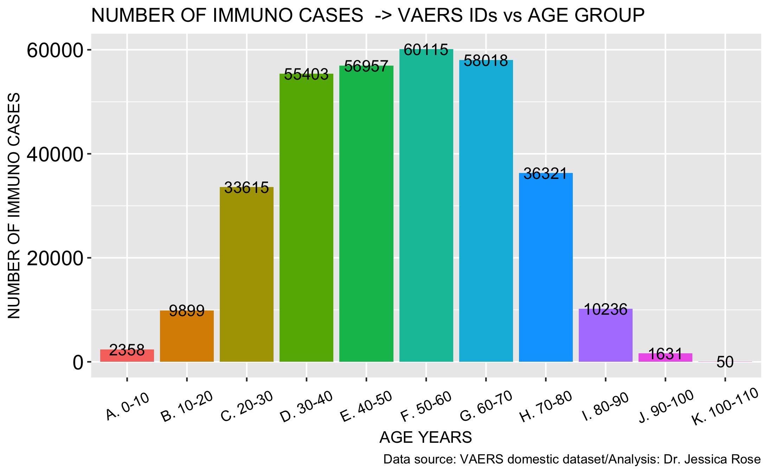
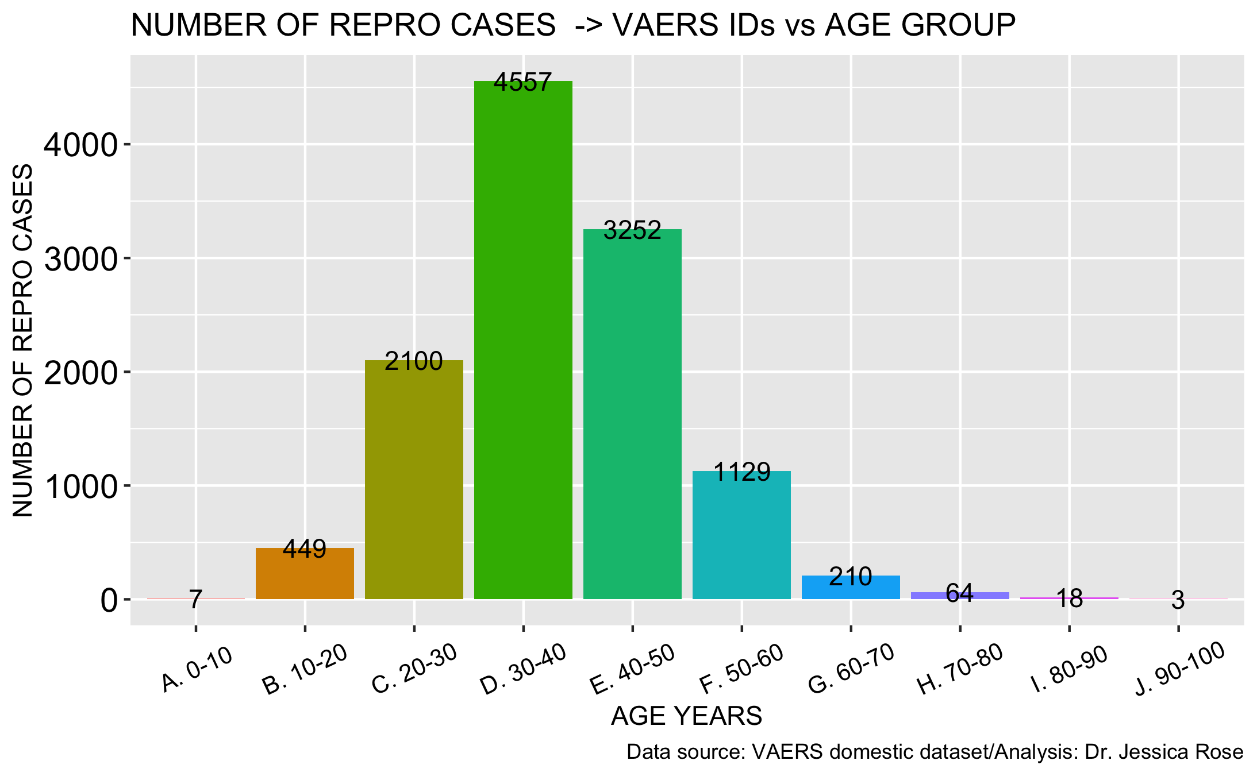
Immunological and reproductive AEs are being reported at rates not seen before…
N = 349,175
N = 12,227

Slide 31
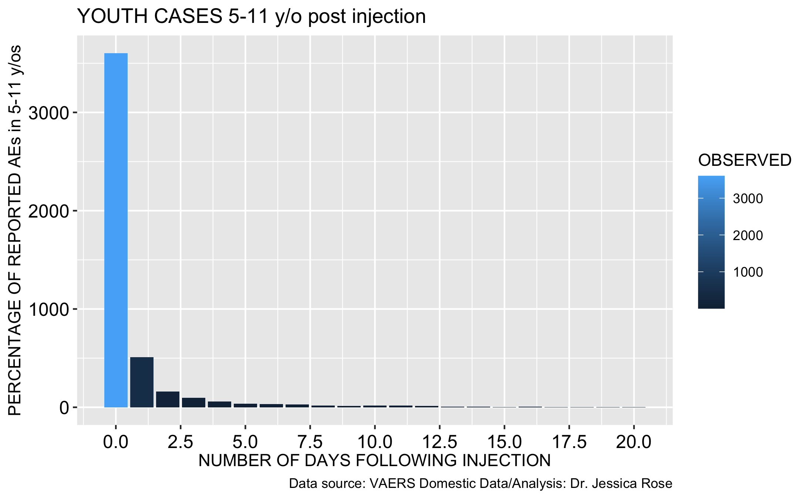
KIDS
AEs in children aged 5-11 years are on the rise and being reported immediately
Children aged 0-18: 41,595
With URF: 1,705,395
Children aged 5-11: 4,777
With URF: 195,857

Slide 32
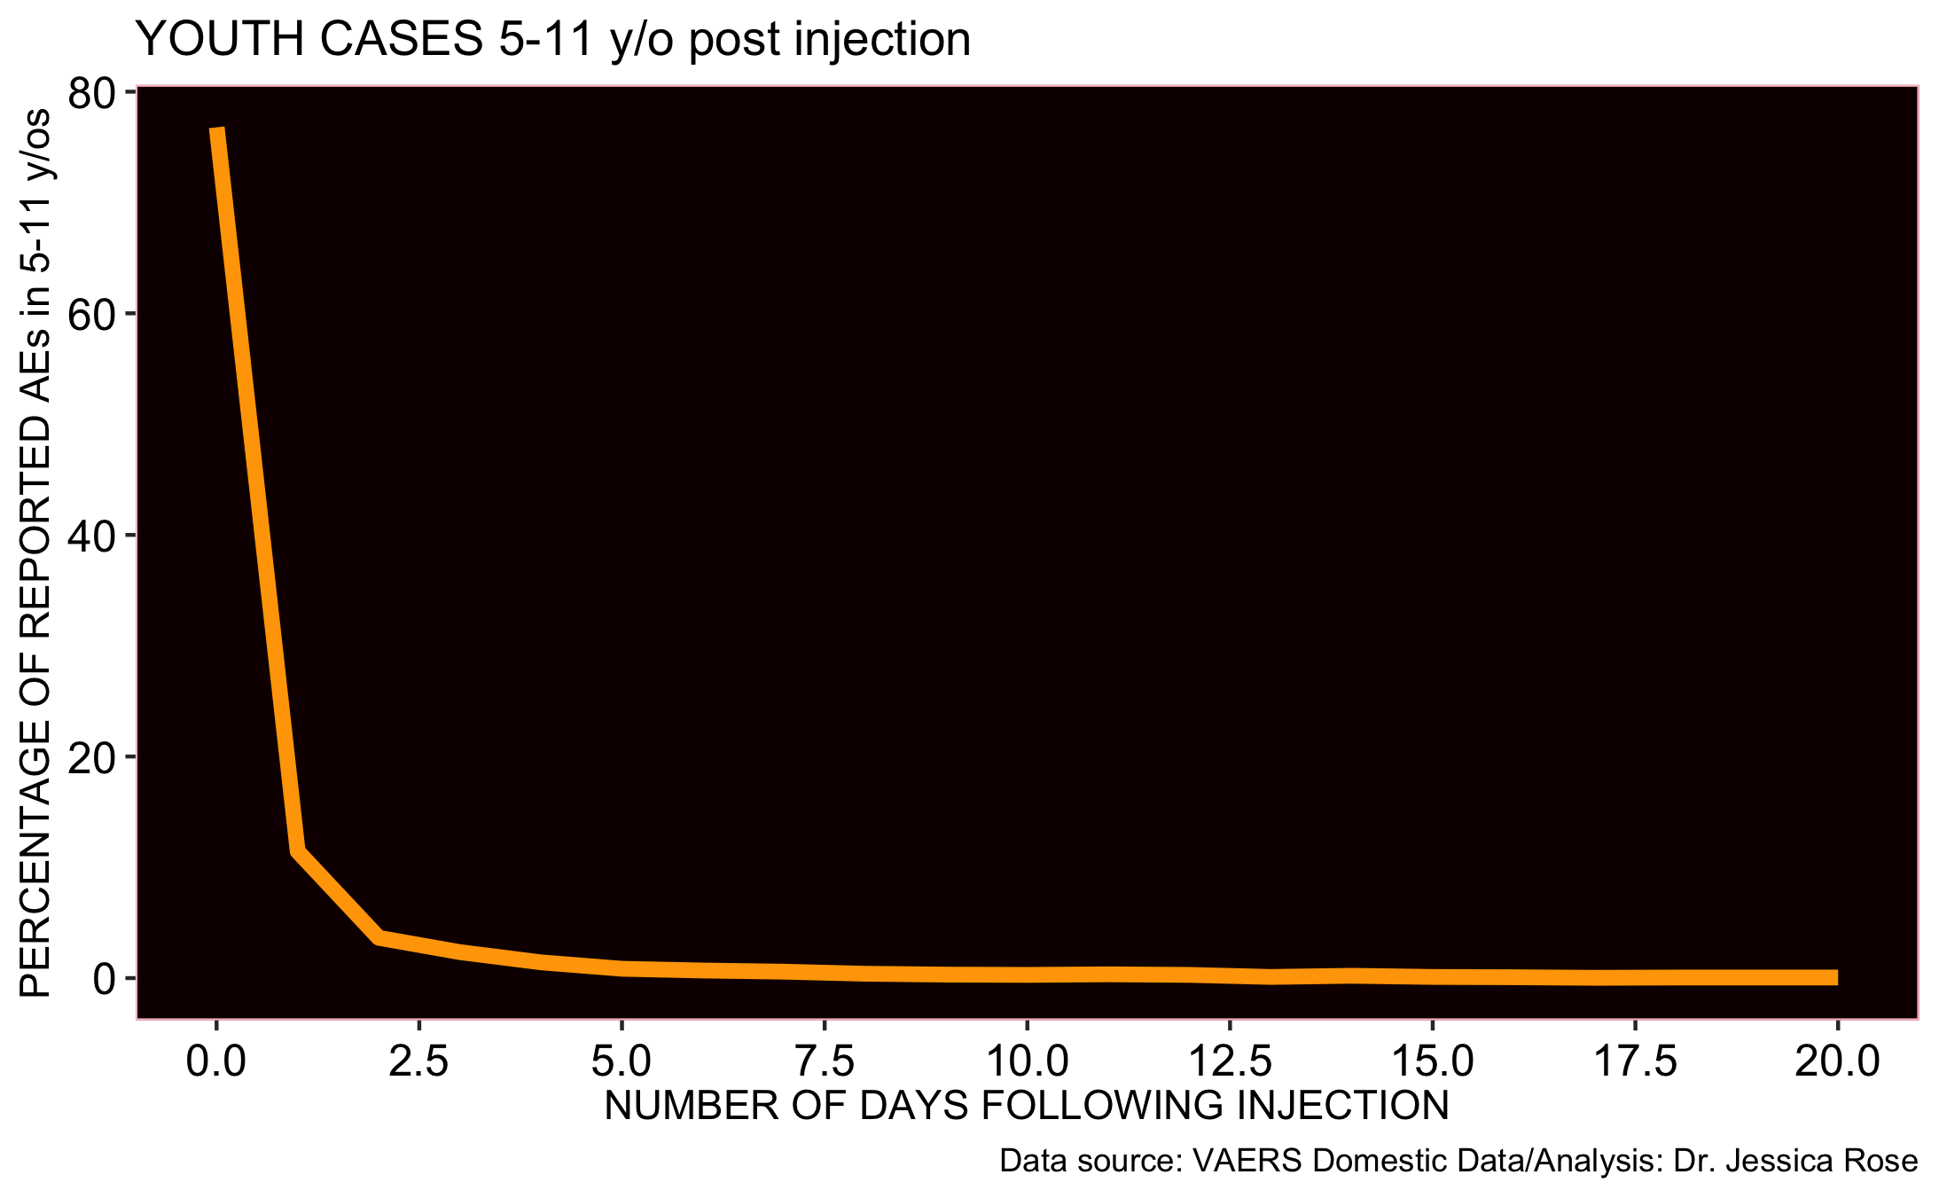
88% of adverse event reports filed to VAERS for 5-11 year olds - within 24 hours
diff_in_days | n | OBSERVED | Percentage_OBSERVED
0 days | 2914 | 2914 | 76.78524374
1 days | 434 | 434 | 11.43610013

Slide 33
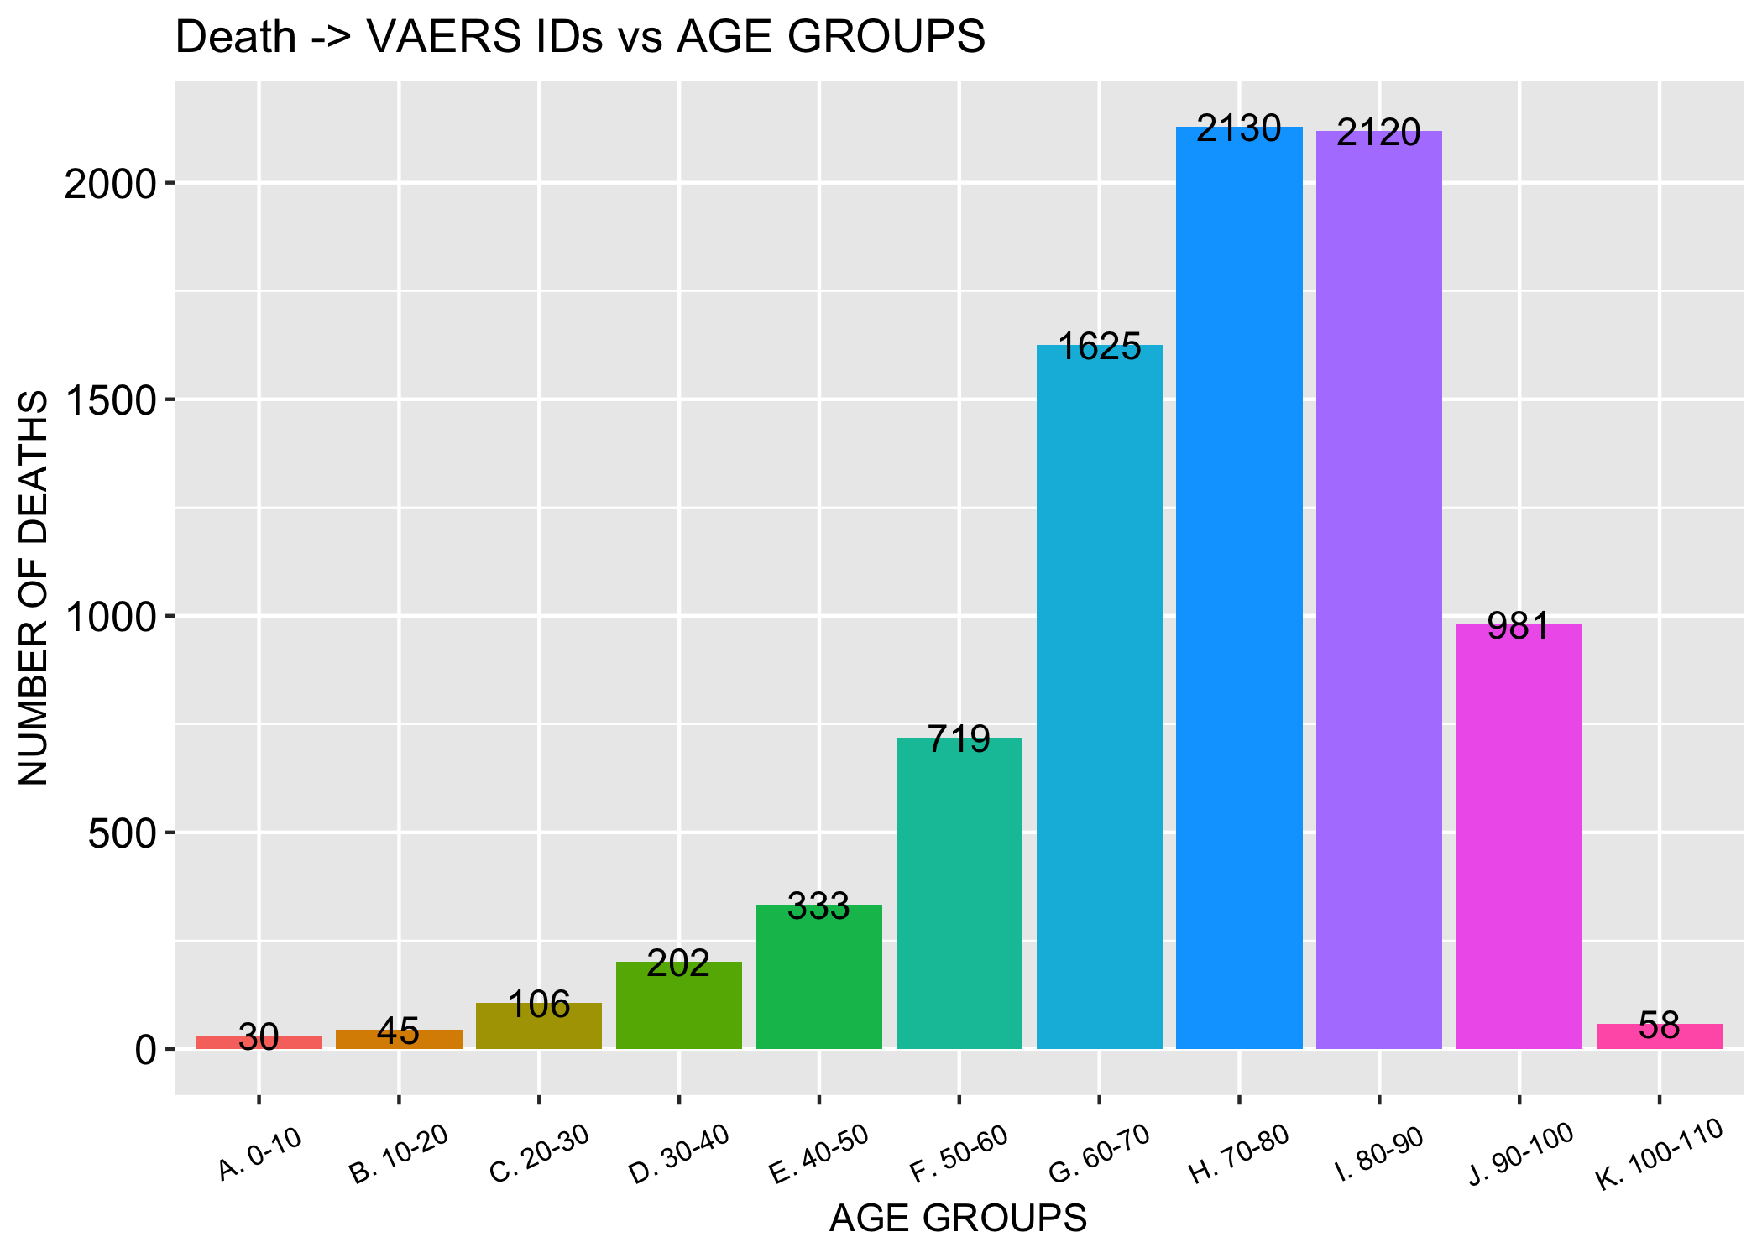
Deaths are being reported at rates not seen in the context of ALL vaccines for the past 30 years…
N = 10,856

Slide 34
Lost safety signals ☹

Slide 35
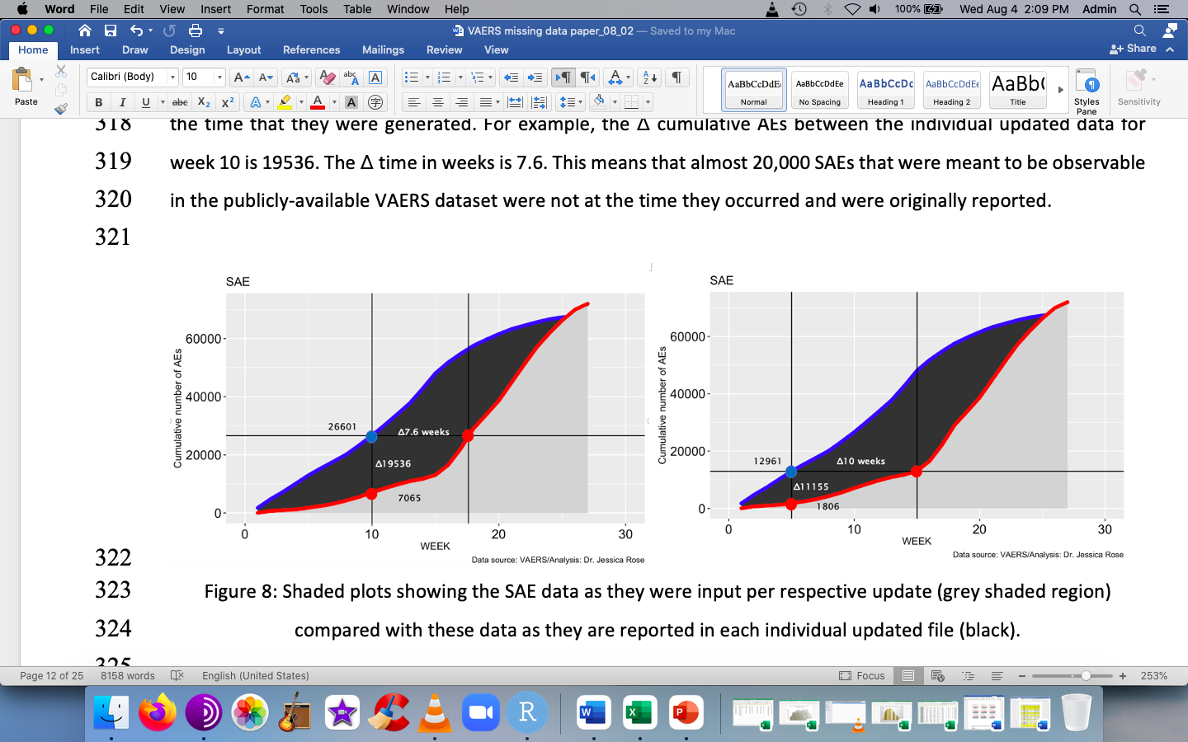
Lost safety signals
Individual updates
Individual updates: every week, the VAERS data is updated… so a new set of data every week!

Slide 36
We would expect the two data trajectories to follow each other…
Most recent update
Most recent update: this file contains all the data from the beginning – or one would hope.

Slide 37
But they don’t…
Most recent update
Most recent update: this file contains all the data from the beginning – or one would hope.

Slide 38
Lost safety signals: VAERS data is being added retroactively due to large backlog of data
Individual updates
Most recent update

Slide 39
Lost safety signals: VAERS data is being added retroactively due to large backlog of data
Individual updates
Most recent update
Notes:
The ∆ cumulative AEs between the individual updated data for week 10 is 19536. The ∆ time in weeks is 7.6. This means that almost 20,000 SAEs that should have been observable in the publicly-available VAERS dataset were not at the time they occurred and were originally reported.

Slide 40
The Potential Under-Reporting Factor (URF)

Slide 41
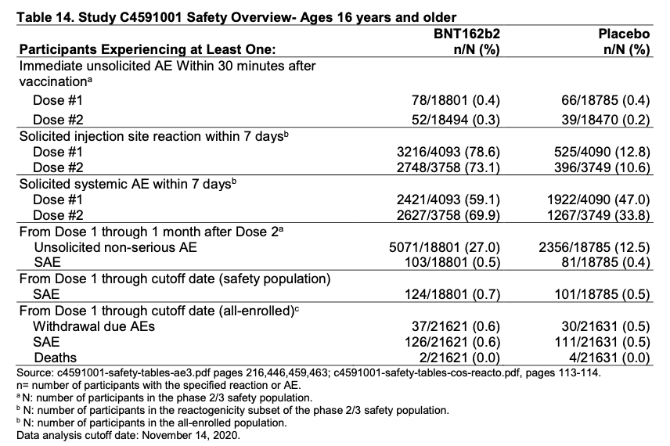
The Potential Under-Reporting Factor (URF)
Vaccines and Related Biological Products Advisory Committee Meeting December 10, 2020. FDA Briefing Document Pfizer-BioNTech COVID-19 Vaccine

Slide 42
The Potential Under-Reporting Factor (URF)
124/18801 = 0.7% = Pfizer rate of SAE incidence
Calculation of expected number of SAEs based on Pfizer SAE rate
0.7% * # of Pfizer doses administered (as of August 10th, 2021) =
0.7% * 351,400,000 = 2,459,800
Observed number of as of August 10th, 2021 = 80011
∴ URF = Expected/Observed = 2,459,800/80011 = 31
∴ 31 is the Under-Reporting Factor (URF)
Since under-reporting of Mild Adverse Events is likely higher than for SAEs, this factor is not inappropriate for any AE.
Vaccines and Related Biological Products Advisory Committee Meeting December 10, 2020. FDA Briefing Document Pfizer-BioNTech COVID-19 Vaccine

Slide 43
Some examples of the URF conversion
CV -> 11,356,385
Neurological -> 12,198,607
Immunological -> 14,316,175
Breakthrough cases -> 1,313,599
FRIs -> 500,036
Children (12-18) -> 1,235,863

Slide 44
Some examples of the URF conversion
Adverse Event | Absolute number | URF applied
Bell’s Palsy | 2,637 | 81,747
Herpes zoster | 4,807 | 149,017
Tinnitus | 6,523 | 202,213
Female Reproductive Issues | 6,549 | 203,019
Death | 6,639 | 205,809
Cough | 9,637 | 298,747
Paraesthesia | 9,860 | 305,660
Lymphadenopathy | 10,420 | 323,020
Chest pain | 11,492 | 356,252
Breakthrough COVID-19 | 11,805 | 365,955
Diarrhoea | 13,495 | 418,345
Injection site pruritis | 15,549 | 482,019
Myalgia | 17,047 | 528,457
Pruritus | 18,103 | 561,193
Dyspnoea (difficulty breathing) | 20,674 | 640,894
Pain | 40,084 | 1,242,604
Fatigue | 61,900 | 1,918,900
Chills | 61,972 | 1,921,132
Headache | 73,565 | 2,280,515
Hospital | 26,402 | 818,462
ER | 59,061 | 1,830,891
Life-threatening events | 7,423 | 230,113
Disabled | 6,861 | 212,691
Birth defects | 258 | 7.998
*updated August 27th, 2021
Data analysis: Steve Kirsch/Dr. Jessica Rose

Slide 45
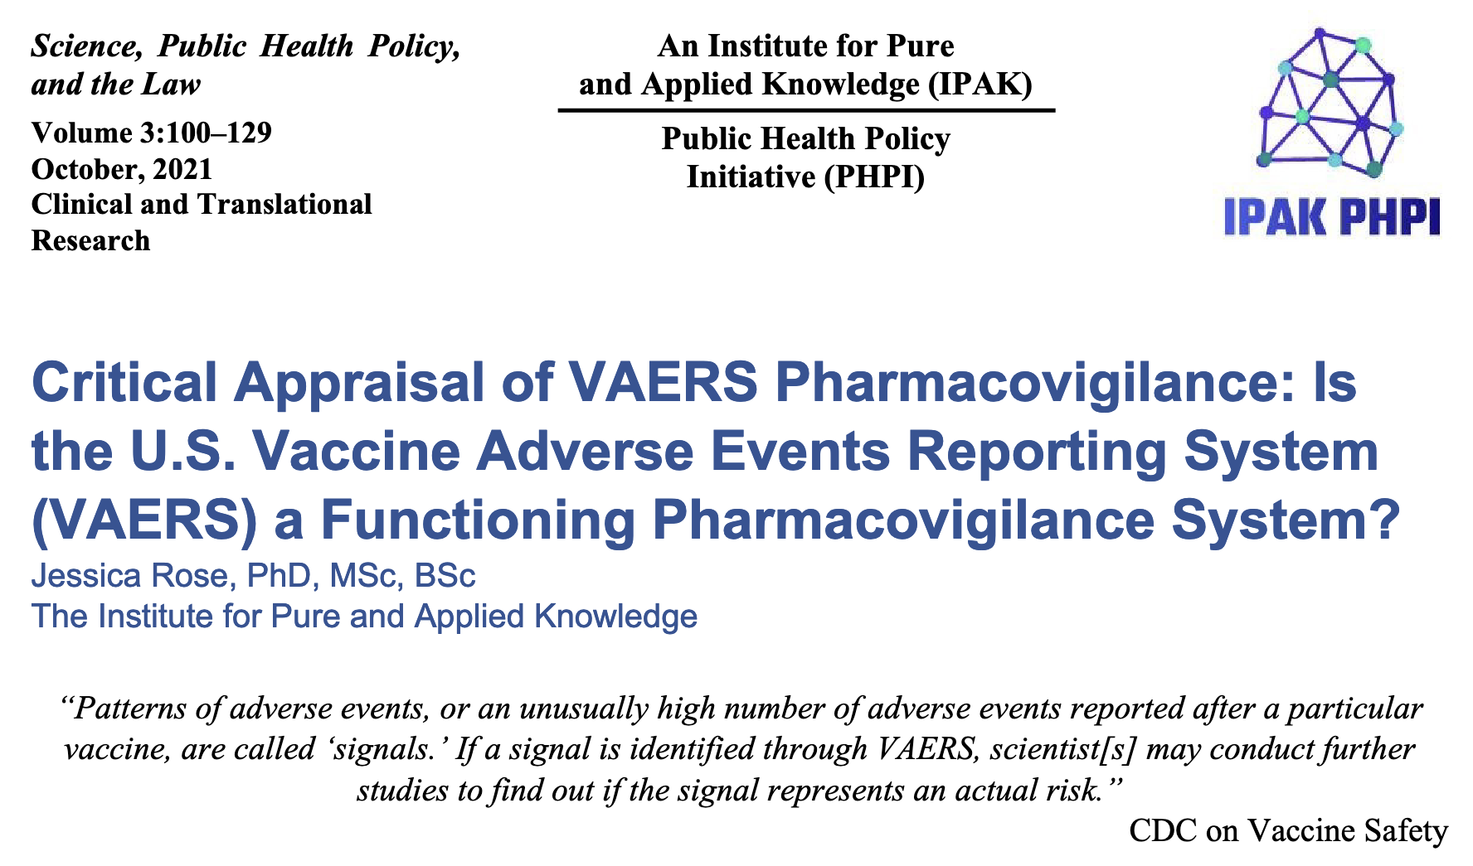
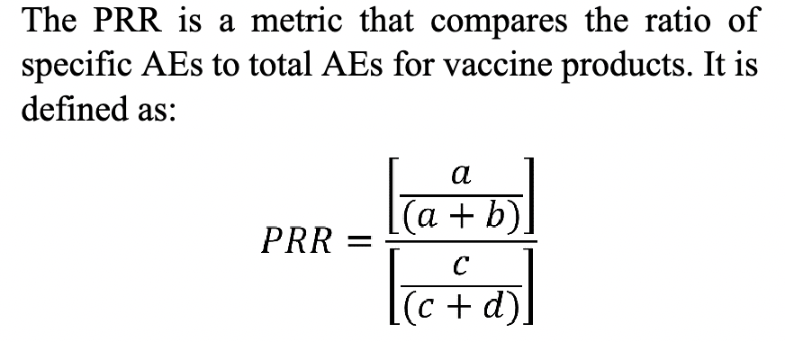
The PRR is currently >1
The proportional reporting ratio (PRR)* is used to define safety signals originating from VAERS.
PRR > 1 – Death is more commonly reported for individuals taking COVID-19 injections, relative to all other injections for 2021.
This indicates that Death is caused by the COVID-19 injections and therefore a "side effect”.
a -> Death count COVID = 10,856
b -> All AEs = 705,991
c -> Death count non-COVID = 334
d -> All AEs non-COVID = 41,784
PRR = 1.9 for 2021
*section 2.3.1 in the SOP: https://www.cdc.gov/vaccinesafety/pdf/VAERS-v2-SOP.pdf
Evans SJ, Waller PC, Davis S. 2001. Use of proportional reporting ratios (PRRs) for signal generation from spontaneous adverse drug reaction reports. Pharmacoepidemiol Drug Saf. Oct–Nov;10(6):483–6. doi: 10.1002/pds.677. PMID: 11828828.

Slide 46
Summary
AEs atypically high and number continue to grow
Injection-induced injury rates increasing anew in spite of waning injections
This is not just happening in the elderly
The backlog of data is resulting in lost safety signals
The URF is telling
Safety
AE counts/ratios, the backlog and the URF (PRR)
Causation
Efficacy
Delta
Epigenetic pressure

Slide 47
Talking points
SAFETY - AE counts/ratios, the backlog and the URF/PRR/Causation
Myocarditis/Female Reproductive Issues/Kids
EFFICACY - Variants -> Delta
Breakthrough infections/Epigenetic pressure/Why it is a bad idea to inject kids

Slide 48
Evidence of causation remains from previous update…
Causation by Bradford Hill Criteria
Strength (effect size): A small association does not mean that there is not a causal effect, though the larger the association, the more likely that it is causal.
Consistency (reproducibility): Consistent findings observed by different persons in different places with different samples strengthens the likelihood of an effect.
Specificity: Causation is likely if there is a very specific population at a specific site and disease with no other likely explanation. The more specific an association between a factor and an effect is, the bigger the probability of a causal relationship.^{[1]}
Temporality: The effect has to occur after the cause (and if there is an expected delay between the cause and expected effect, then the effect must occur after that delay).
Biological gradient (dose-response relationship): Greater exposure should generally lead to greater incidence of the effect. However, in some cases, the mere presence of the factor can trigger the effect. In other cases, an inverse proportion is observed: greater exposure leads to lower incidence.^{[1]}
Plausibility: A plausible mechanism between cause and effect is helpful (but Hill noted that knowledge of the mechanism is limited by current knowledge).
Coherence: Coherence between epidemiological and laboratory findings increases the likelihood of an effect. However, Hill noted that "... lack of such [laboratory] evidence cannot nullify the epidemiological effect on associations".
Experiment: "Occasionally it is possible to appeal to experimental evidence".
Analogy: The use of analogies or similarities between the observed association and any other associations.
Reversibility: If the cause is deleted then the effect should disappear as well.

Slide 49
Evidence of causation remains from previous update…
Causation by Bradford Hill Criteria
Strength (effect size): A small association does not mean that there is not a causal effect, though the larger the association, the more likely that it is causal.
Consistency (reproducibility): Consistent findings observed by different persons in different places with different samples strengthens the likelihood of an effect.
Specificity: Causation is likely if there is a very specific population at a specific site and disease with no other likely explanation. The more specific an association between a factor and an effect is, the bigger the probability of a causal relationship.
Temporality: The effect has to occur after the cause (and if there is an expected delay between the cause and expected effect, then the effect must occur after that delay).
Biological gradient (dose-response relationship): Greater exposure should generally lead to greater incidence of the effect. However, in some cases, the mere presence of the factor can trigger the effect. In other cases, an inverse proportion is observed: greater exposure leads to lower incidence.
Plausibility: A plausible mechanism between cause and effect is helpful (but Hill noted that knowledge of the mechanism is limited by current knowledge).
Coherence: Coherence between epidemiological and laboratory findings increases the likelihood of an effect. However, Hill noted that "... lack of such [laboratory] evidence cannot nullify the epidemiological effect on associations".
Experiment: "Occasionally it is possible to appeal to experimental evidence".
Analogy: The use of analogies or similarities between the observed association and any other associations.
Reversibility: If the cause is deleted then the effect should disappear as well.

Slide 50
We would expect AEs to happen at any given point on the x-axis if no causal relationship
Vaccination Date = VD
Onset of AEs date = OD
Amount of time passed between = OD-VD
% OF REPORTED AEs
OD-VD
0 1 2 3 4 5 6 ⇢
NUMBER OF DAYS FOLLOWING INJECTION
12/27/21
Data source: VAERS/Analysis: Dr. Jessica Rose

Slide 51
We would expect AEs to happen at any given point on the x-axis if no causal relationship
This is not what we see…
% OF REPORTED DEATHS
OD-VD
0 1 2 3 4 5 6 ⇢
NUMBER OF DAYS FOLLOWING INJECTION
12/27/21
Data source: VAERS/Analysis: Dr. Jessica Rose

Slide 52
We would expect AEs to happen at any given point on the x-axis if no causal relationship
We see something like this…
% OF REPORTED DEATHS
OD-VD
0 1 2 3 4 5 6 ⇢
NUMBER OF DAYS FOLLOWING INJECTION
12/27/21
Data source: VAERS/Analysis: Dr. Jessica Rose

Slide 53
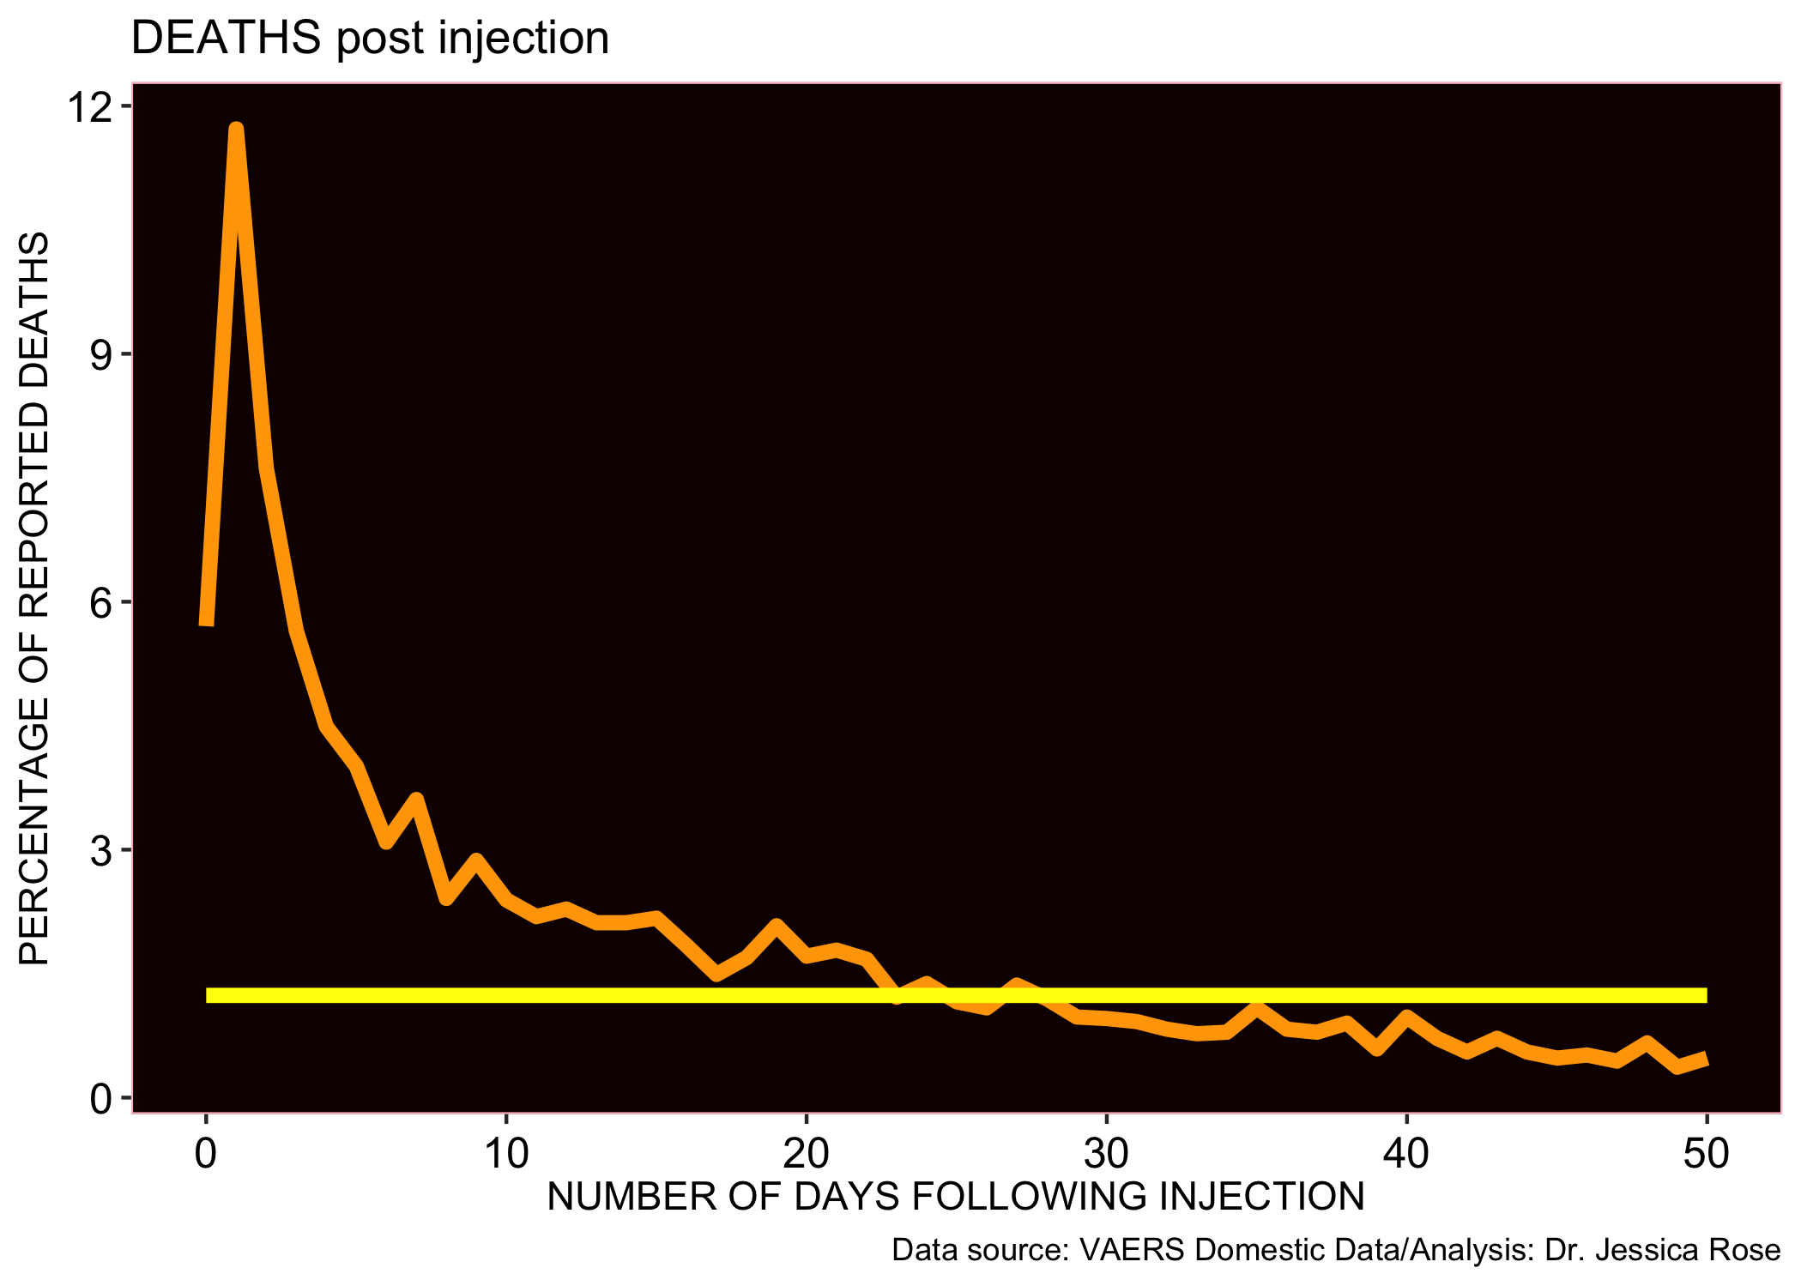
Evidence of causation remains from previous update…
Clustering of reports around 0 and 1

Slide 54
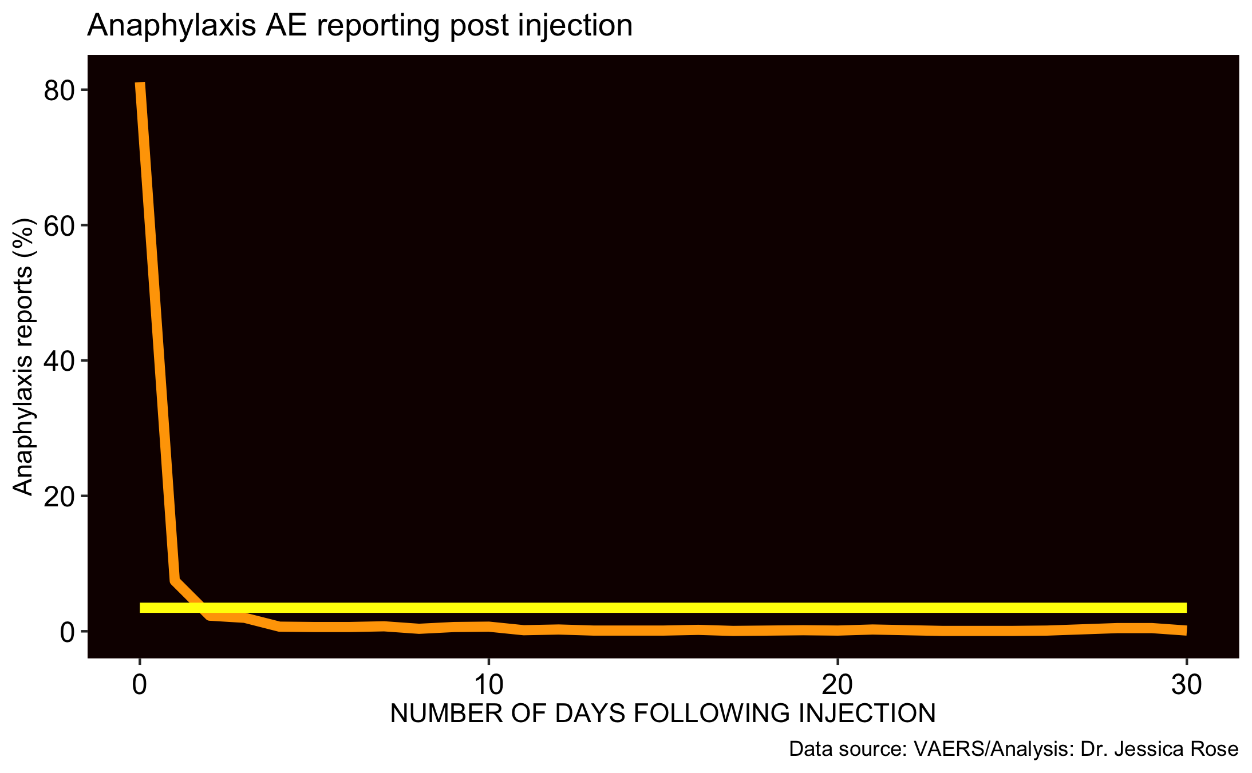
Evidence of causation remains from previous update…
88% of reports filed within 24 hours
Anaphylaxis as a positive control…

Slide 55
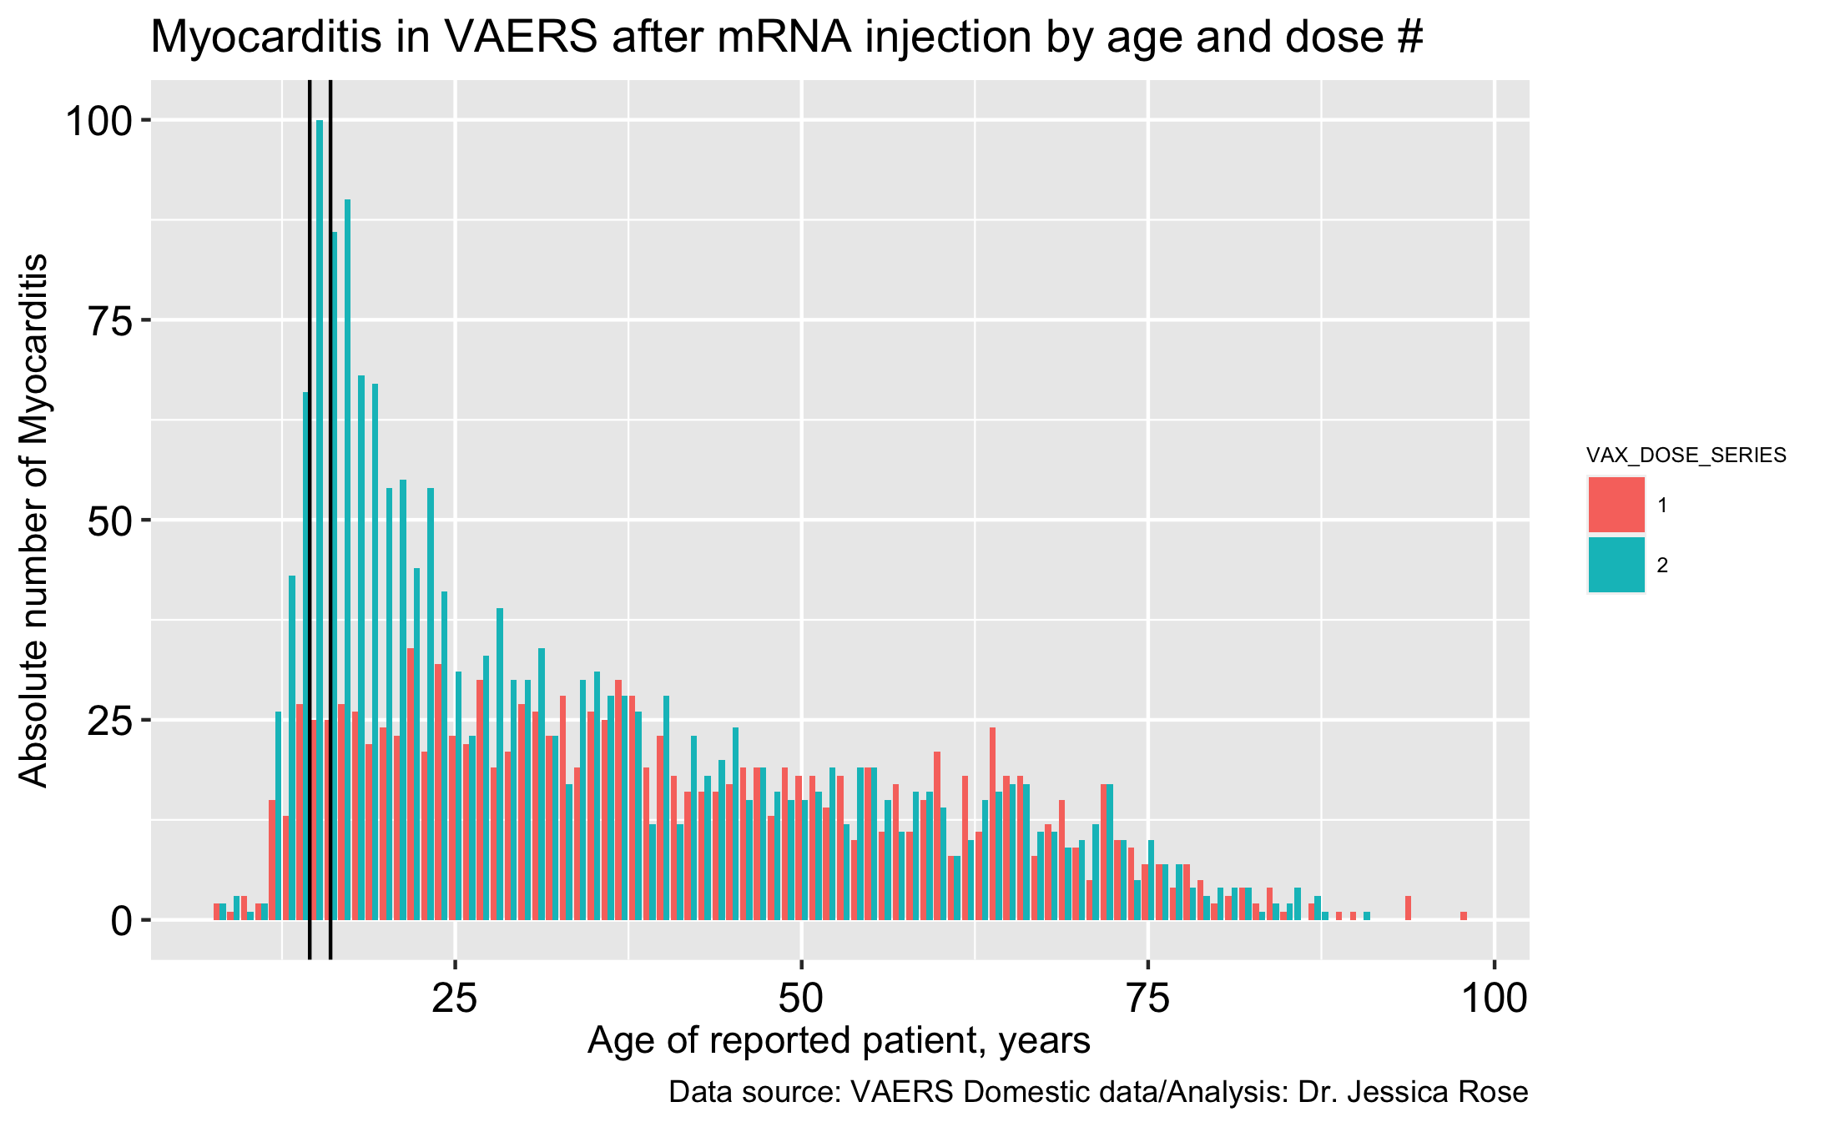
Second dose frequency reporting strong evidence to support causation of Myocarditis
31% of reports were made within 24 hours
46% of reports were made within 48 hours
N = 4,255

Slide 56
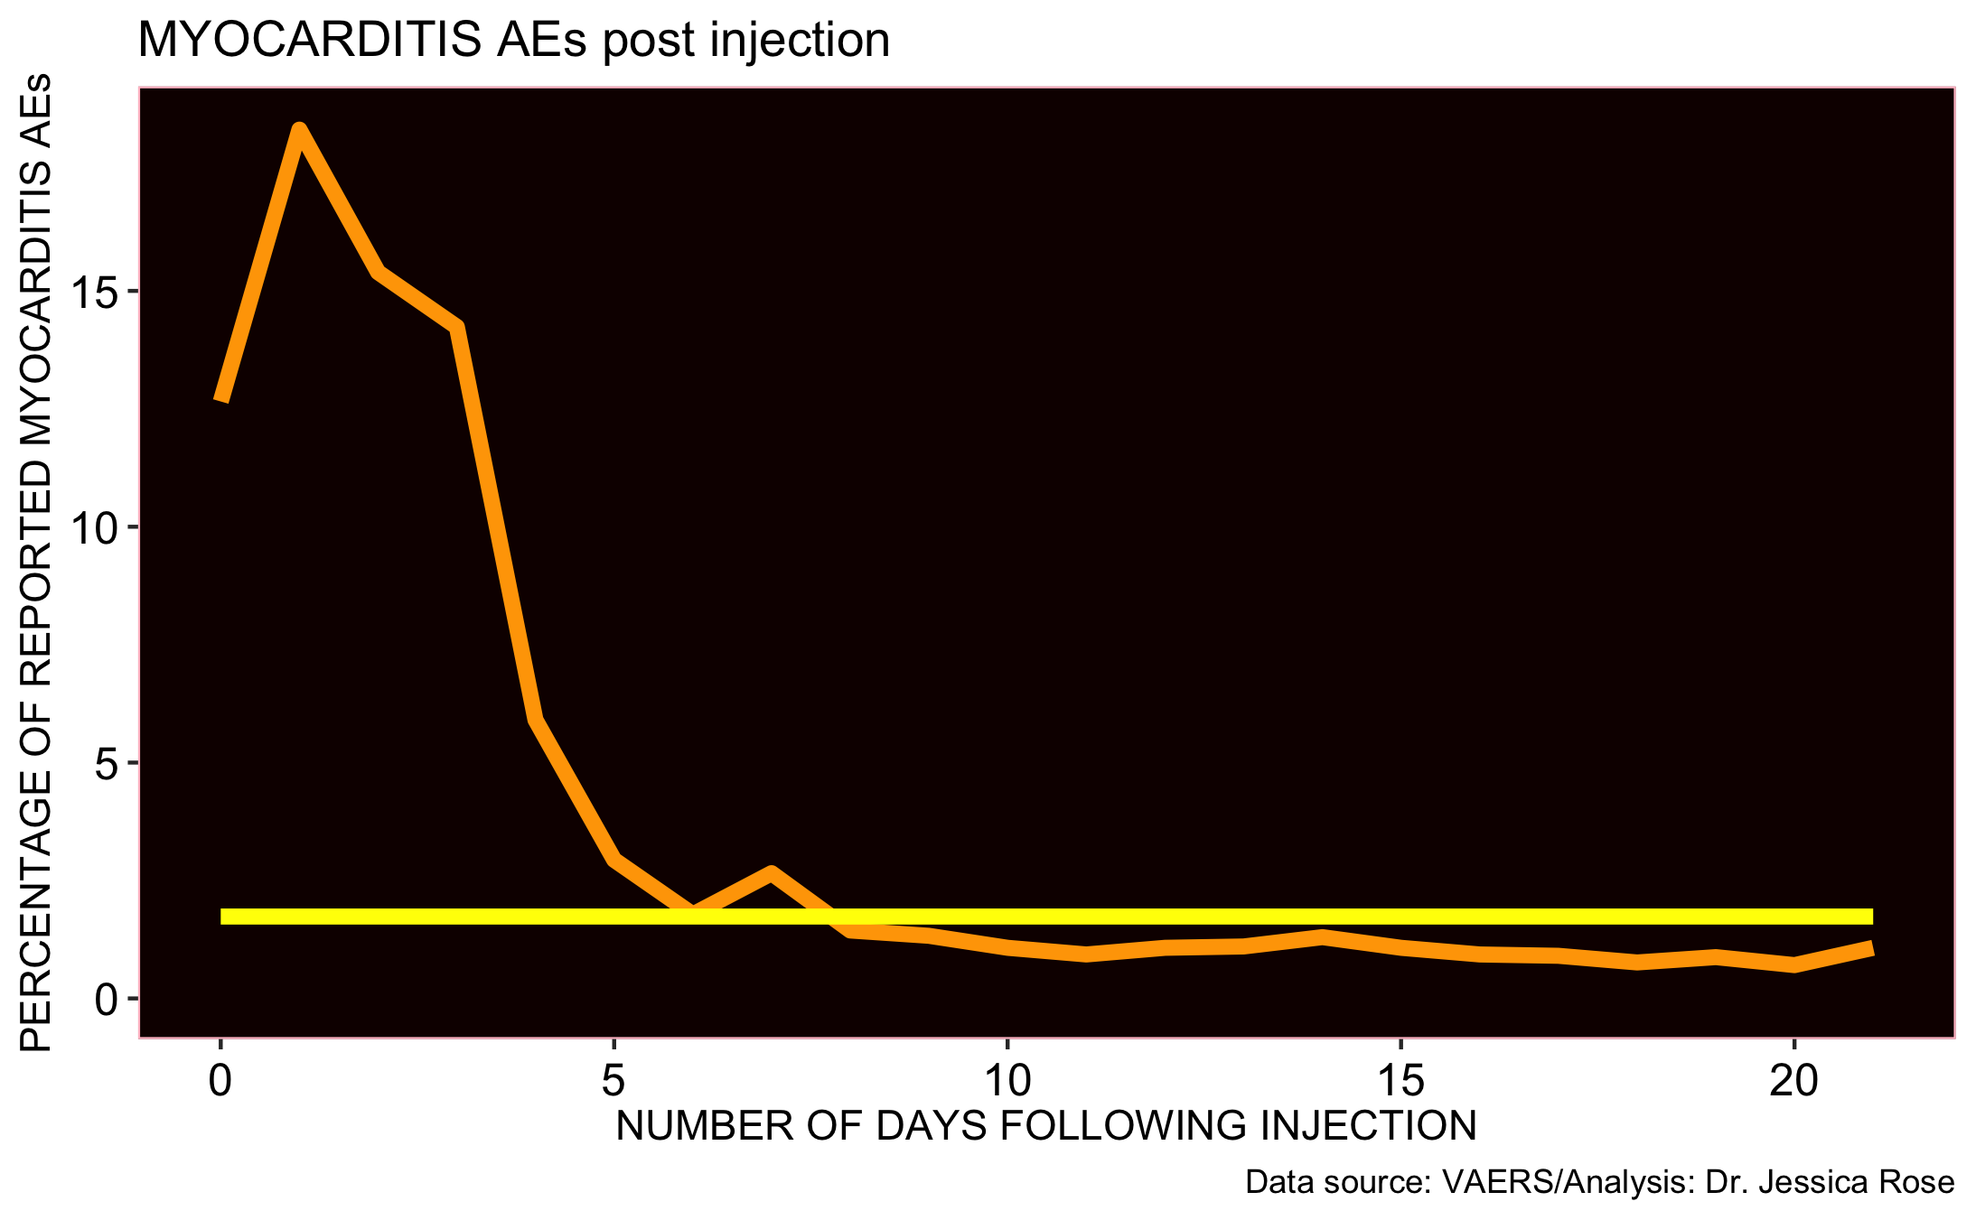
ALL DOSE ALL AGE frequency reporting strong evidence to support causation of Myocarditis
31% of reports were made within 24 hours
46% of reports were made within 48 hours
10% of myocarditis reports are made for 12-15 year-olds

Slide 57
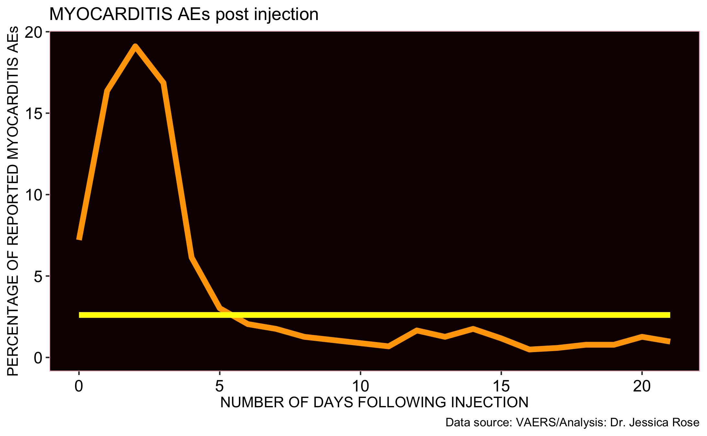
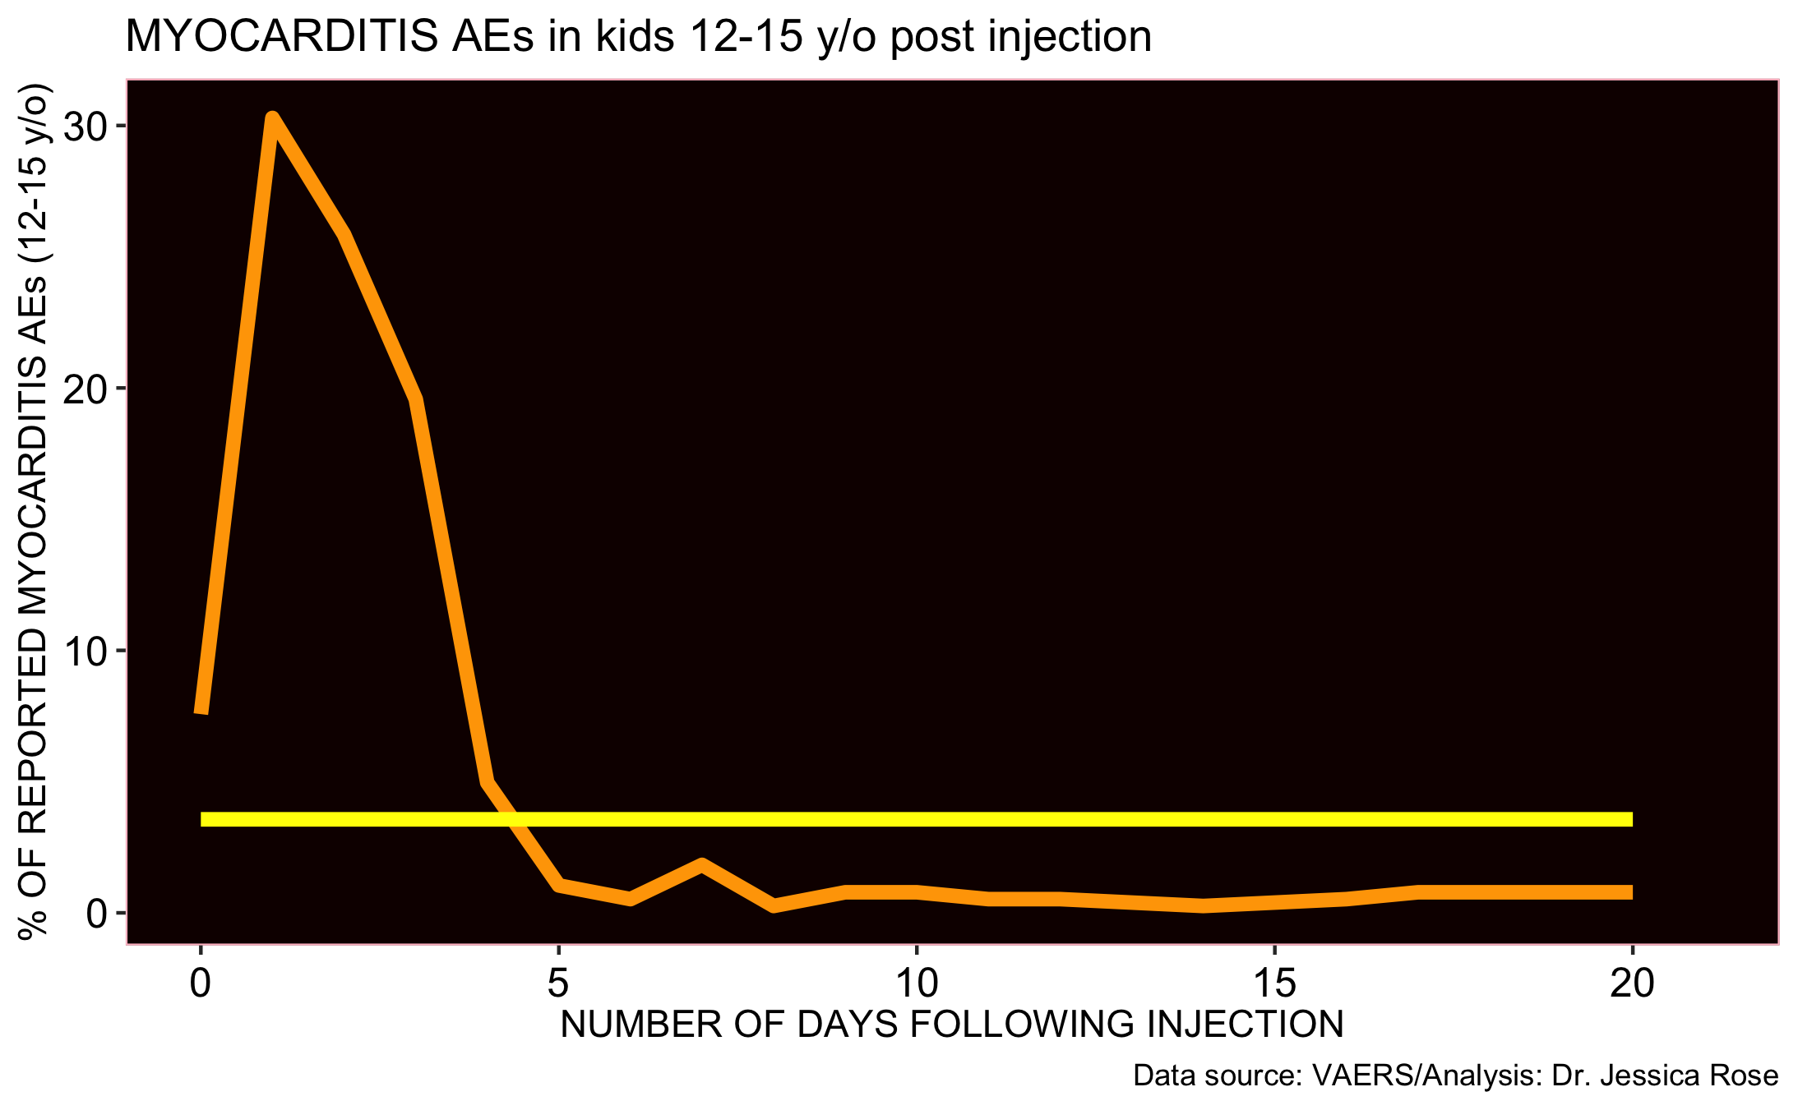
All dose frequency reporting strong evidence to support causation of Myocarditis
31% of reports were made within 24 hours
46% of reports were made within 48 hours
37% of reports were made within 24 hours
64% of reports were made within 48 hours
10% of myocarditis reports are made for 12-15 year-olds

Slide 58

A NOTE ABOUT KIDS

Slide 59
Three reasons NOT to give the kids these shots
Never mass vaccinate a population with a non-sterilizing product across all age groups during a pandemic.
Geert Vanden Bossche, DVM, PhD
Needless COVID-19 is not a childhood disease
Harmful Adverse events/no safety data
Dangerous Potential for driving variants of concern

Slide 60
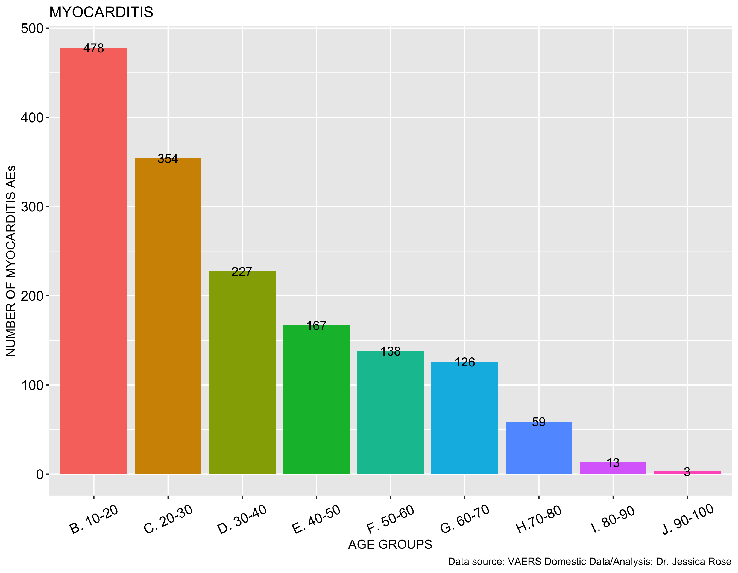
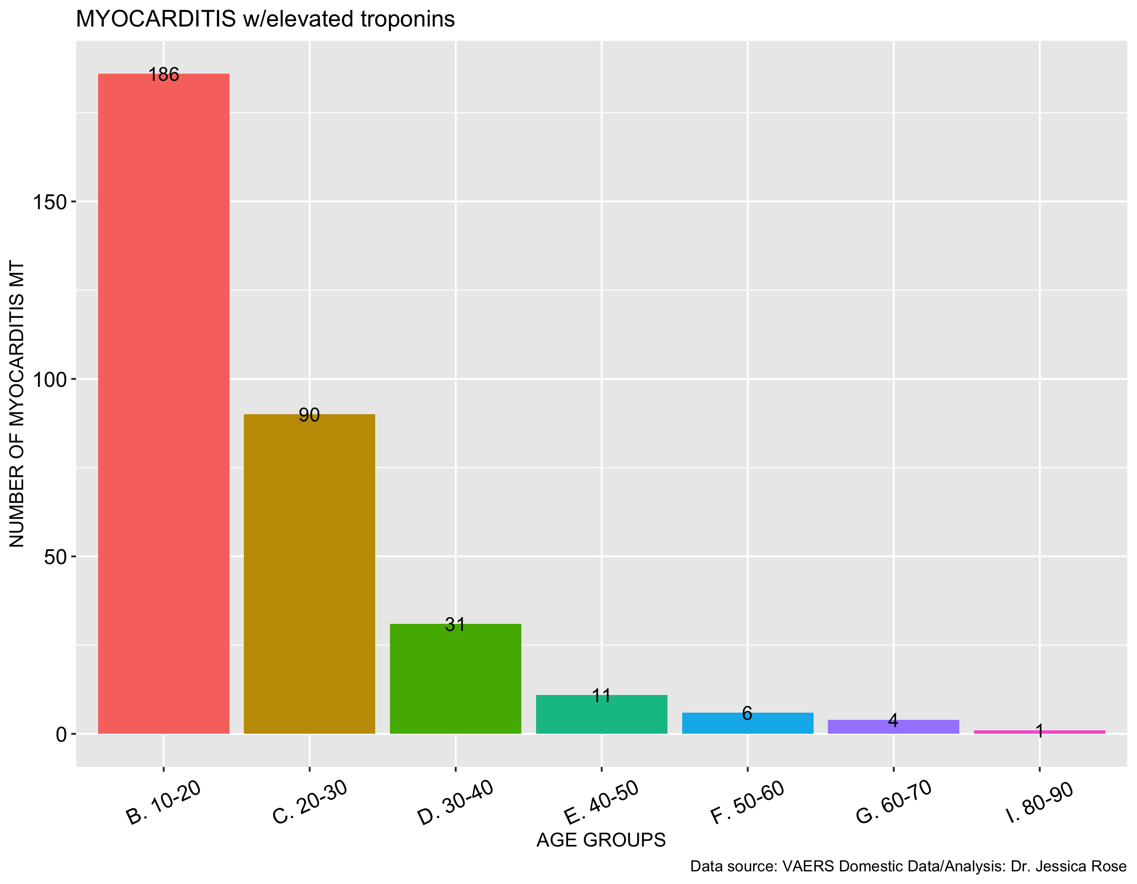
Myocarditis associated with elevated troponins (markers of heart damage)
N=1,742
N=341
Histogram showing all myocarditis reports in VAERS by age group
Histogram showing all myocarditis reports in VAERS by age group associated with elevated troponins

Slide 61
Myocarditis not MILD – 73% of reports made for children ages 12-17 are associated with HOSPITALIZATION
Variable N (% total) | Myocarditis N = 1743 | Myocarditis w/elevated troponin N = 341 | Myocarditis w/o elevated troponin N = 1402 | Myocarditis Children 0-20 N = 489 | Myocarditis Children 12-17 N = 313
Death | 34 (2) | 0 (0) | 34 (2.4) | 1 (0.2) | 0 (0)
Hospital | 941 (54) | 252 (74) | 689 (49) | 338 (69.1) | 229 (73.2)
ER | 727 (42) | 124 (36.4) | 603 (43) | 192 (39.3) | 114 (36.4)
Covid Cases§ | 12 (0.7) | 1 (0.3) | 11 (0.8) | 1 (0.2) | 1 (0.3)
Chest Pain | 696 (40) | 174 (51) | 522 (37.2) | 278 (56.9) | 194 (62)

Slide 62
Comparison of cumulative doses versus cumulative deaths

Slide 63
Summary
Large percentage of reports made within 48 hours
Bradford Hill Criteria satisfied
Dose 2 myocarditis reports provide further evidence of causative effect
Autoimmune myocarditis AEs reported in the absence of COVID-19*
1:1 ratio between deaths and injections
Safety
AE counts/ratios, the backlog and the URF
Causation
Efficacy
Delta
Epigenetic pressure
*Chamling B, Vehof V, Drakos S, et al. Occurrence of acute infarct-like myocarditis following COVID-19 vaccination: just an accidental co-incidence or rather vaccination-associated autoimmune myocarditis? Clin Res Cardiol. 2021;1-5.

Slide 64
Talking points
SAFETY - AE counts/ratios, the backlog and the URF/PRR/Causation
Myocarditis/Female Reproductive Issues/Kids
EFFICACY - Variants -> Delta
Breakthrough infections/Epigenetic pressure/Why it is a bad idea to inject kids

Slide 65
What is a Variant?
It is an adaption to new hosts and environments via mutation that is highly dependent on their ability to generate de novo (new) diversity in a short period of time and can be directed by environmental changes such as exogenous drugs.*
*Rafael Sanjuán and Pilar Domingo-Calap. Mechanisms of viral mutation. Cell Mol Life Sci. 2016; 73(23): 4433–4448. Published online 2016 Jul 8. doi: 10.1007/s00018-016-2299-6.

Slide 66
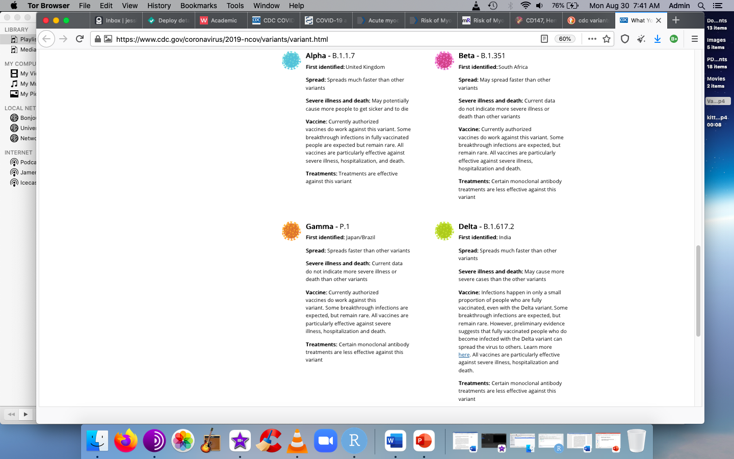
SARS-nCoV-2 variants
Omicron - B.1.1.529
First identified: South Africa
Spread: Fast
Severe illness and death: No
*Rafael Sanjuán and Pilar Domingo-Calap. Mechanisms of viral mutation. Cell Mol Life Sci. 2016; 73(23): 4433–4448. Published online 2016 Jul 8. doi: 10.1007/s00018-016-2299-6.

Slide 67
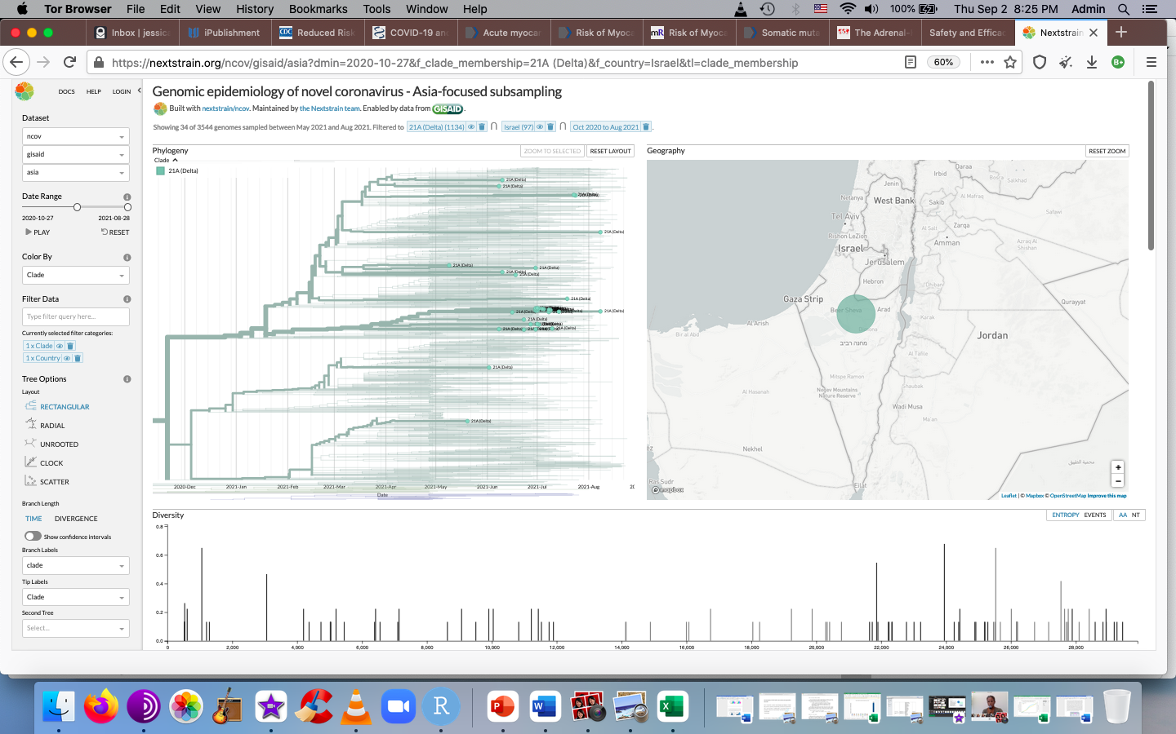
When did the delta variant arise in Israel?
May 9th, 2021
July 2021:
cluster

Slide 68
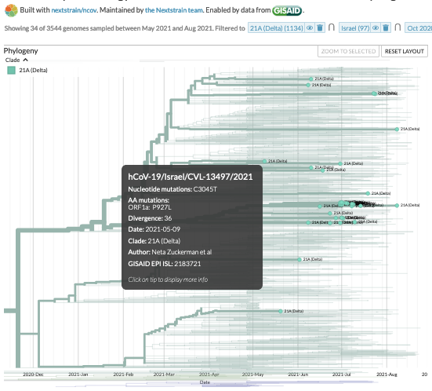
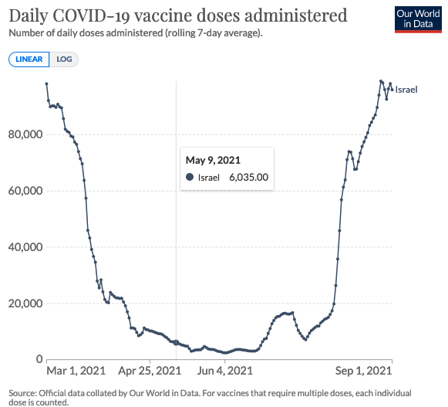
When did the delta arise in Israel?
May 2021

Slide 69
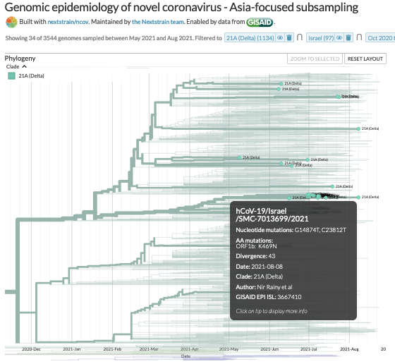
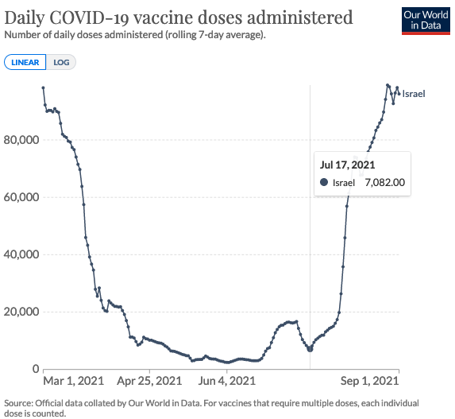
When did delta cases grow in Israel?

Slide 70
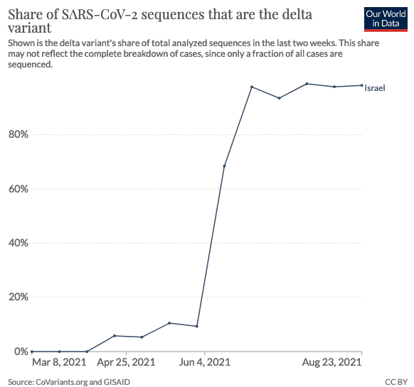
98.18% of sequences are delta variant in Israel

Slide 71
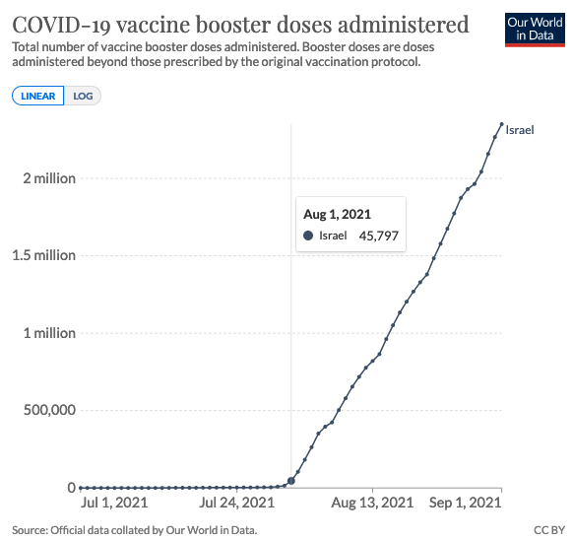
Booster doses are also concomitant to delta variant spread in Israel

Slide 72
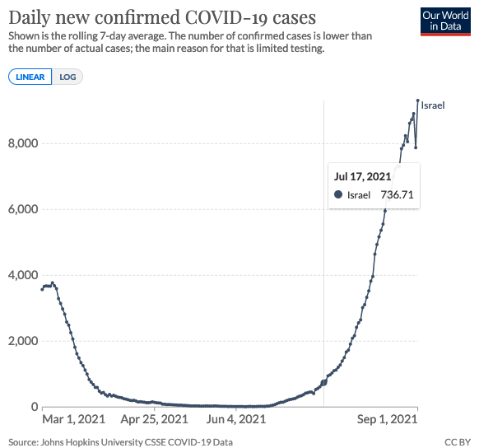
Cases started growing at the same time as delta clustering and injection restart
July 17th, 2021

Slide 73
Cases started growing at the same time as delta clustering and injection restart
July 17th, 2021

Slide 74

Safety and efficacy called into question

Slide 75
Summary
Immune escape can take place at the host population level
The benefit of escape resides in the ability of the virus to re-infect hosts that have developed protective immunity or infect hosts with that recognize the same antigens
Safety
AE counts/ratios, the backlog and the URF
Causation
Efficacy
Delta
Breakthrough infections/Epigenetic pressure

Slide 76
Talking points
SAFETY - AE counts/ratios, the backlog and the URF/PRR/Causation
Myocarditis/Female Reproductive Issues/Kids
EFFICACY - Variants -> Delta
Breakthrough infections/Epigenetic pressure/Why it is a bad idea to inject kids

Slide 77
What is a breakthrough infection?
Etymology of the word ‘breakthrough’: The verbal phrase is attested from c. 1400 in the sense "overcome or penetrate a barrier." Meaning "abrupt solution or progress" is from 1930s, on the notion of a successful attack.*
What is a epigenetic pressure?
Modifications of the genome by exogenous factors. Vaccines, for example, can put evolutionary pressure on viruses to speed up mutations and potentially create more virulent and dangerous variants.*
https://pubmed.ncbi.nlm.nih.gov/25646075/*

Slide 78
Breakthrough infections? Waning immunity?
Protective immunity, if previously established, is lacking
Natural innate and adaptive responses are obfuscated in the context of a targeted immune-inducing therapy
Injected individuals are ‘immunocompromised’ with regards to COVID-19 ‘variants’**
*Rafael Sanjuán and Pilar Domingo-Calap. Mechanisms of viral mutation. Cell Mol Life Sci. 2016;
73(23): 4433–4448. Published online 2016 Jul 8. doi: 10.1007/s00018-016-2299-6.
**Gazit, et al. Comparing SARS-CoV-2 natural immunity to vaccine-induced immunity: reinfections versus breakthrough infections by Covid Strategies | Aug 25, 2021 | Science & News, Vaccines

Slide 79

32,039 breakthrough COVID cases reported to VAERS

Slide 80
Open questions…
Does prior exposure to WT or other variants render the individual protected against the delta variant?
Does one dose

Slide 81
0% efficacy in injected individuals above 20 years of age with regards to breakthrough infections

Slide 82

0% efficacy in injected individuals 20-29 years of age with regards to breakthrough infections

Slide 83

Evolutionary pressure on viruses to speed up mutations?
U.S./Israel -> Mid-December 2020

Slide 84


Omicron is a live-attenuated viral vaccine

Slide 85
Summary
Breakthrough infection rates are increasing
This could be the result of waning immunity from injections
Injections may be propagating immunocompromisation
Epigenetic pressure from injections could be driving the emergence of variants
Safety
AE counts/ratios, the backlog and the URF
Causation
Efficacy
Delta
Breakthrough infections/Epigenetic pressure

Slide 86
SUMMARY
AEs are still rising even though the rates of injection have declined
  The AEs themselves are a new injection-induced disease
The onus is on the opponents of causation to prove that there is no causative relationship
  The VD_OD plots and the myocarditis dose plots tell the same story
The injections are failing
Leave the kids alone
Omicron is a live-attenuated viral vaccine

Slide 87
Conclusions
Use early treatment
Stop injection roll-out until safety and efficacy can properly be assessed
Develop treatment options for the injection-injured
Leave the kids alone – opt for true herd immunity

Slide 88
Recommendation: early treatment with known efficacious and safe drugs.
Acknowledgements:
Enormous thanks to those who are trying to do science properly. I really appreciate you.

Slide 89

Joshua Kuntz Research Fellowship
Please head to: https://ipaknowledge.org/joshua-kuntz-research-fellowship.php to make a small donation. ☺

