Slide 1

Robust Round Table Webinar #1
Dr. Jessica Rose
December 22, 2021

Slide 2
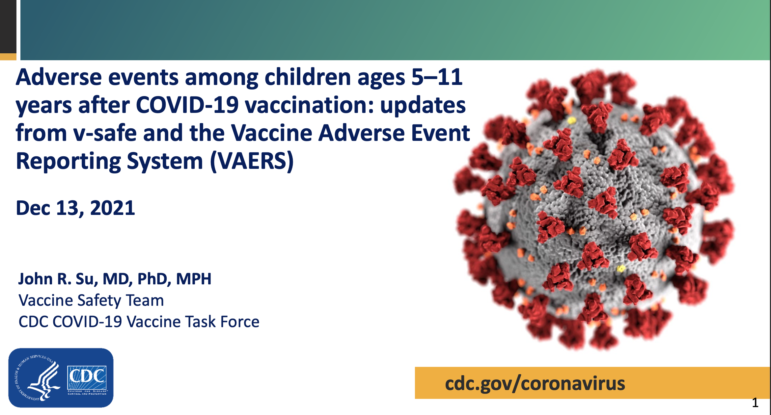
In response to the December 13, 2021 ACIP meeting presentation by John Su

Slide 3
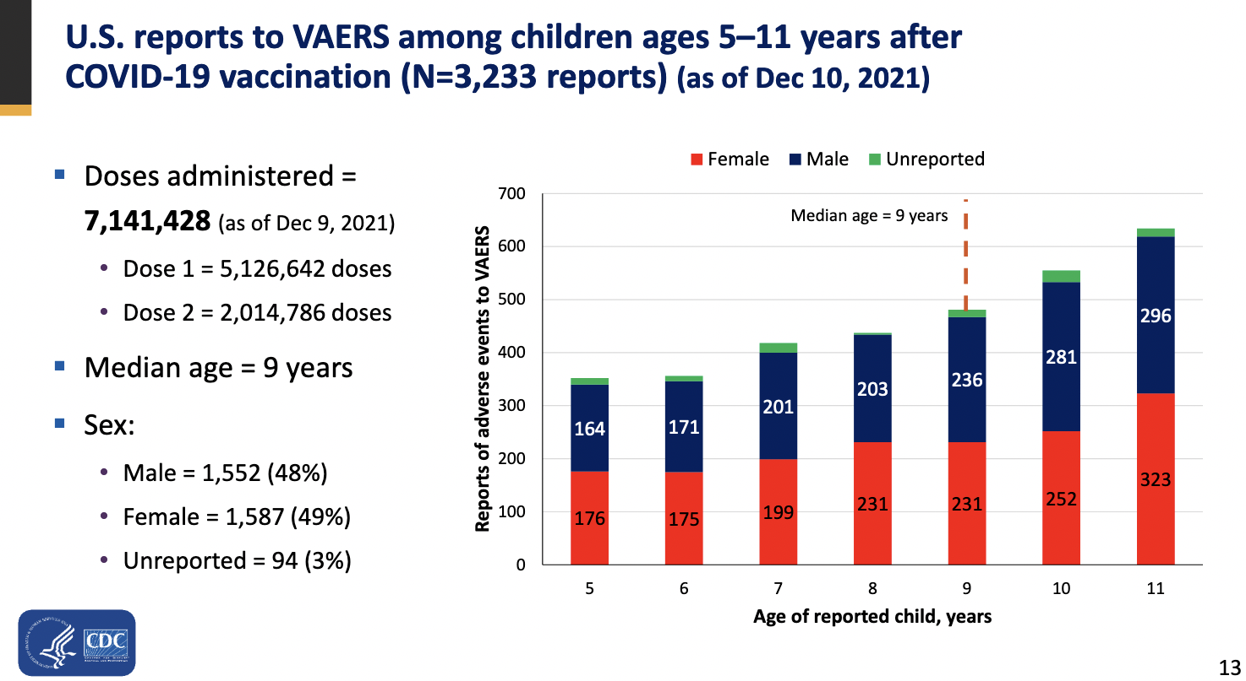
N reports, gender stratified, not confirmed.
U.S. reports to VAERS among children ages 5-11 years after COVID-19 injection (N=3,917) as of December 17th, 2021)
If we consider an under-reporting factor of 41 -> 160,597
Median age = 9 years
Sex:
Male = 1,891 (48%)
Female = 1,927 (49%)
Unreported = 99 (3%)

Slide 4
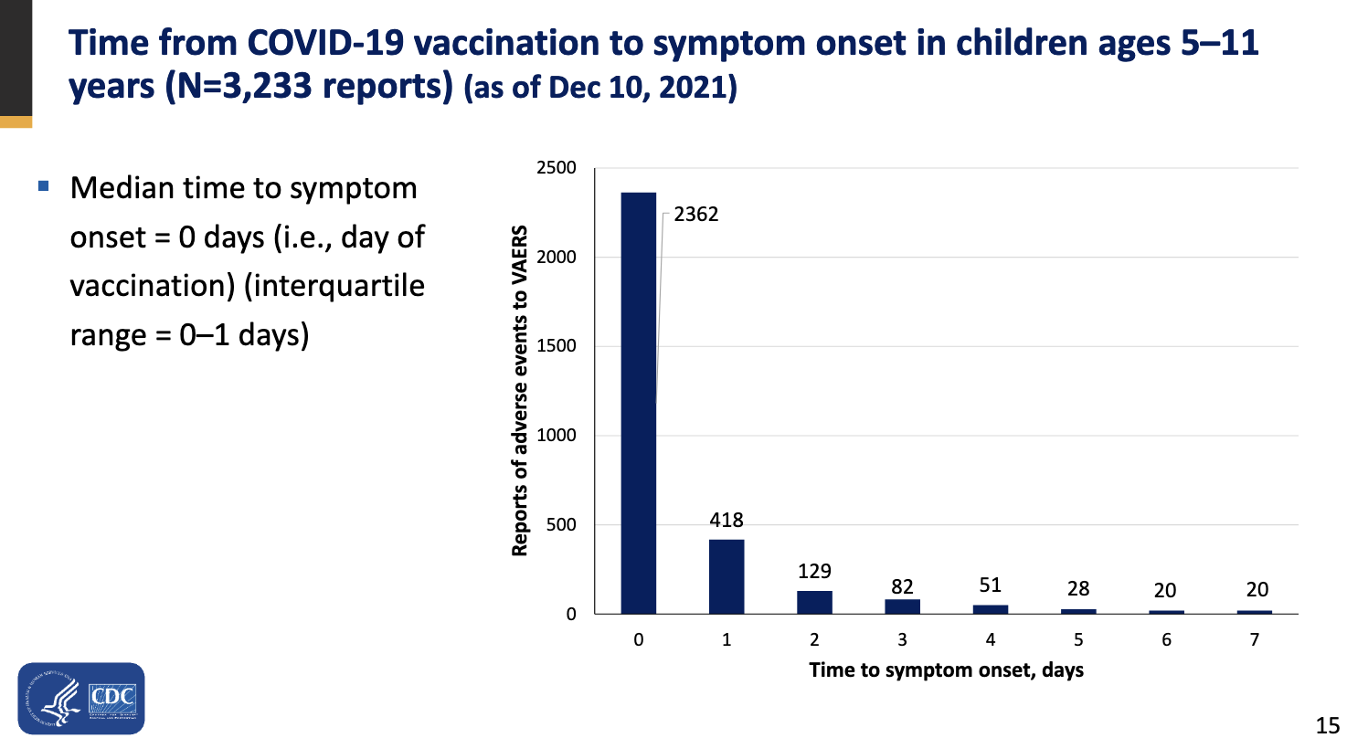
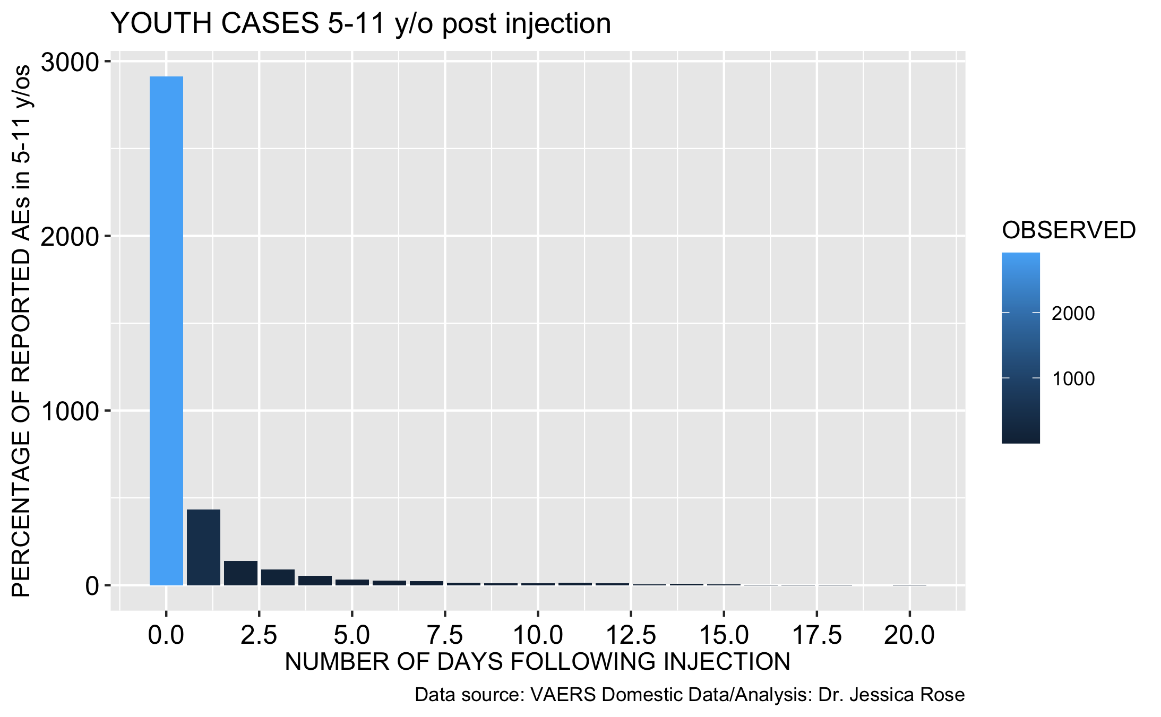
Trend toward immediate reporting is confirmed although N is not.
Su
Rose
Time from COVID-19 injection to symptom onset in children ages 5-11 years (N= 3,917) (as of December 17, 2021)

Slide 5
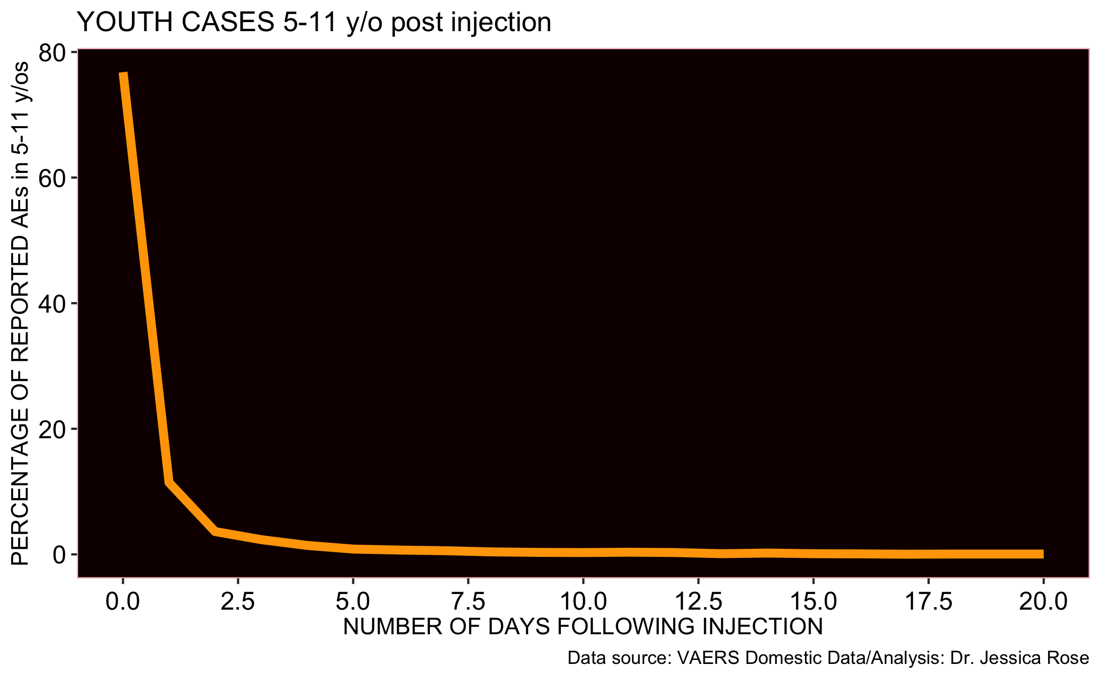
88% of adverse event reports filed to VAERS for 5-11 year olds - within 24 hours
diff_in_days | n | OBSERVED | Percentage_OBSERVED
0 days | 2914 | 2914 | 76.78524374
1 days | 434 | 434 | 11.43610013

Slide 6
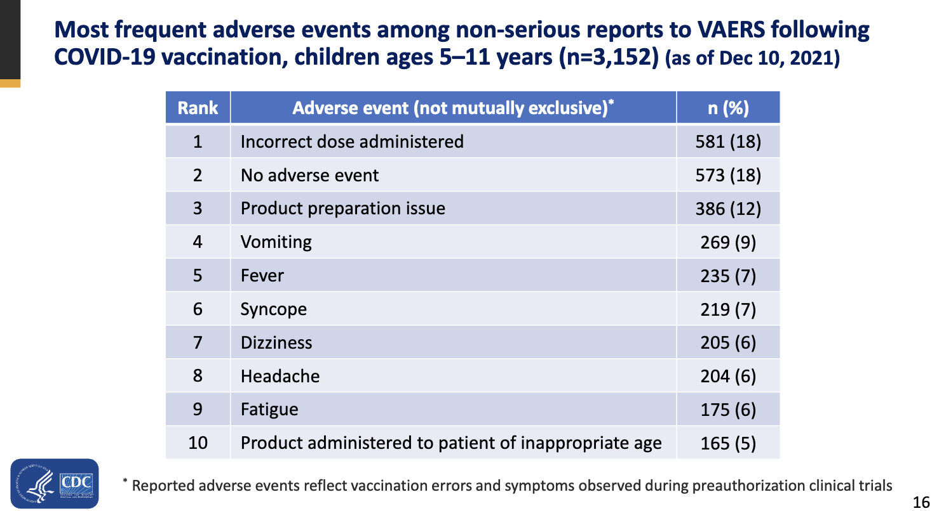
The ACIP reported statistics on non-serious adverse events by John Su are not confirmed and the ranks are wrong.
Su
Rose
Most frequent adverse events among non-serious reports to VAERS following COVID-19 injection, children ages 5-11 years (N=3,600) (as of December 17, 2021)

Slide 7
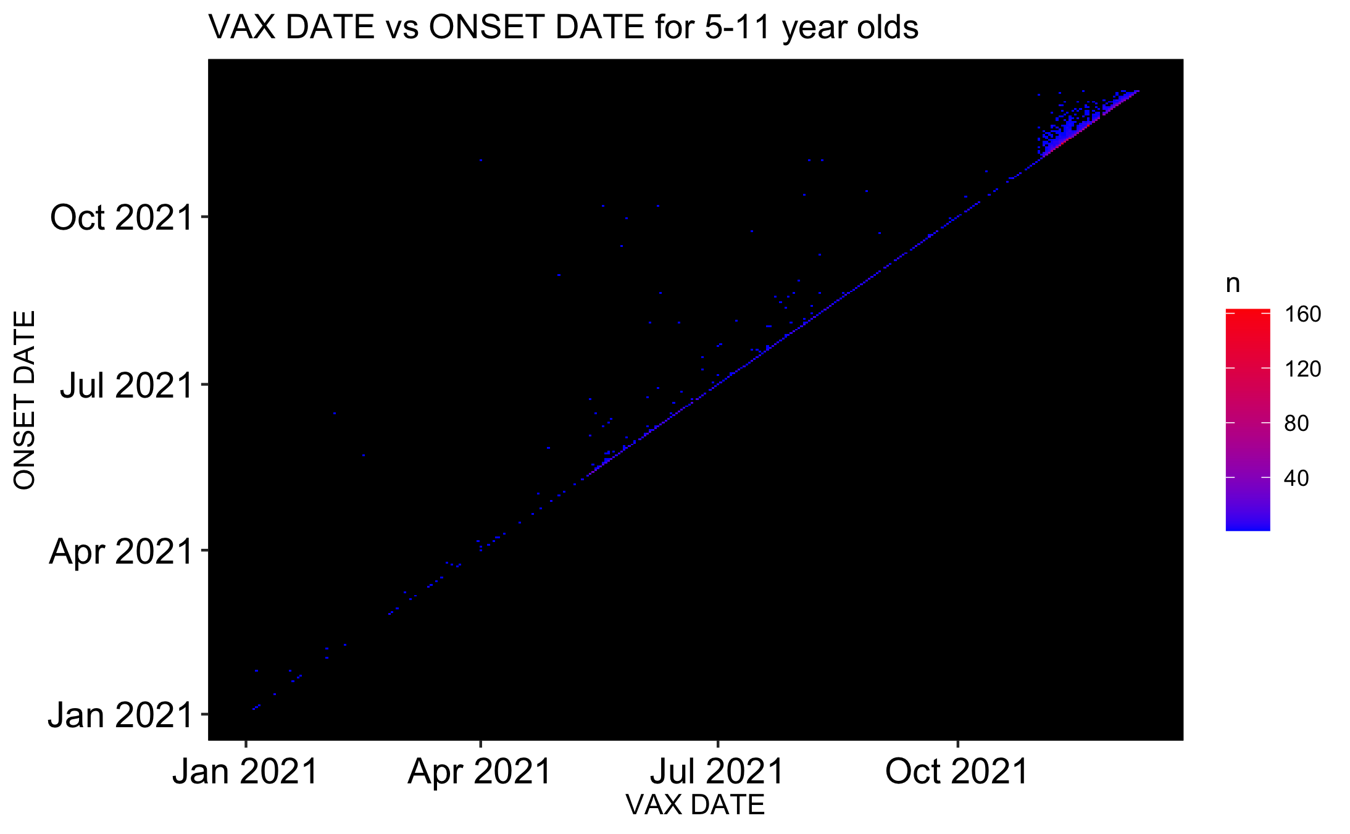
This heat map shows how many 5-11 year olds not only were injected but reported an AE to VAERS
N = 3,917
With URF = 160,597

Slide 8
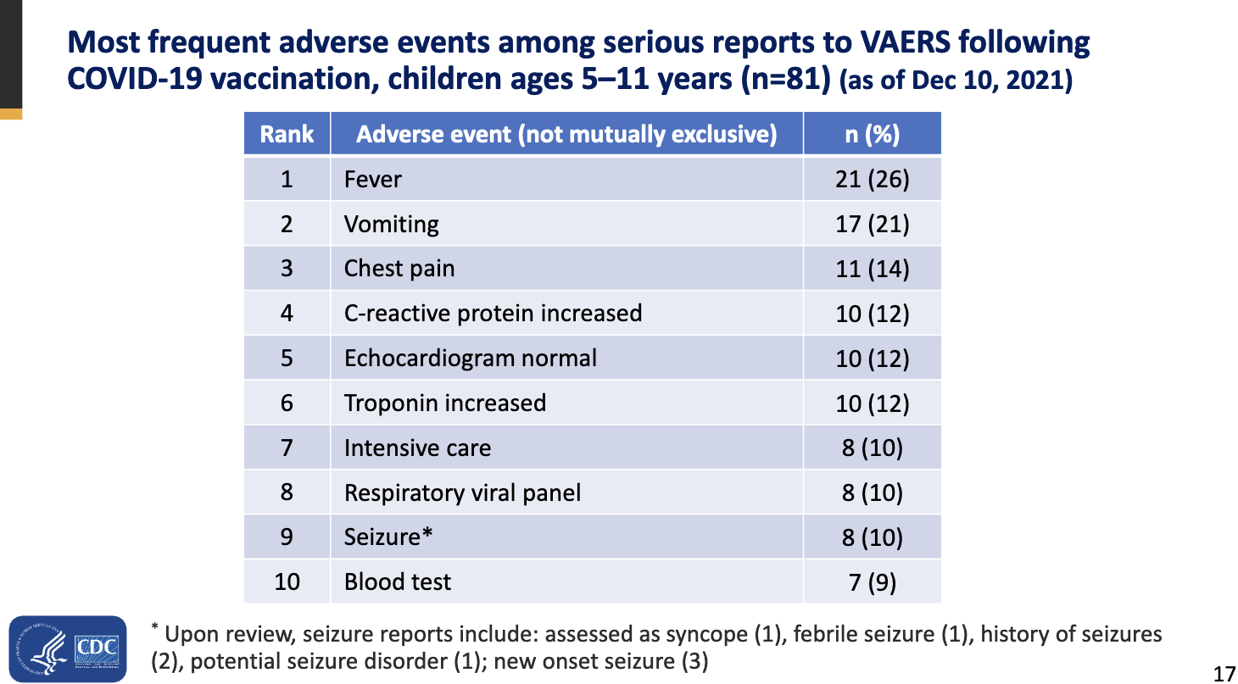
The ACIP reported statistics on serious adverse events by John Su are not confirmed and the ranks are wrong.
Su
Rose
Most frequent adverse events among serious reports to VAERS following COVID-19 injection, children ages 5-11 years (N=317) (as of December 17, 2021)

Slide 9
The ACIP reported statistics on serious adverse events by John Su are missing many data points and adverse event types.
There are 933 neurological adverse event reports to VAERS following COVID-19 injection, children ages 5-11.
There are 1423 immunological adverse event reports to VAERS following COVID-19 injection, children ages 5-11.
There are 1193 cardiovascular adverse event reports to VAERS following COVID-19 injection, children ages 5-11.
There are 12 reproductive adverse event reports to VAERS following COVID-19 injection, children ages 5-11.
There are 2 death reports to VAERS following COVID-19 injection, children ages 5-11.
There are 102 hospitalization reports to VAERS following COVID-19 injection, children ages 5-11.
There are 388 emergency room visit reports to VAERS following COVID-19 injection, children ages 5-11.
There are 25 life threatening event reports to VAERS following COVID-19 injection, children ages 5-11.
There are 29 disability induced reports to VAERS following COVID-19 injection, children ages 5-11.
There is 1 birth defect report to VAERS following COVID-19 injection, children ages 5-11.

Slide 10
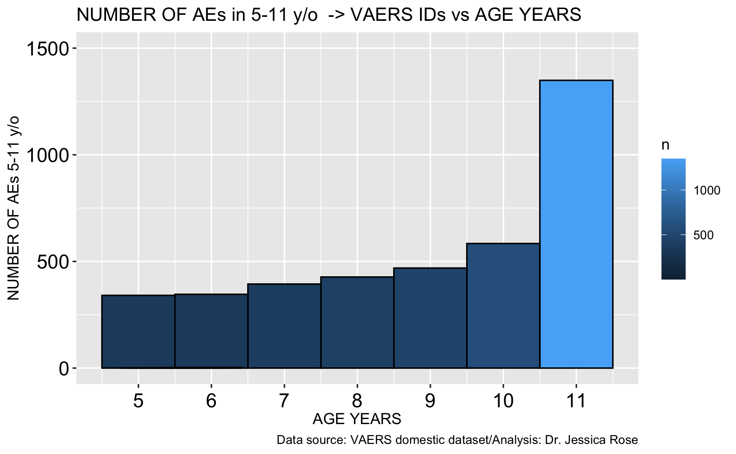
The total number of adverse event reports filed to VAERS for 5-11 year olds (as of December 17, 2021)
N = 3,917
With URF = 160,597

Slide 11
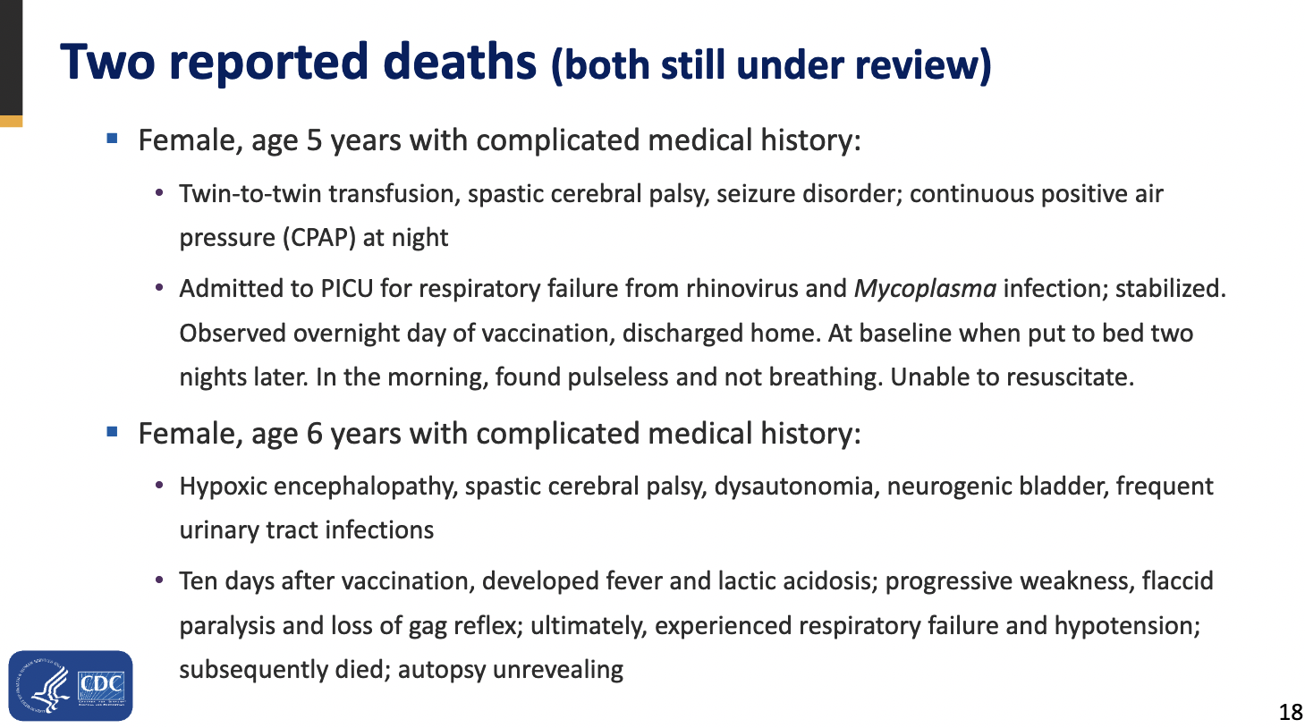
The ACIP reported statistics on deaths by John Su are not confirmed.
Su
Rose
Two Reported COVID-19-associated deaths
Female, age 5, on Monday morning, father checked on patient and she was found pulseless and not breathing. Patient expired at 11/22/21 at 11:05 CST. (VAERS ID: 1890705)
Female, age 11, Patient was 11 years old and 8 months at the time of vaccine No side effects noted. Well except for the fact that she died. (VAERS ID: 1696757)
I can’t find this one which is even more disturbing. The VAERS IDs should be listed to confirm his finding.

Slide 12
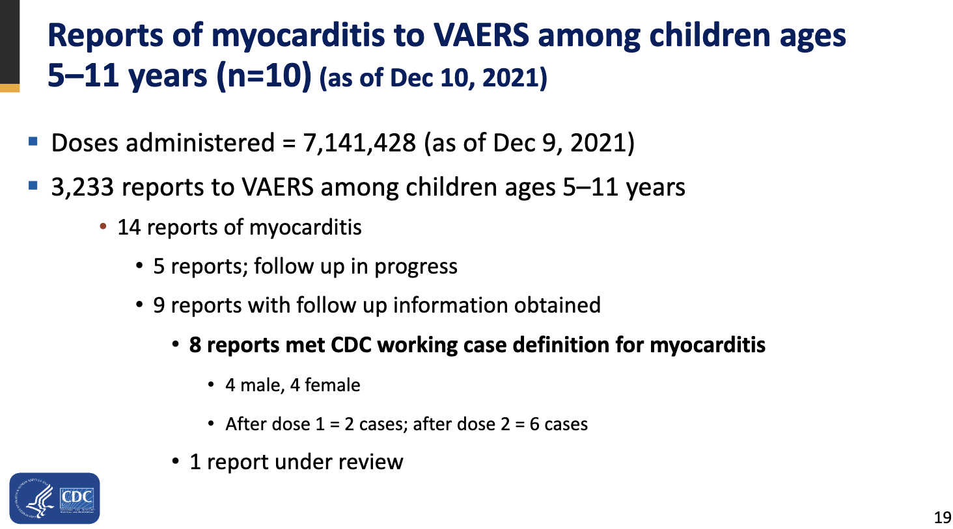
*strings_myocarditis <- c("Myocarditis", "Pericarditis", "Autoimmune myocarditis", "Endocarditis", "Carditis", "Viral pericarditis", "Endocarditis bacterial", "Pericarditis constrictive", "Endocarditis noninfective", "Eosinophilic myocarditis", "Myocardial necrosis marker increased", "Myocardial rupture", "Myocardial ischaemia", "Pericarditis constrictive", "Eosinophilic myocarditis", "Viral myocarditis", "Viral endocarditis", "carditis", "Myopericarditis”, “Chest pain”)
This is in accordance with the ACIP definition of myocarditis and includes chest pain.
The ACIP reported statistics for myocarditis by John Su are not confirmed.
Su
Rose
Reports of myocarditis to VAERS among children ages 5-11 years (N=67) (as of December 17, 2021)
3,917 reports to VAERS among children ages 5-11 years
  67 reports of myocarditis*

Slide 13
Thank you for listening!
Merry Christmas and a Happy New Year of FREEDOM ☺

