Slide 1
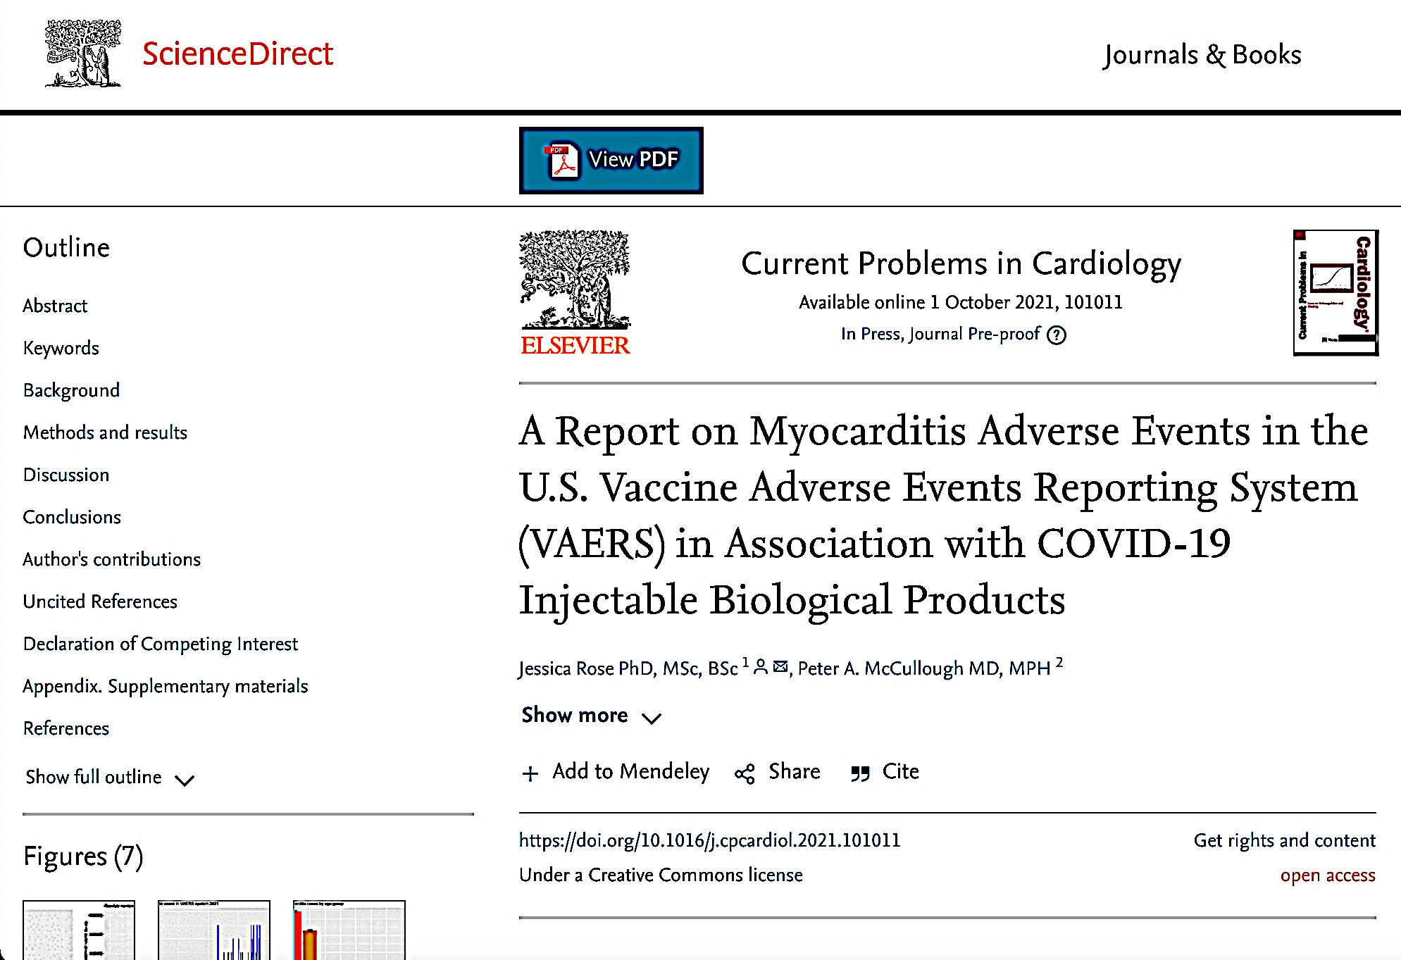
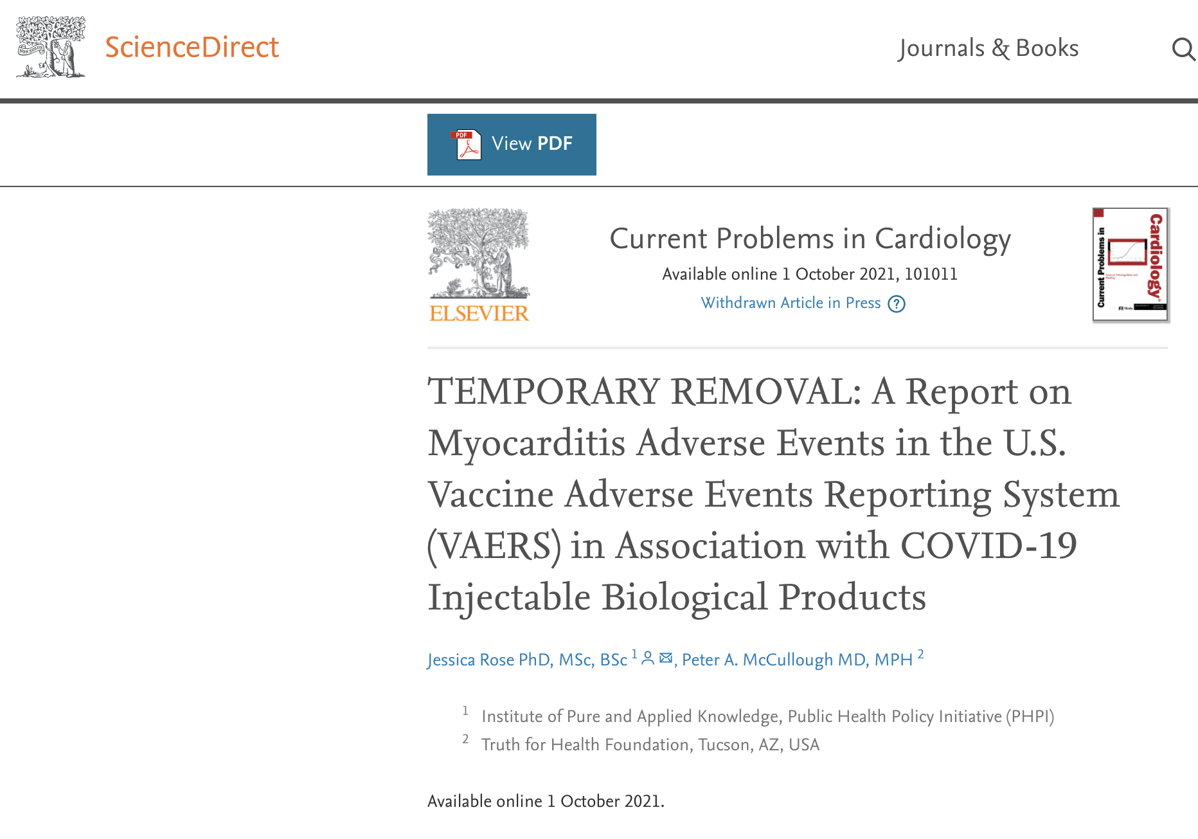
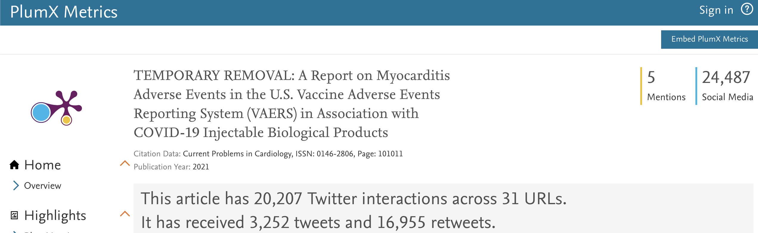
The paper has since undergone ‘Temporarily Removal’. The paper was fully accepted and published as a pre-proof and cited in PUBMED. Fees paid, contract signed. In an act of censorship, the paper was pulled. The paper is being relied upon by many around the world and regardless of the dictates of censors, other cardiologists and scientists and the public at large deserve an opportunity to read the paper.
Myocarditis rates reported in VAERS were significantly higher in youths between the ages of 13 to 23 (p<0.0001) with ∼80% occurring in males. Within 8 weeks of the public offering of COVID-19 products to the 12-15-year-old age group, we found 19 times the expected number of myocarditis cases in the vaccination volunteers over background myocarditis rates for this age group.

Slide 2
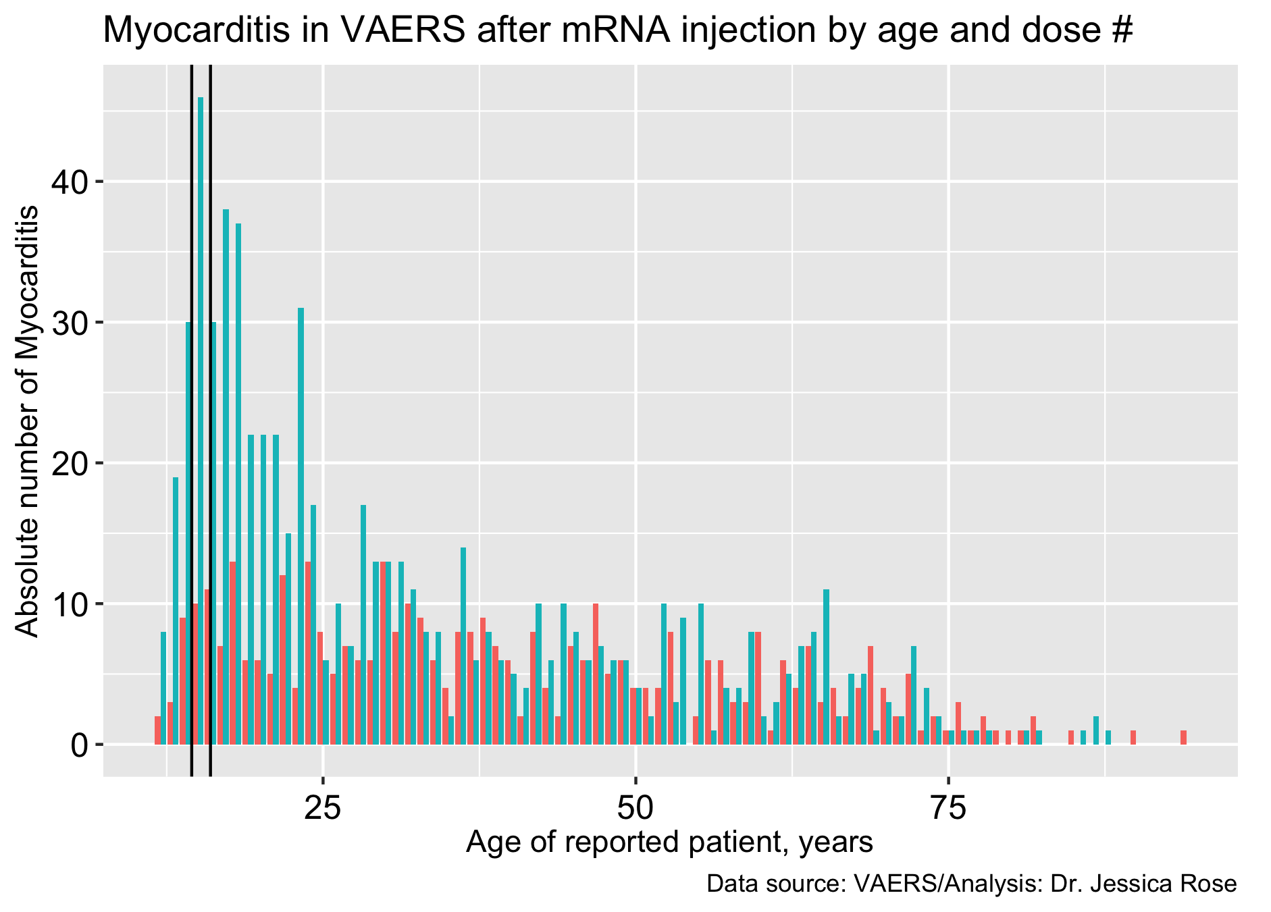
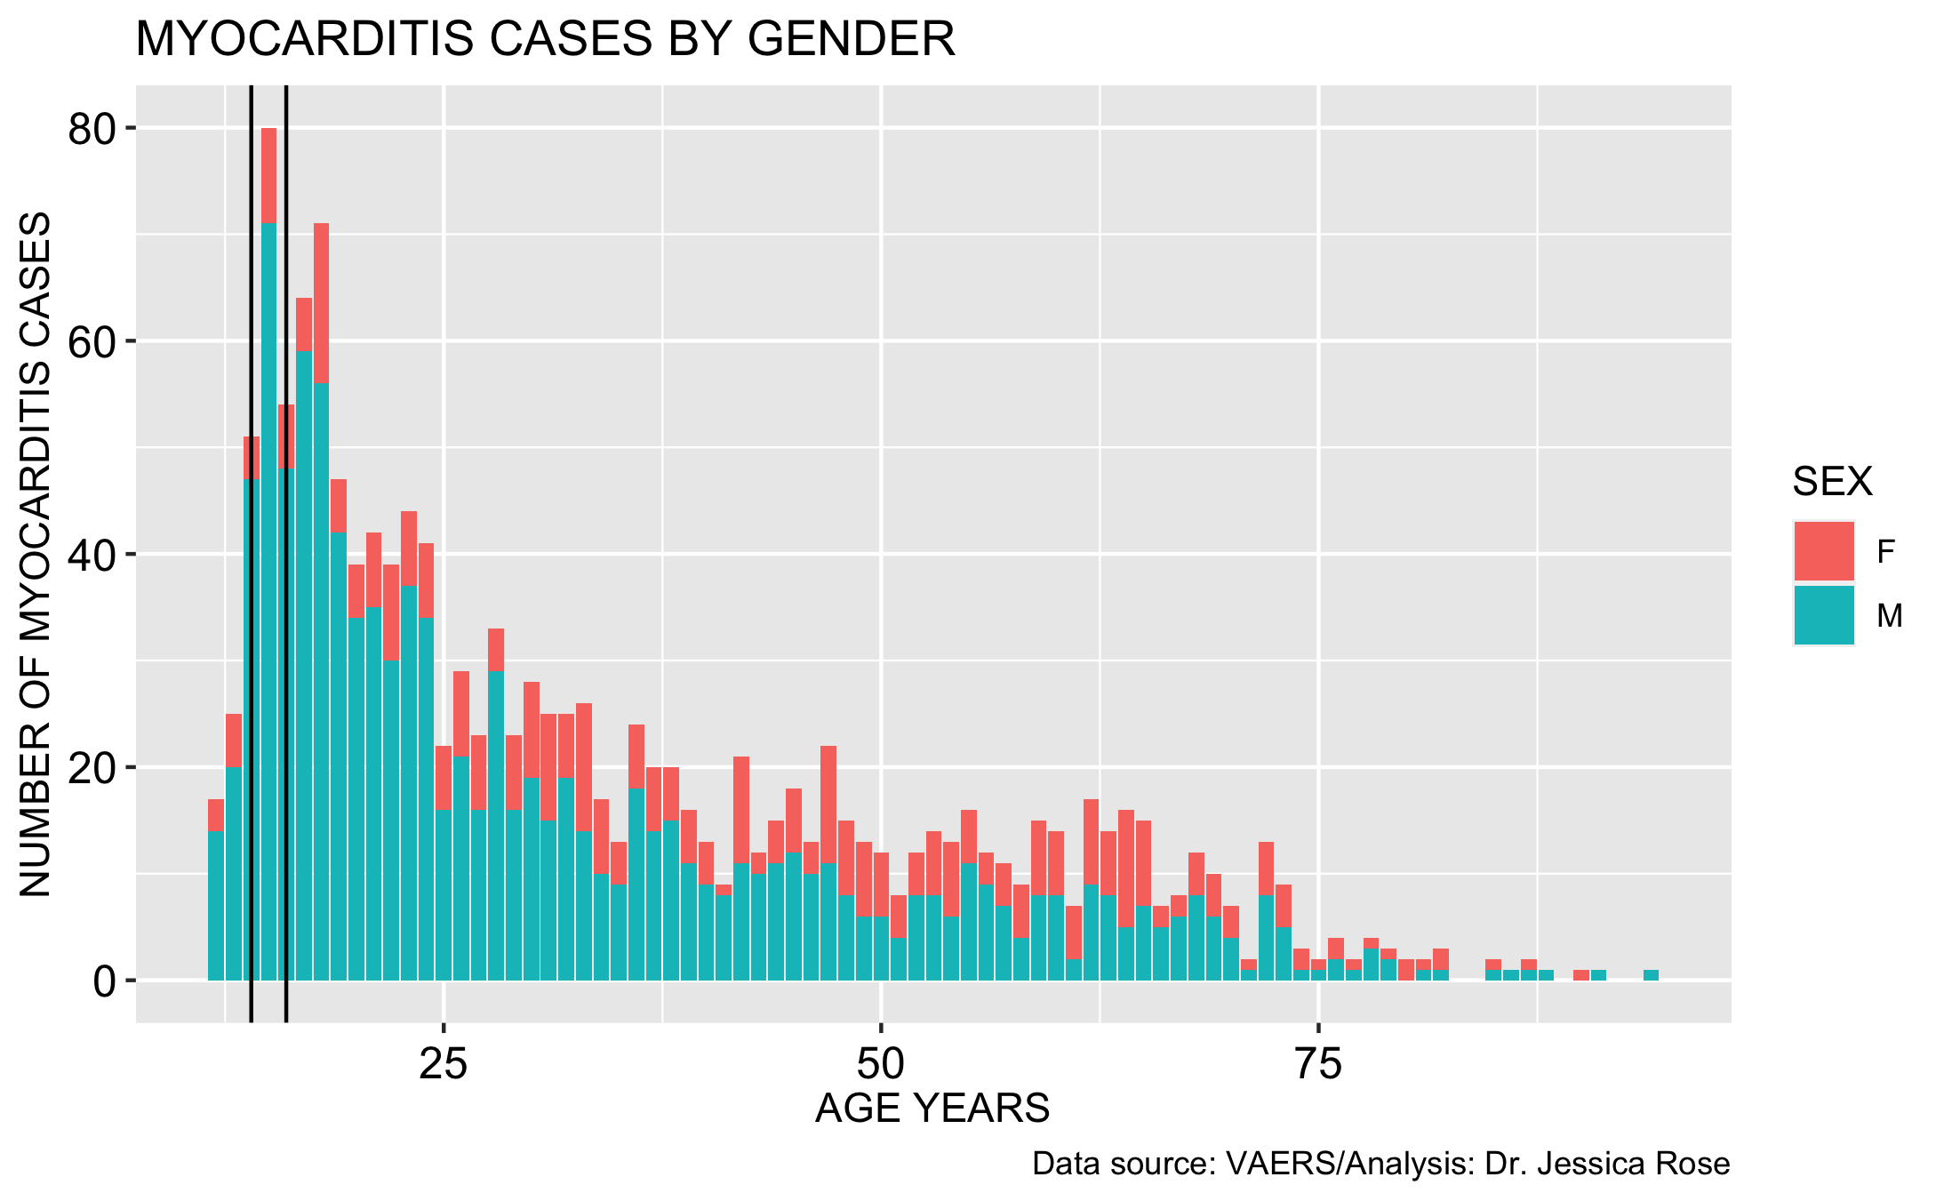
Updated myocarditis reports across age by dose (left) and gender (right)
0-18: 365 reports (23%)
12-15: 173 reports (11%) *
Dose 1
Female
Dose 2
Male
What will happen in children aged 5-11? Where is the safety data?
*As of October 15th, 2021

Slide 3
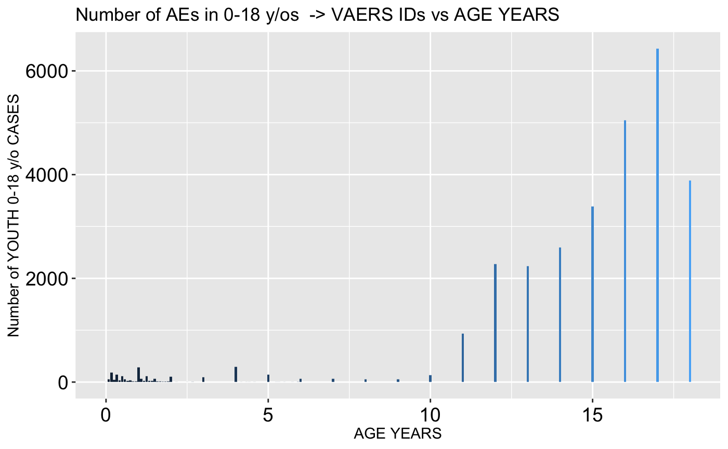
Tens of thousands of reports have been filed to VAERS for children aged 0-18…
5510 children aged 0-18 reported “Product administered to patient of inappropriate age” – 2 died (11 and 13 years old)
60 children have died -
23 (38%) of them were less than 2 years old

Slide 4
Some recent examples of COVID-19 injectable product-associated DEATH in age group 5-11
An 11 year old: somebody’s little girl - DIED.
Cause of death:
She didn’t get hit by a car while riding her bike.
She didn’t drown.
She didn’t choke
She was injected, presumably by a trained medical professional, with a product deemed ‘safe’ that was meant to protect her.
Ronald N. Kostoff, et al., Why are we vaccinating children against COVID-19?, Toxicology Reports, Volume 8, 2021, https://doi.org/10.1016/j.toxrep.2021.08.010.
Tracy Beth Høeg, Allison Krug, Josh Stevenson, John Mandrola
SARS-CoV-2 mRNA Vaccination-Associated Myocarditis in Children Ages 12-17: A Stratified National Database Analysis
medRxiv 2021.08.30.21262866; doi: https://doi.org/10.1101/2021.08.30.21262866
Jessica Rose, Peter A. McCullough,
A Report on Myocarditis Adverse Events in VAERS in Association with COVID-19 Injectable Biological Products, Current Problems in Cardiology, 2021, https://doi.org/10.1016/j.cpcardiol.2021.101011.

Slide 5
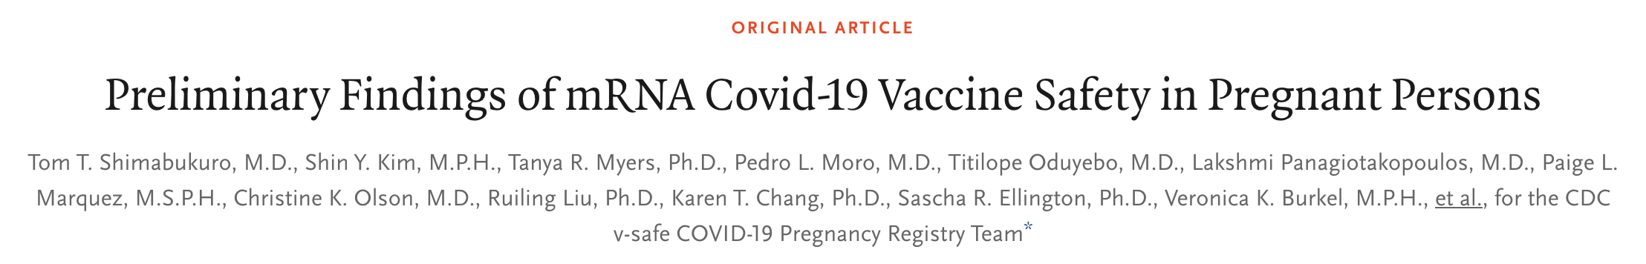
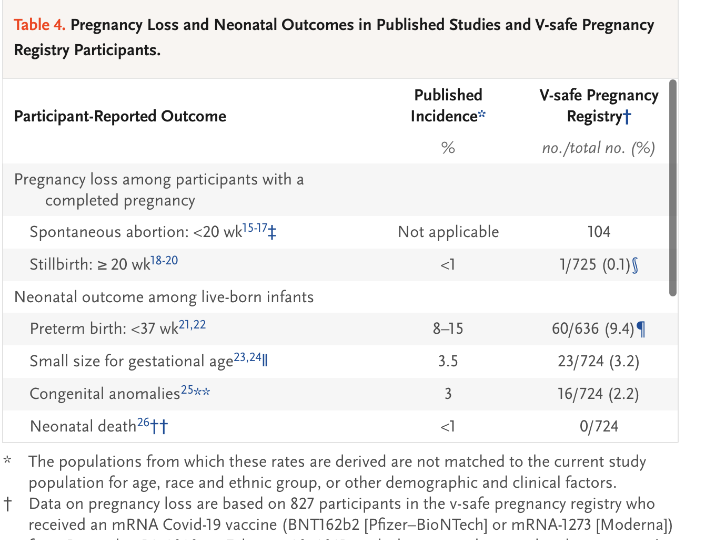
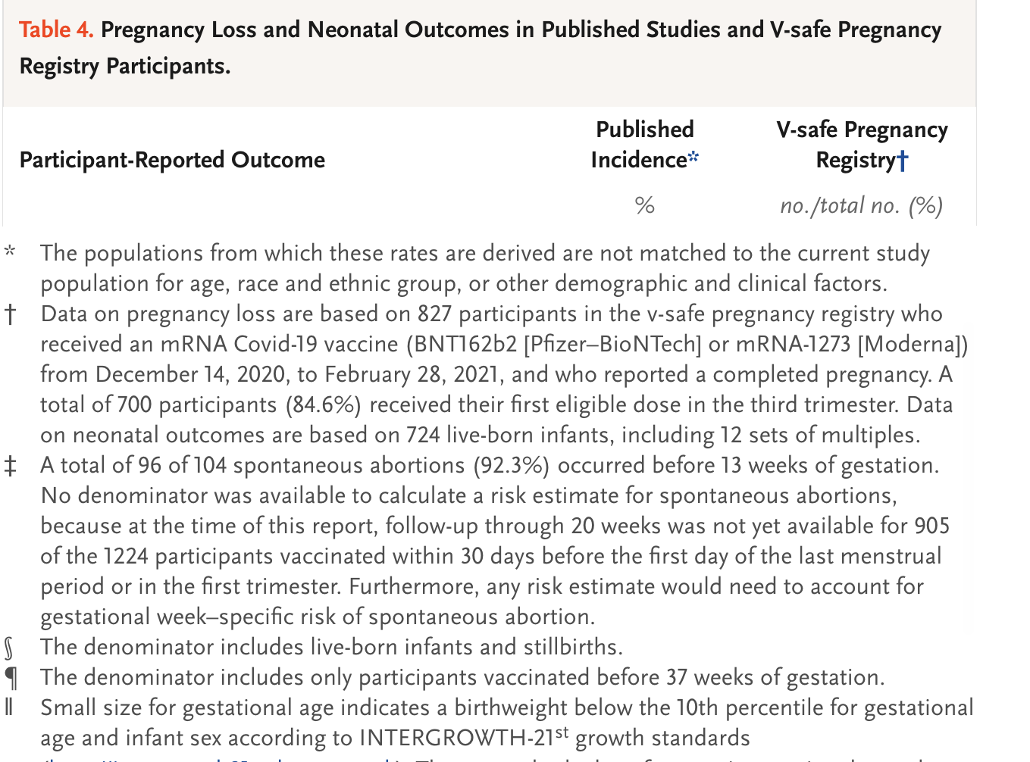
104/127*100=82% rate of spontaneous abortion in women in 1st and 2nd trimesters.

